Slide 1
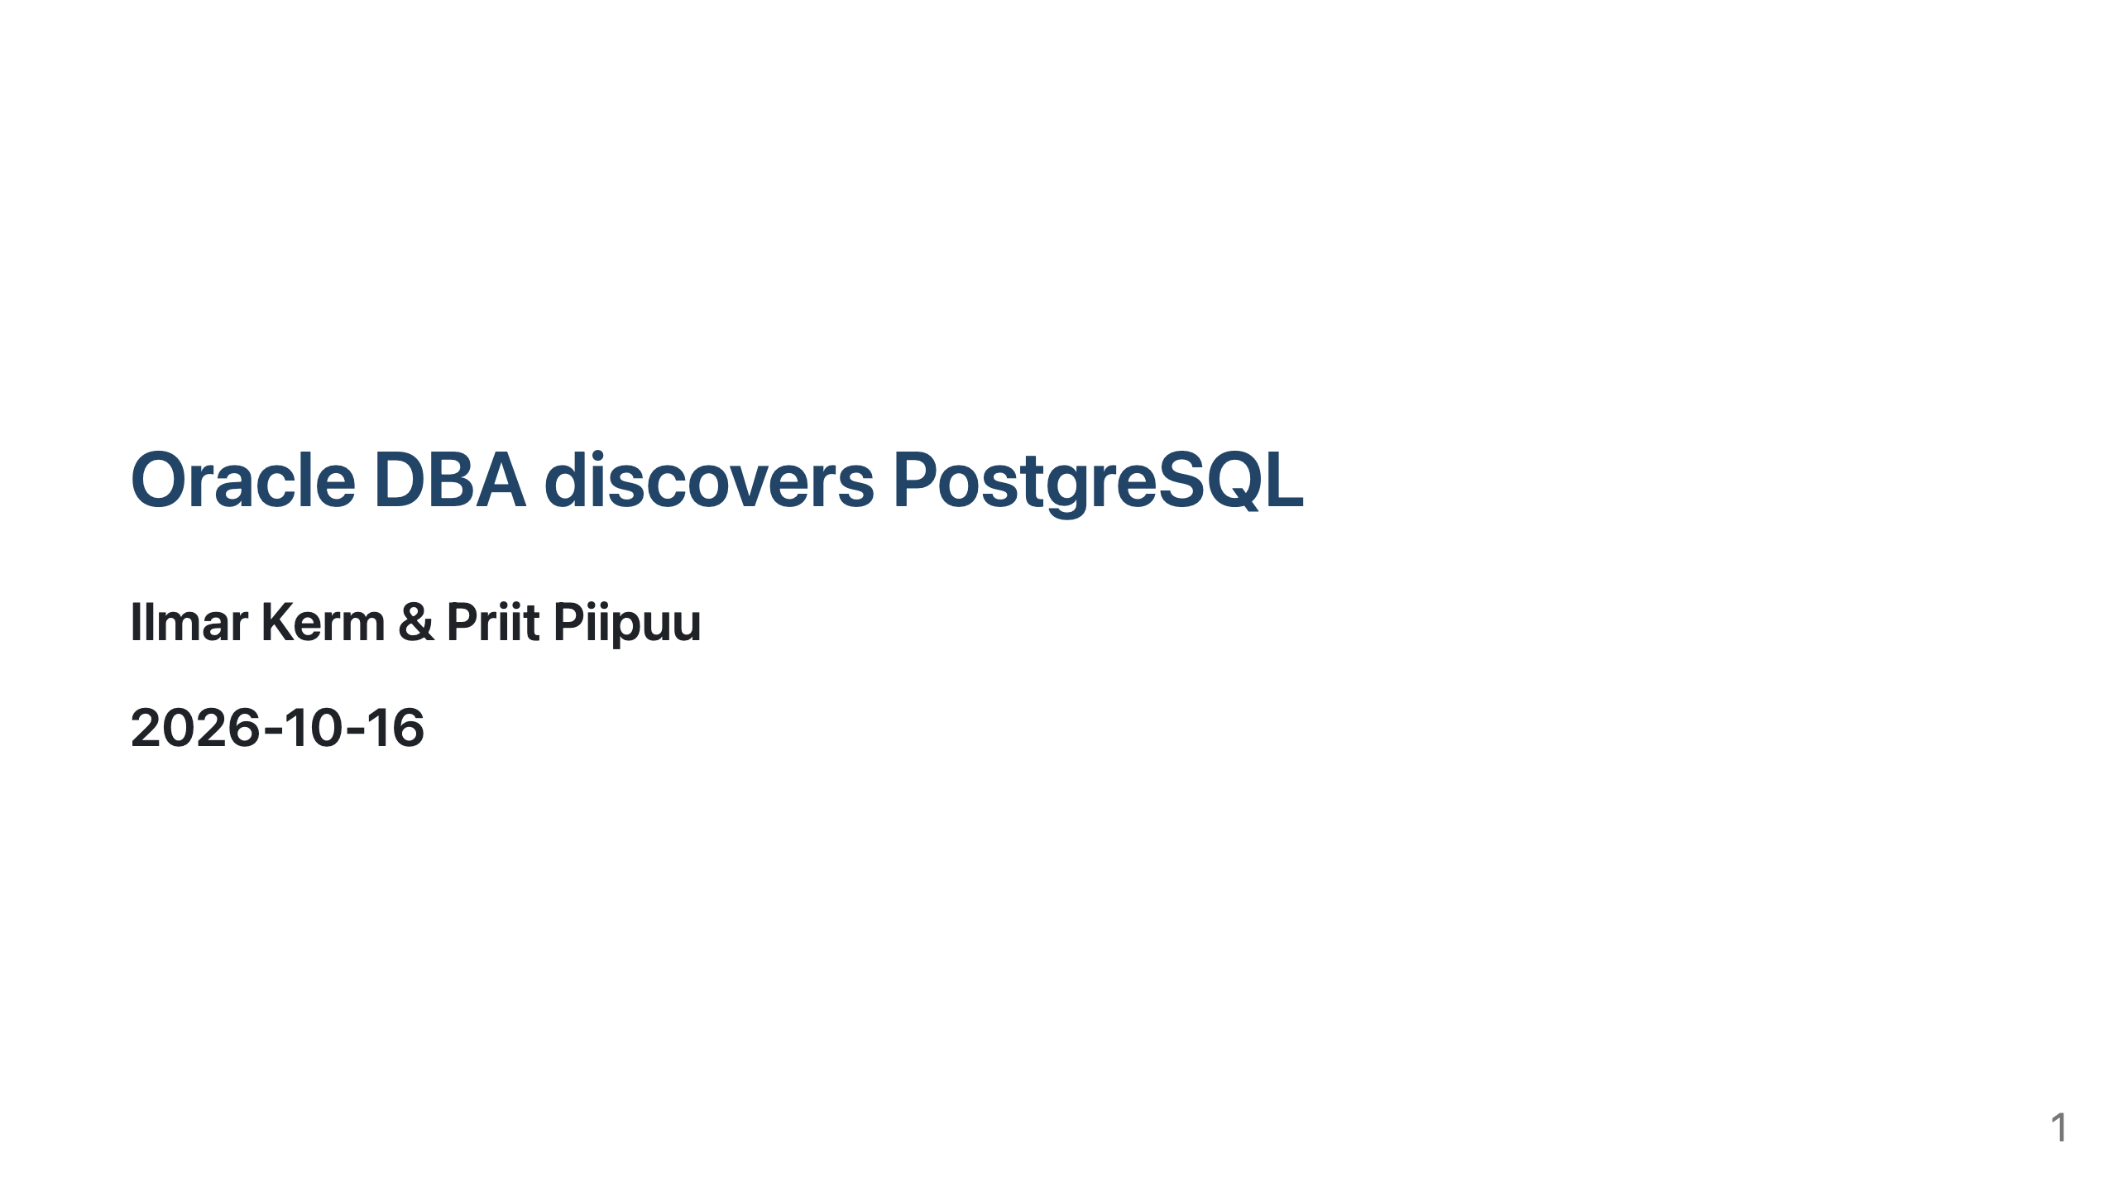

Slide 2
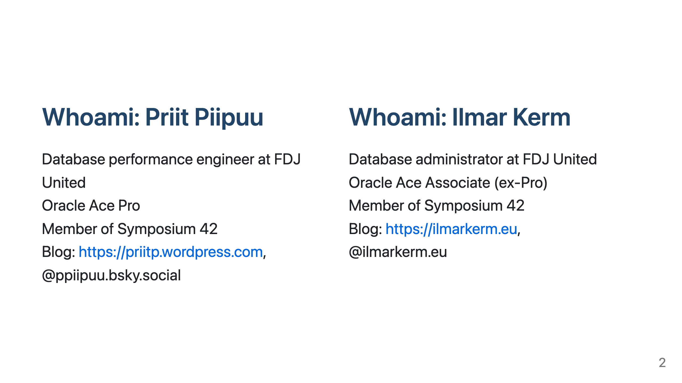

Slide 3


Slide 4
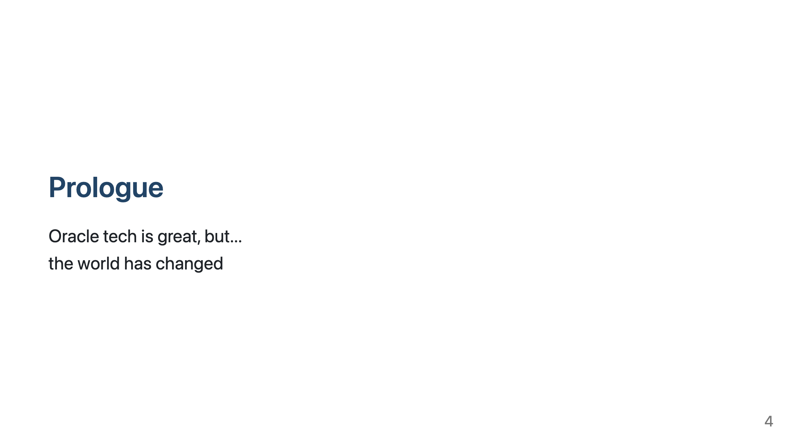
Notes:
Thanks to Trump, tech idenpendence from US is now in the agenda
Oracle has been rising prices, a lot for some, like us (200x) - unacceptable

Slide 5
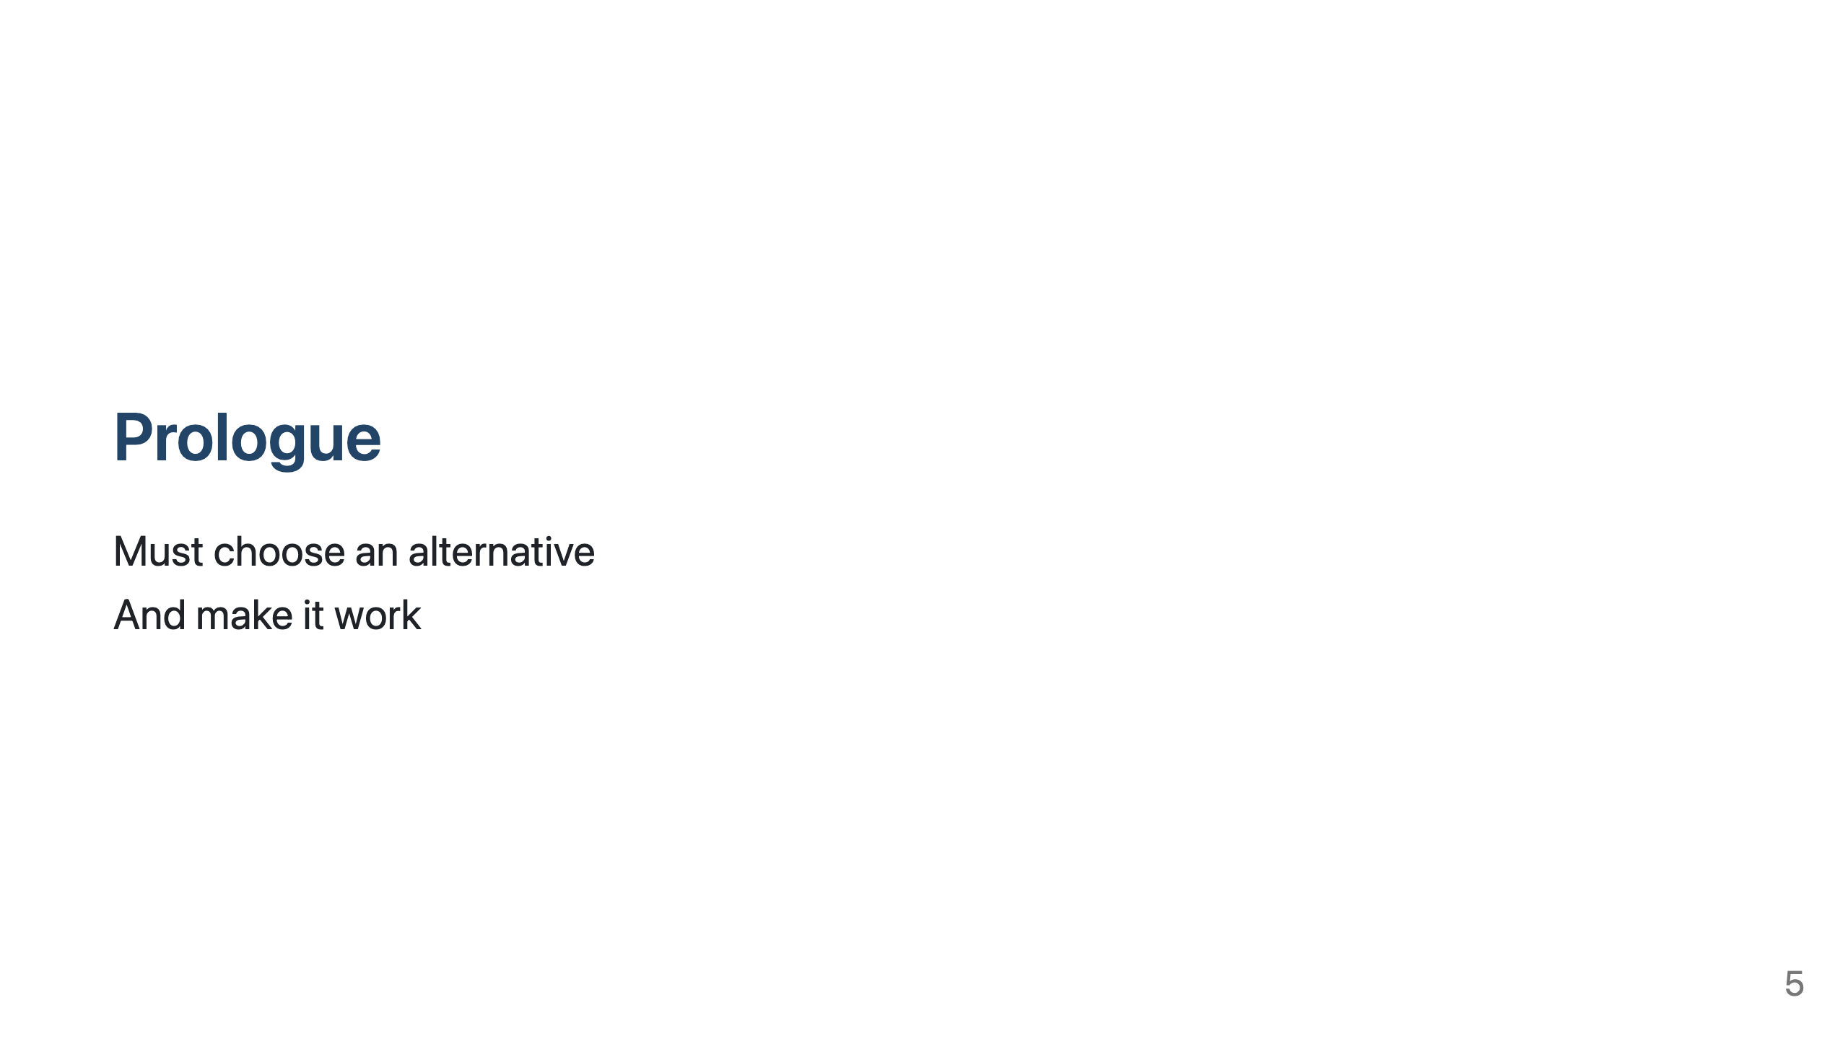
Notes:
So Oracle is out... we needed to find an alternative and then make it work as best as we can
This presentation is not about comparing technologies, it is about Oracle dinosaurs exploring PostgreSQL world any trying to make it work.

Slide 6
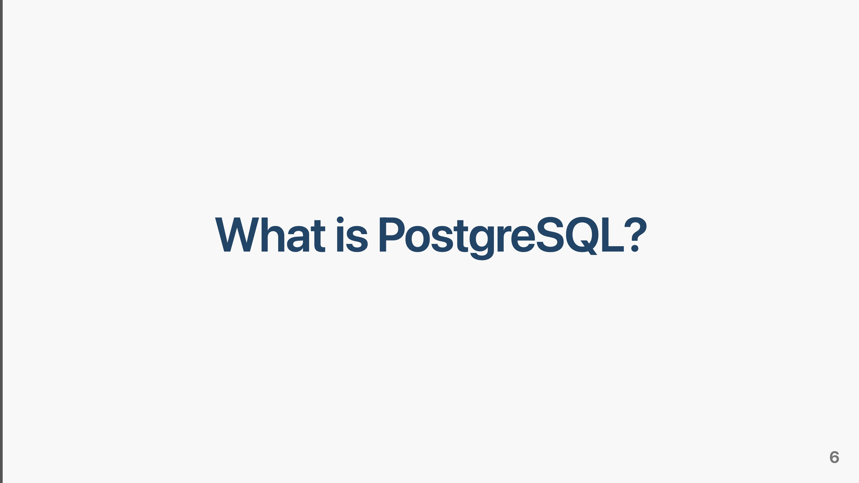

Slide 7
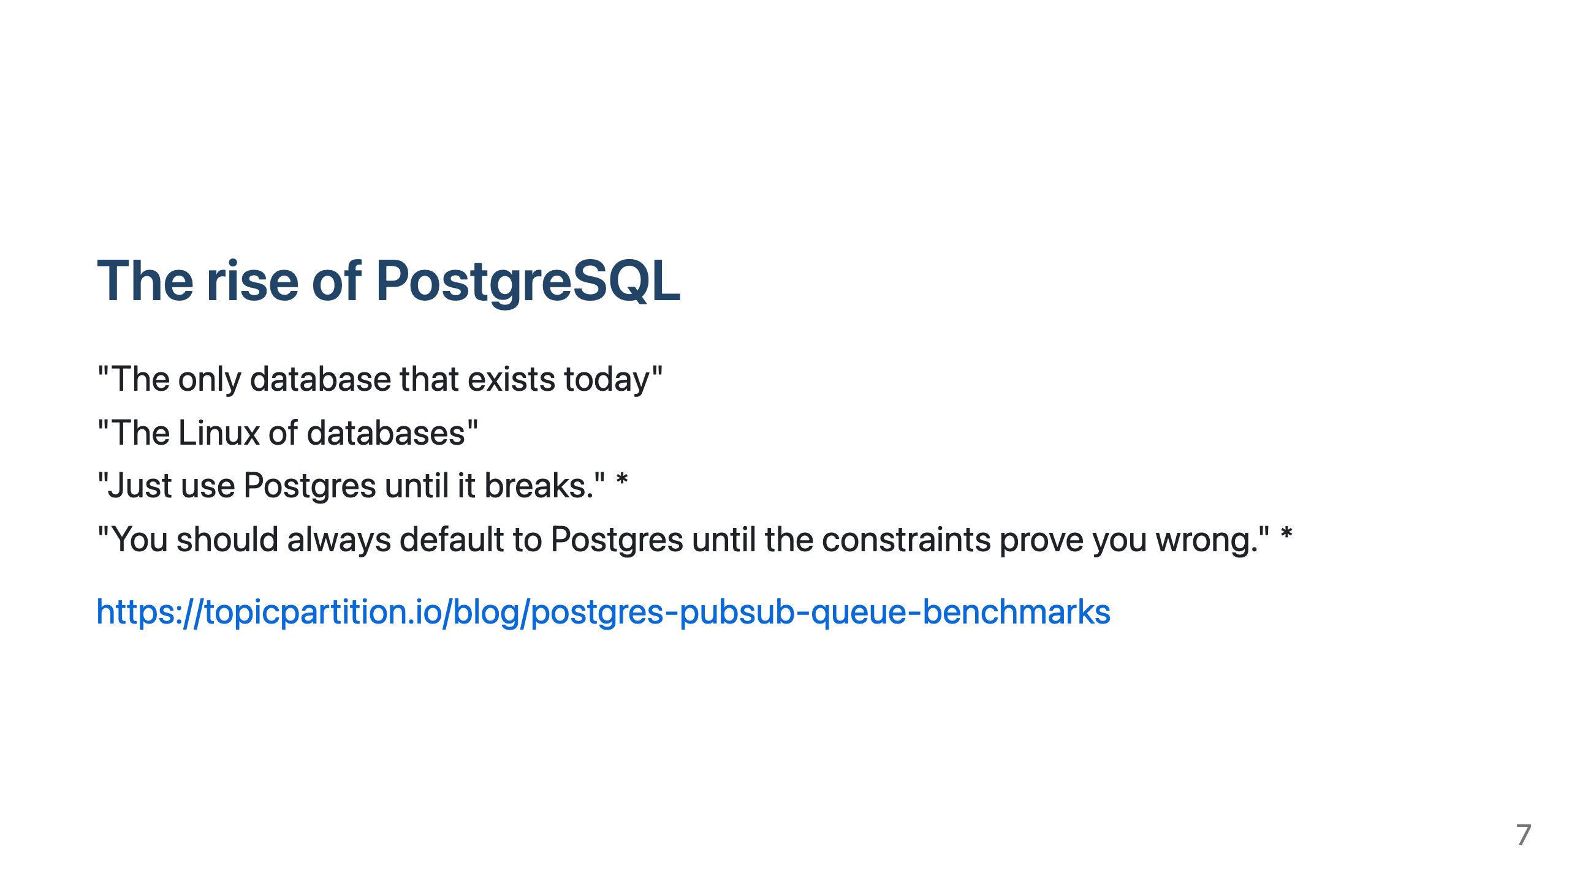
Notes:
Everything in the database world today is PG related and this is the only database modern devs think exists
In this presentation adressing some issue that Oracle professionals might face with PostgreSQL.

Slide 8
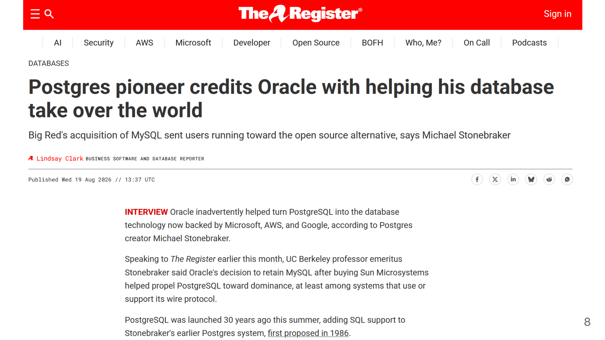
Notes:
"We have to thank Oracle for [PostgreSQL's popularity] because when they bought MySQL, everybody was afraid that they were going to dominate where MySQL went to, and that was the beginning of the PostgreSQL ascendancy," Stonebraker said.

Slide 9
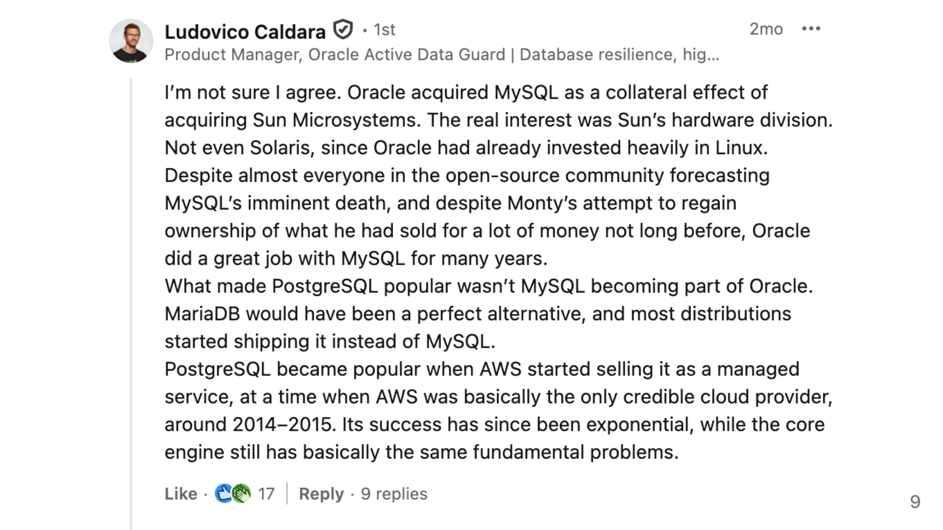
Notes:
Ludovico Caldara passionately disagreed, pointing out PostgreSQL rise correlates well with AWS popularity.
https://www.linkedin.com/feed/update/urn:li:activity:7470111757714210816?commentUrn=urn%3Ali%3Acomment%3A%28activity%3A7470111757714210816%2C7470190330773131264%29&dashCommentUrn=urn%3Ali%3Afsd_comment%3A%287470190330773131264%2Curn%3Ali%3Aactivity%3A7470111757714210816%29

Slide 10
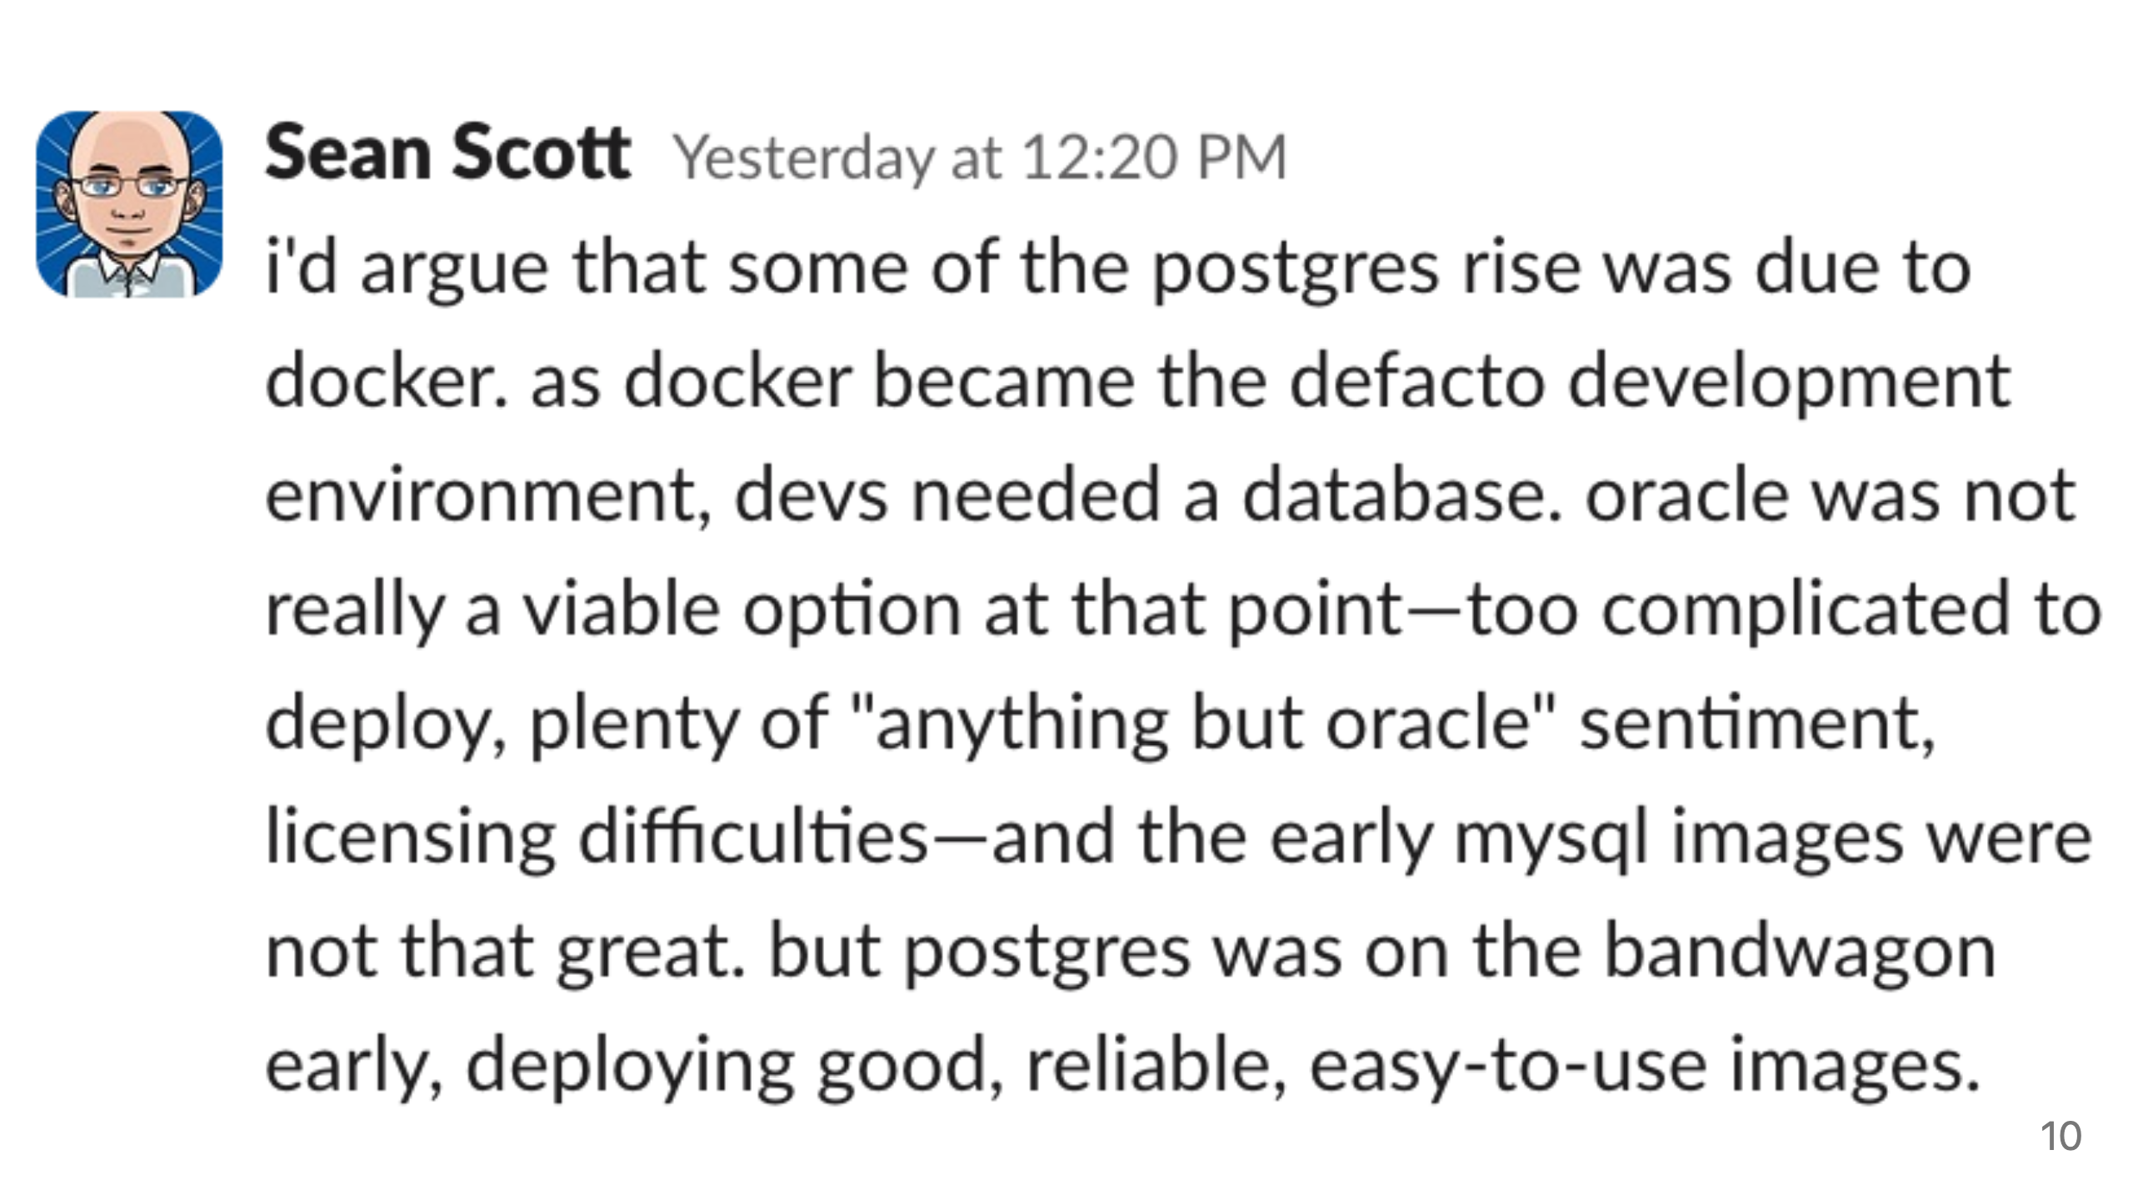
Notes:
Scott argues, that docker had a lot to do with PostgreSQL popularity with devs.
Early MySQL images were not good, but Postgres early images were good.

Slide 11
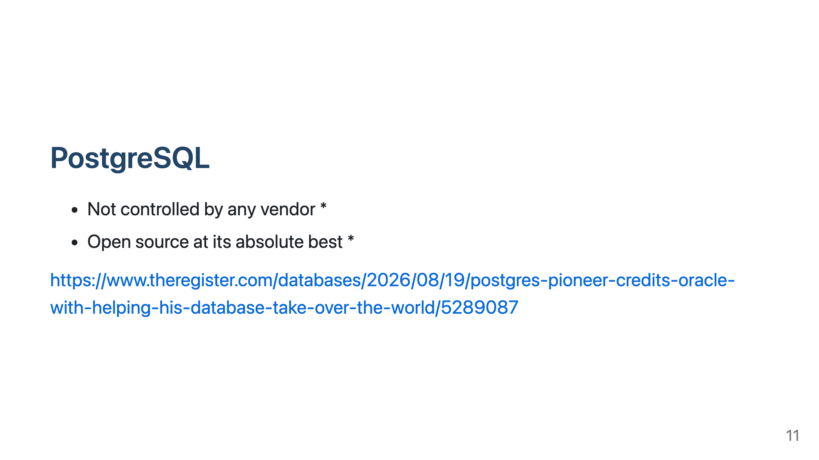
Notes:
Controlled by 20-30 "very smart super programmers"; Core team 7 (4xUSA, Germany, Sweden, UK)
Although big tech has its own forks, they also contribute to the core. Microsoft and AWS - yes; Google, Oracle - no

Slide 12
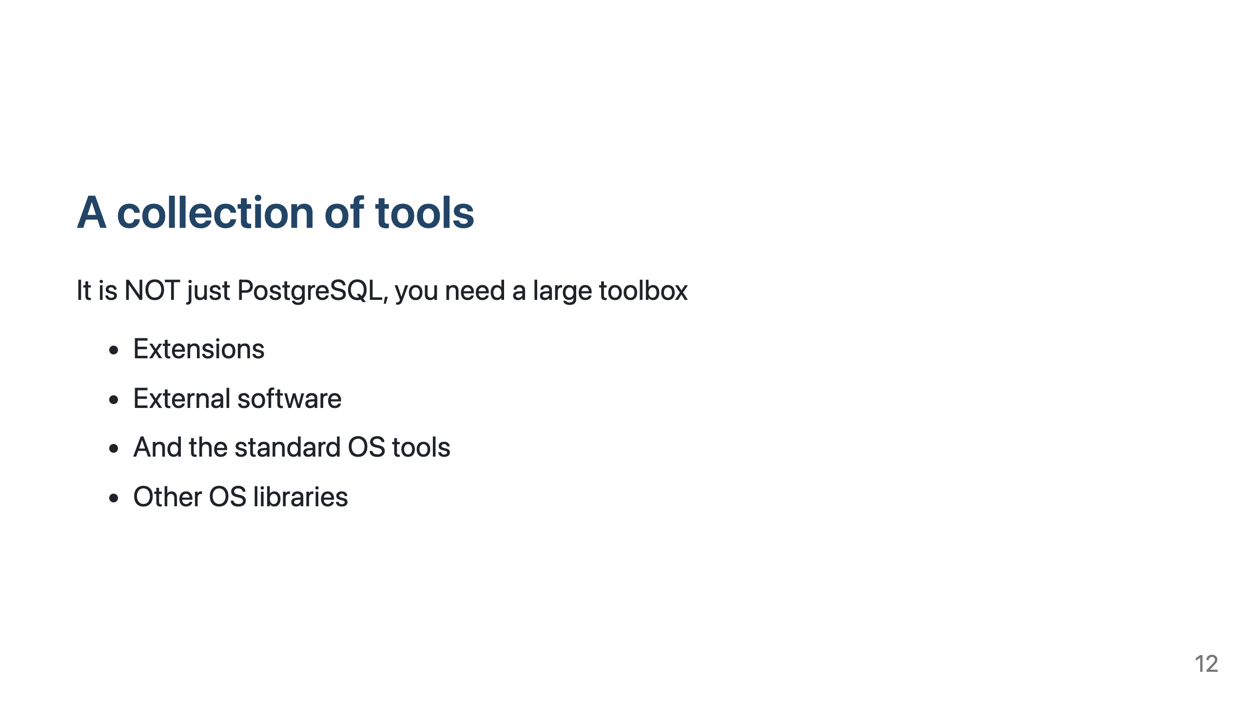
Notes:
PostgreSQL is just the basic core, you need extensions, you need external software
High Availability, backup

Slide 13
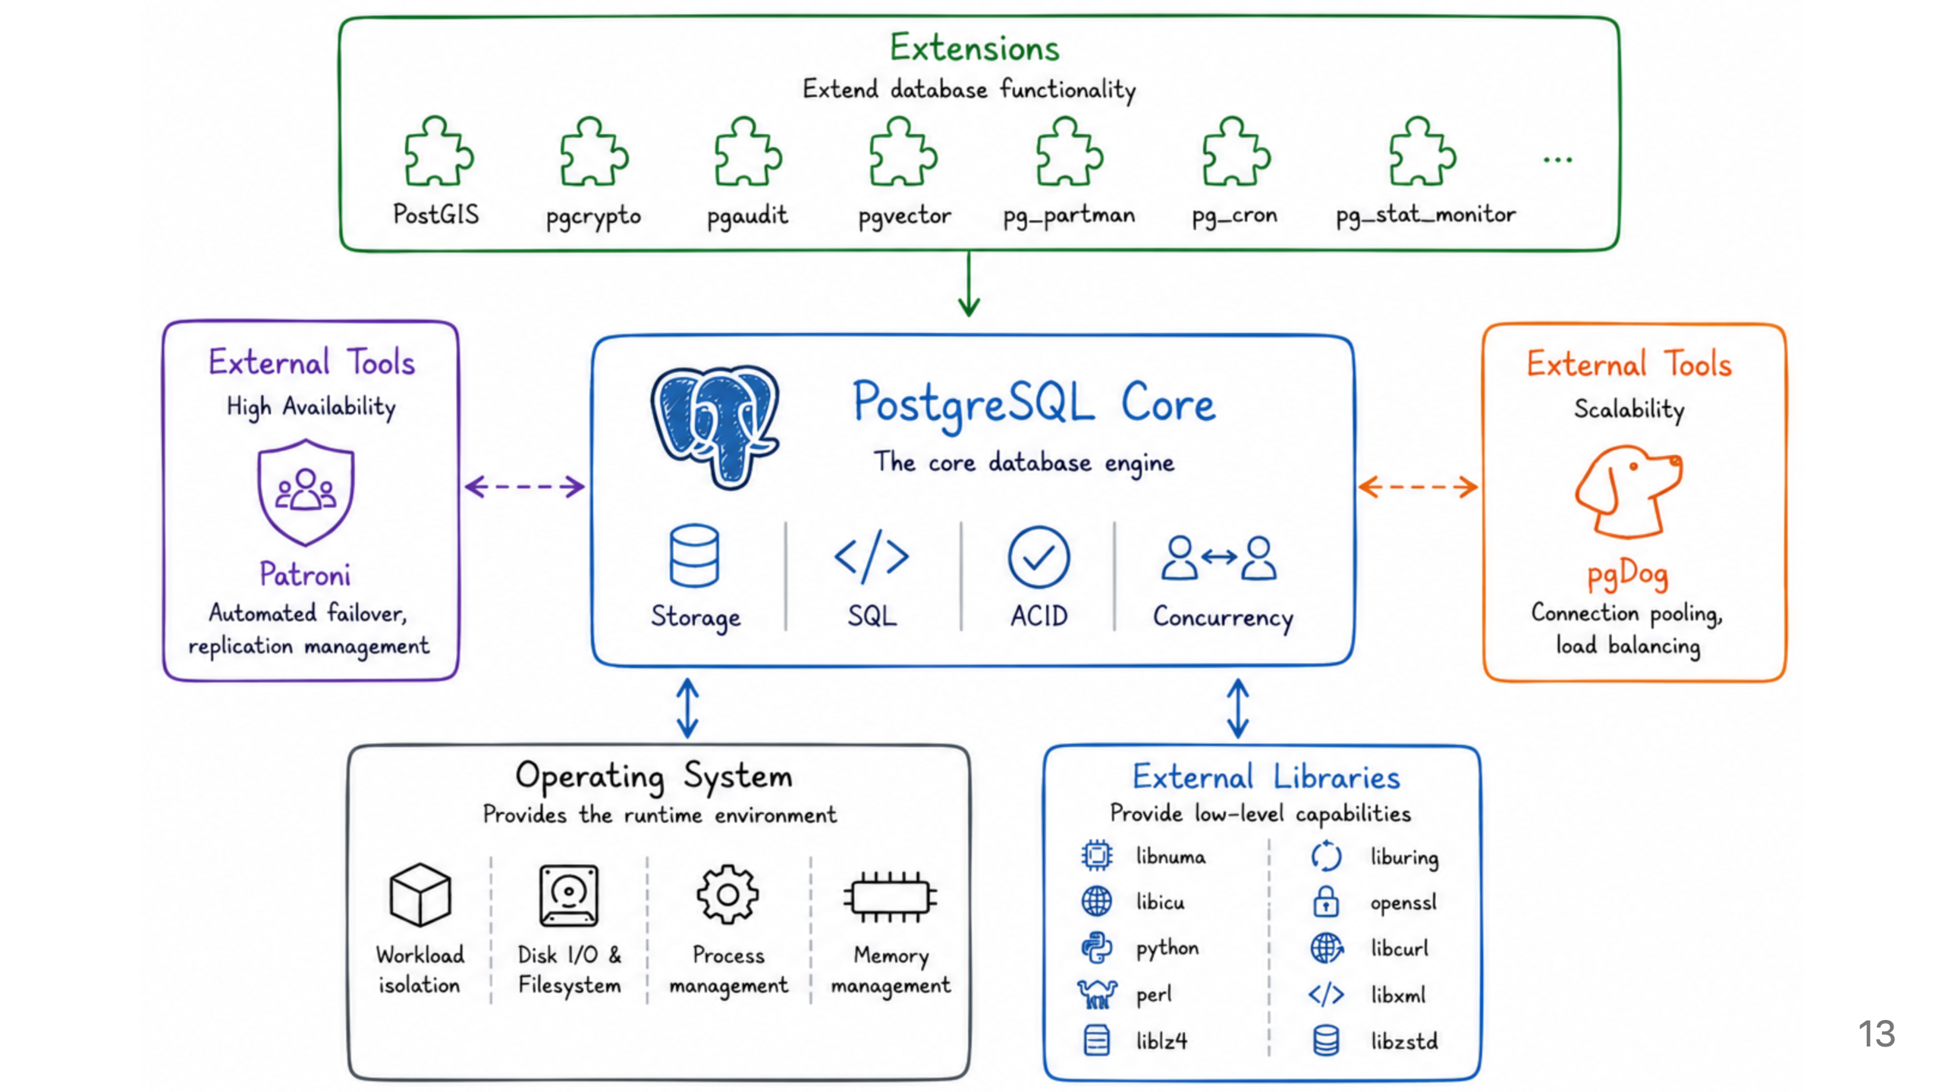

Slide 14
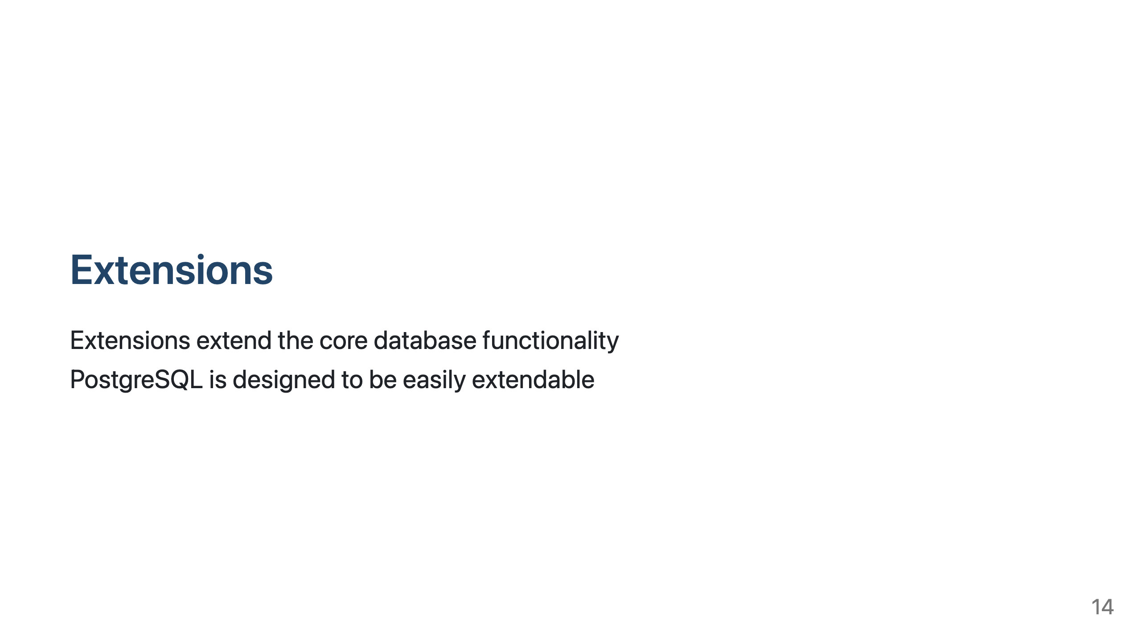
Notes:
New data types, operators, functions
PostgreSQL contrib ships with about 50 already included
Can't be considered a weakness of PostgreSQL - that is the idea - core is minimal and advanced functionality is provided by extensions. Often wish Oracle would do the same.
Negative - often maintainer is a single person

Slide 15
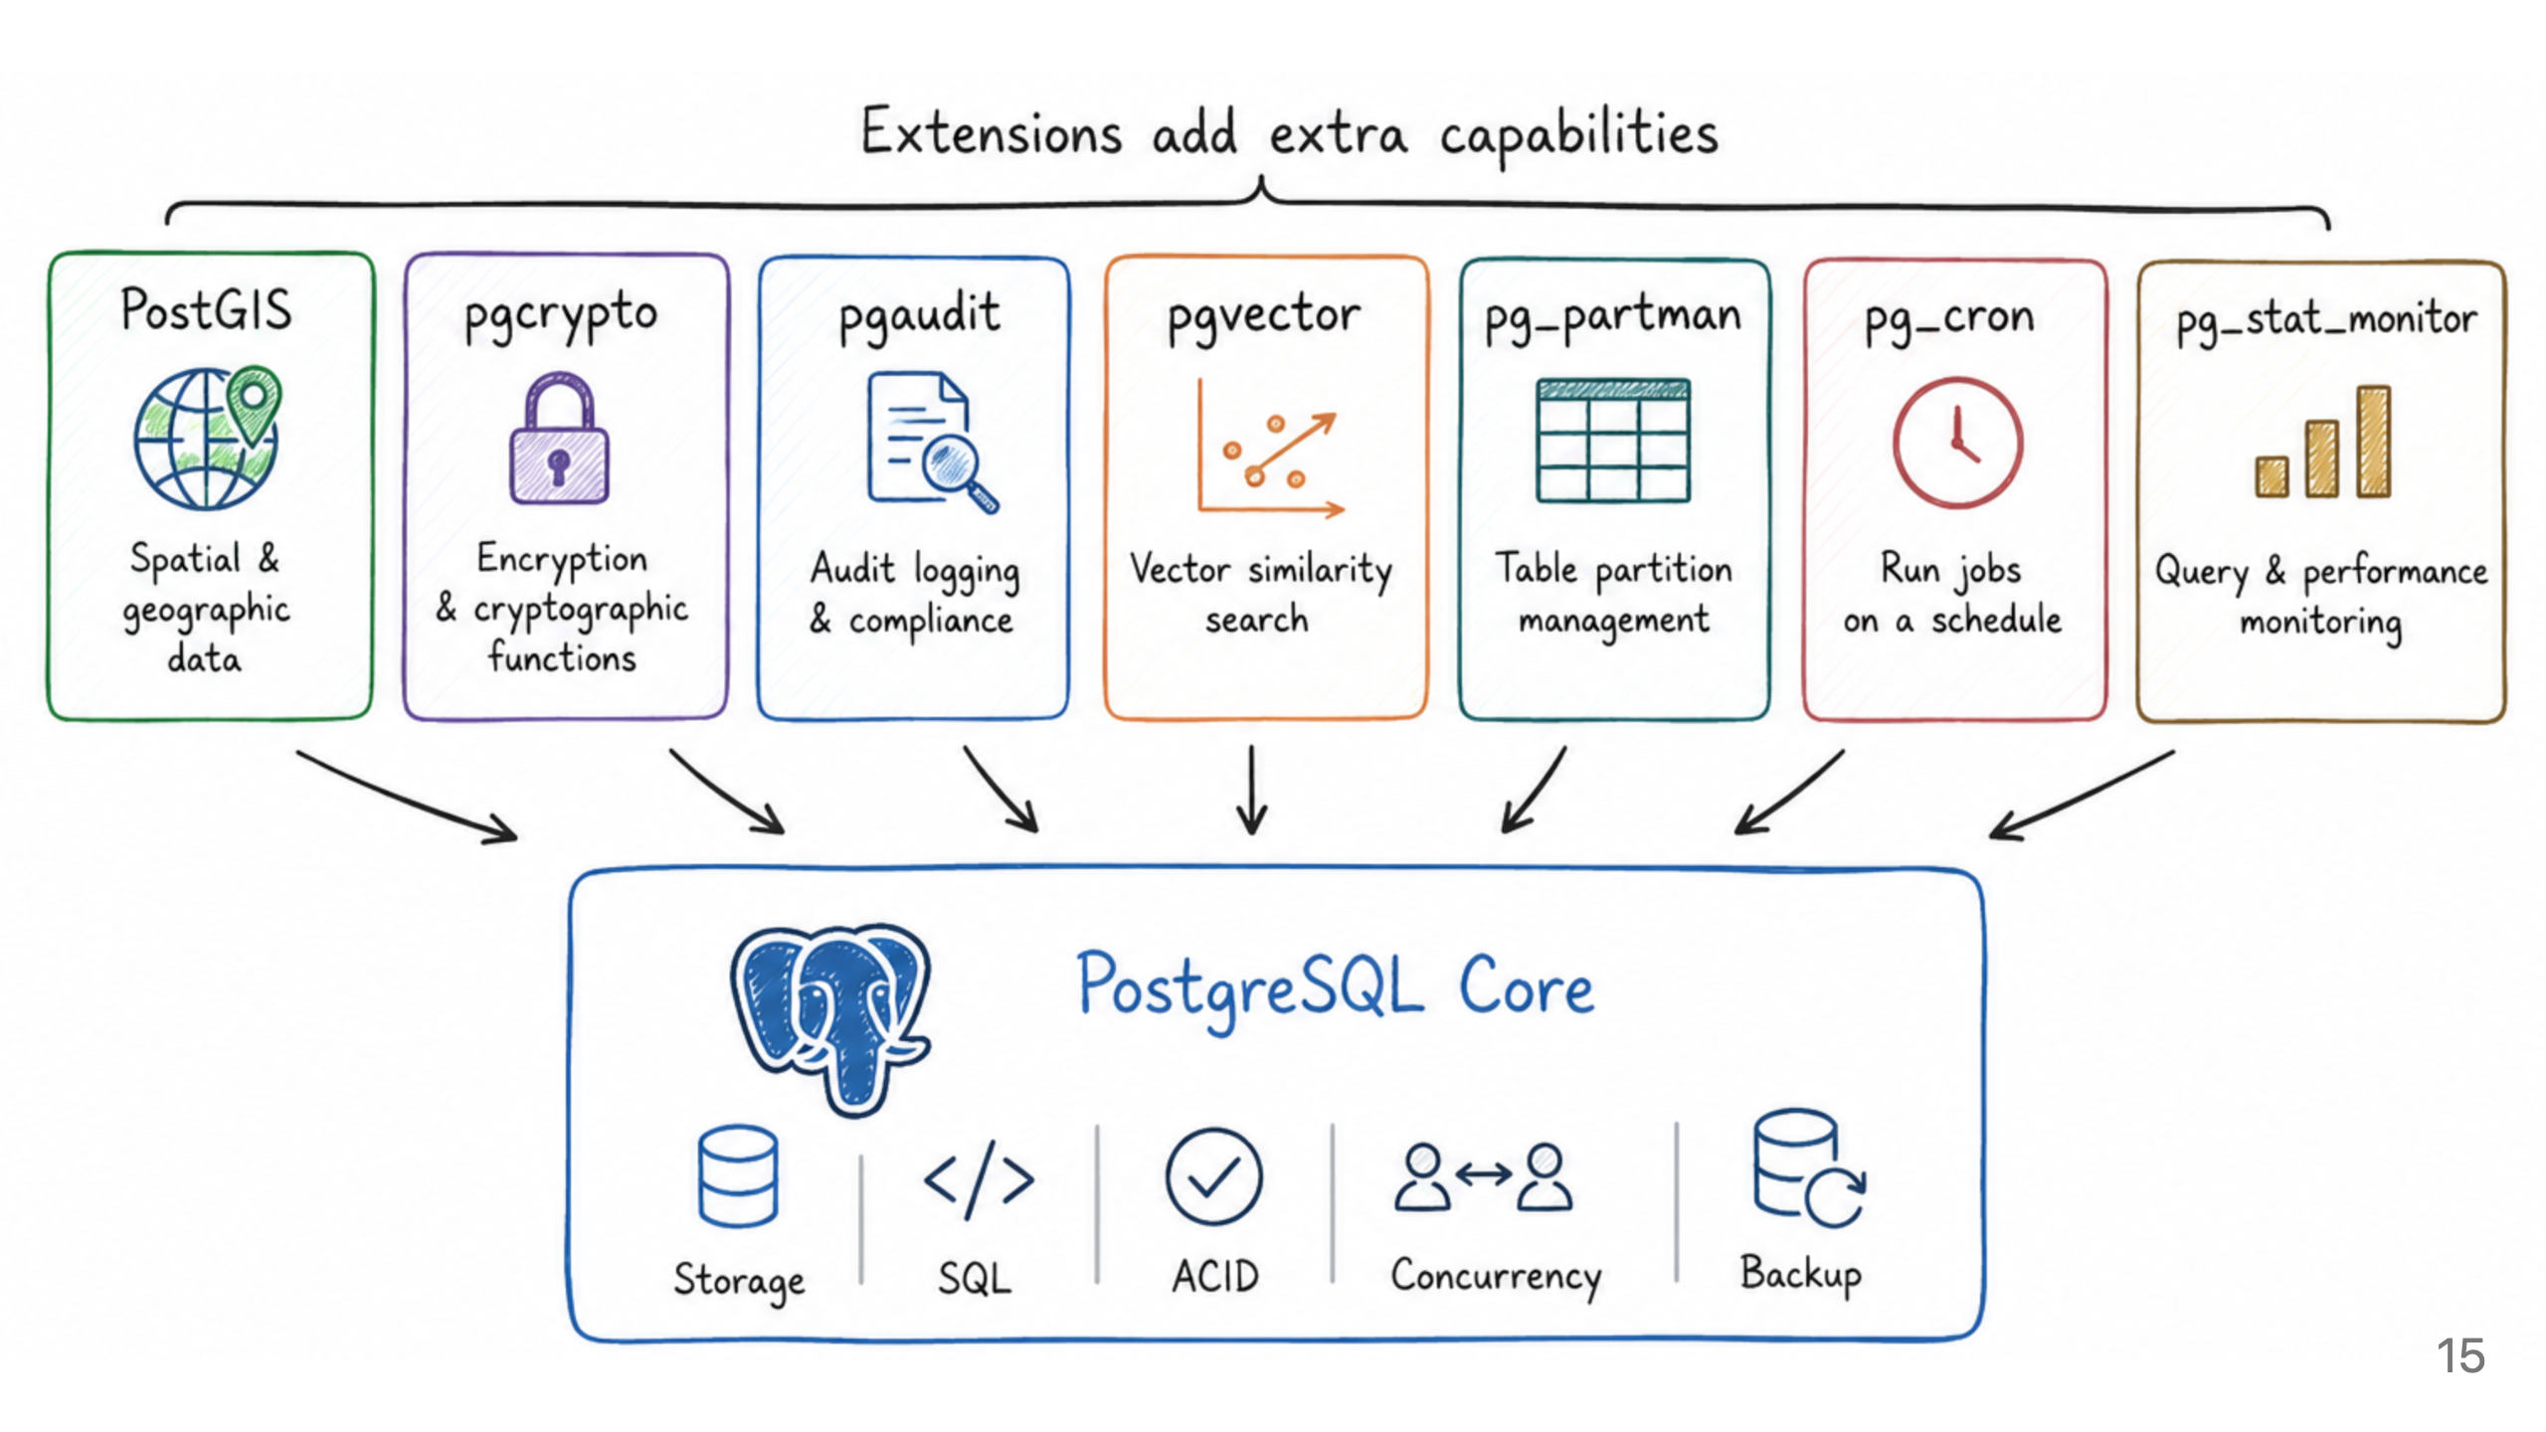
Notes:
PostGIS - better than Oracle Spatial

Slide 16
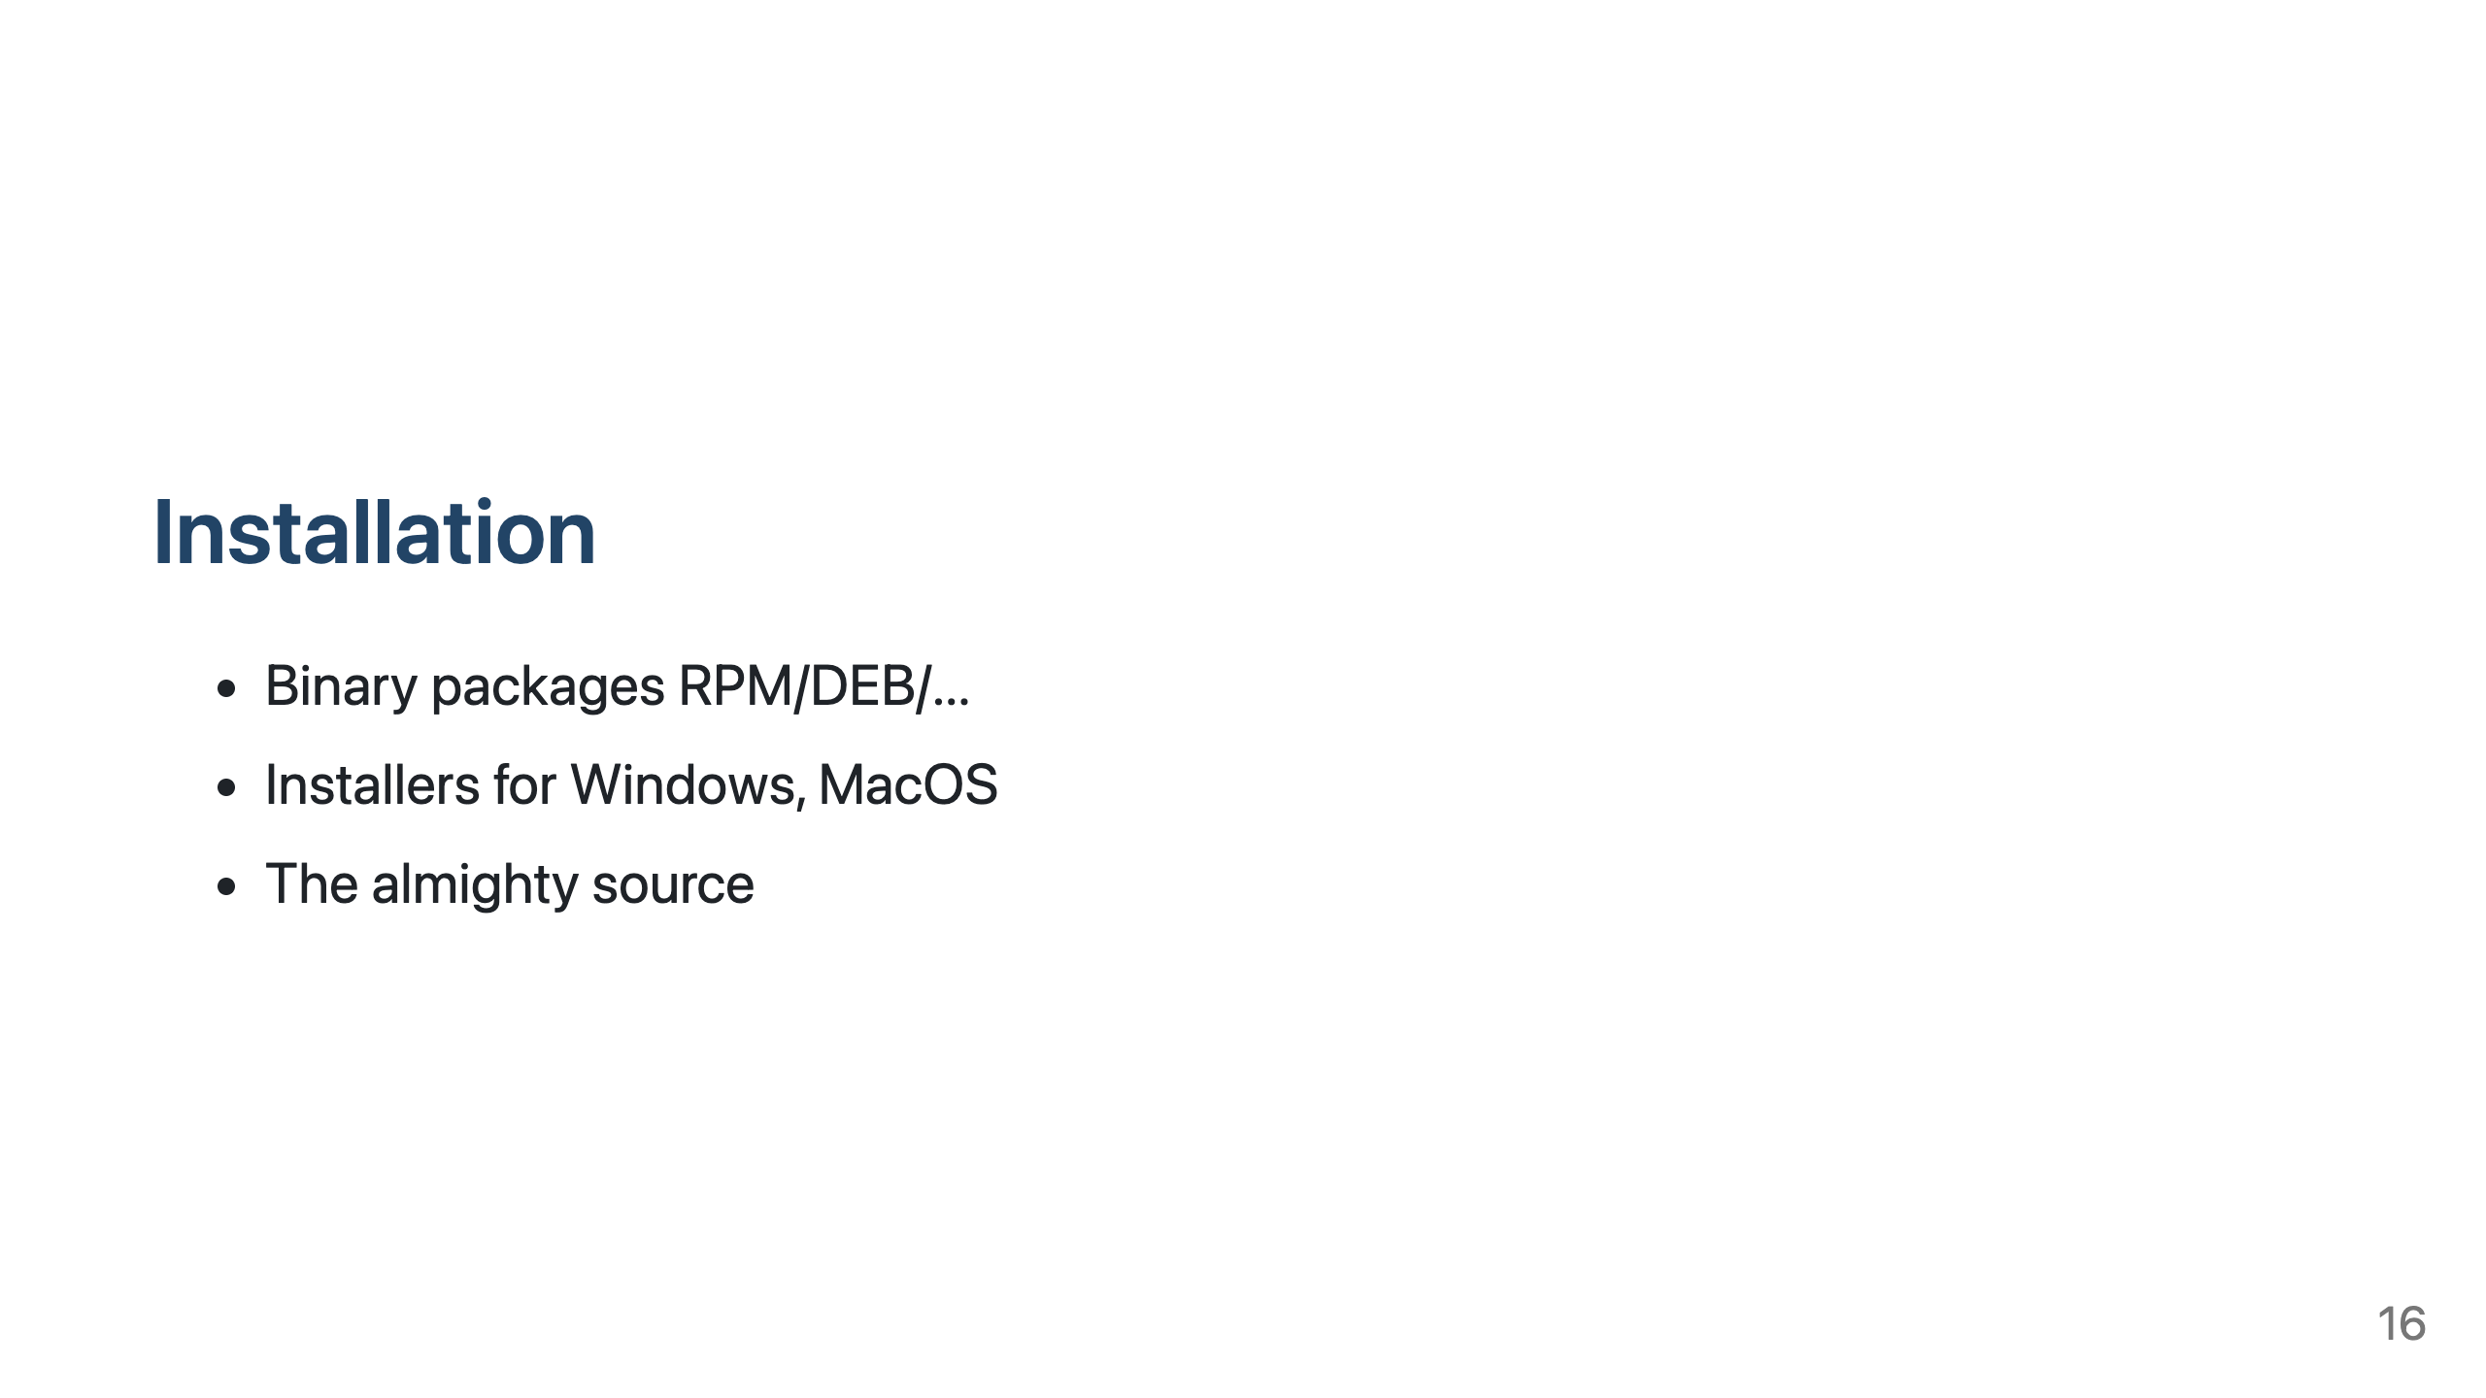
Notes:
Linux distributions often come with built in PostgreSQL, Ubuntu also has nice upgrade automation.
Official PostgreSQL repository comes with many-many-many extra extensions also, already compiled.
Don't be afraid to compile it yourself, it is quite easy - but be mindful of dependencies, it is linked dynamically

Slide 17
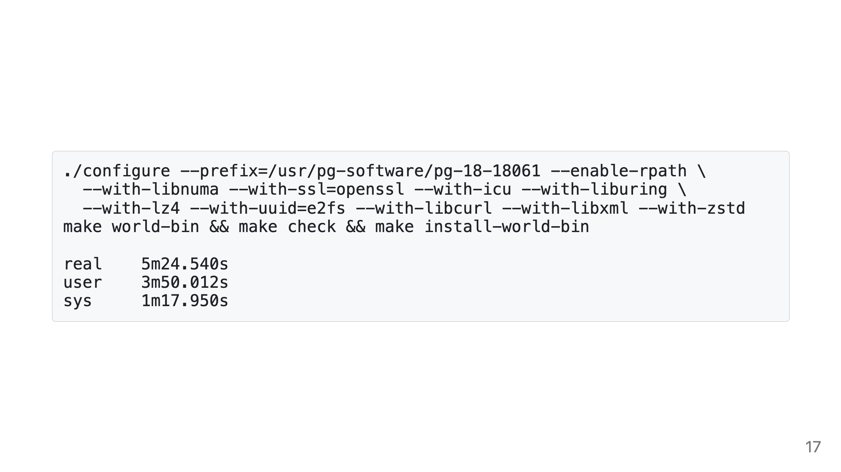
Notes:
2cpu_8G
Does include contrib extensions (pgcrypto, ...), does not include external extensions (pgvector, pgaudit, ...)

Slide 18
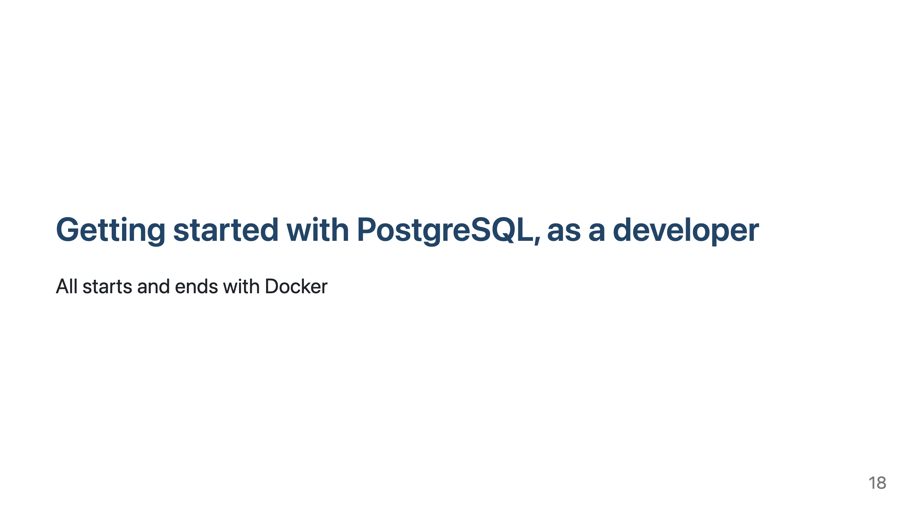
Notes:
While running databases in k8s haven't been popular in our company, containerized environments are
essential for swd development these days. Testcontainers make possible to run the integration tests in your laptop,
what not to like?!

Slide 19
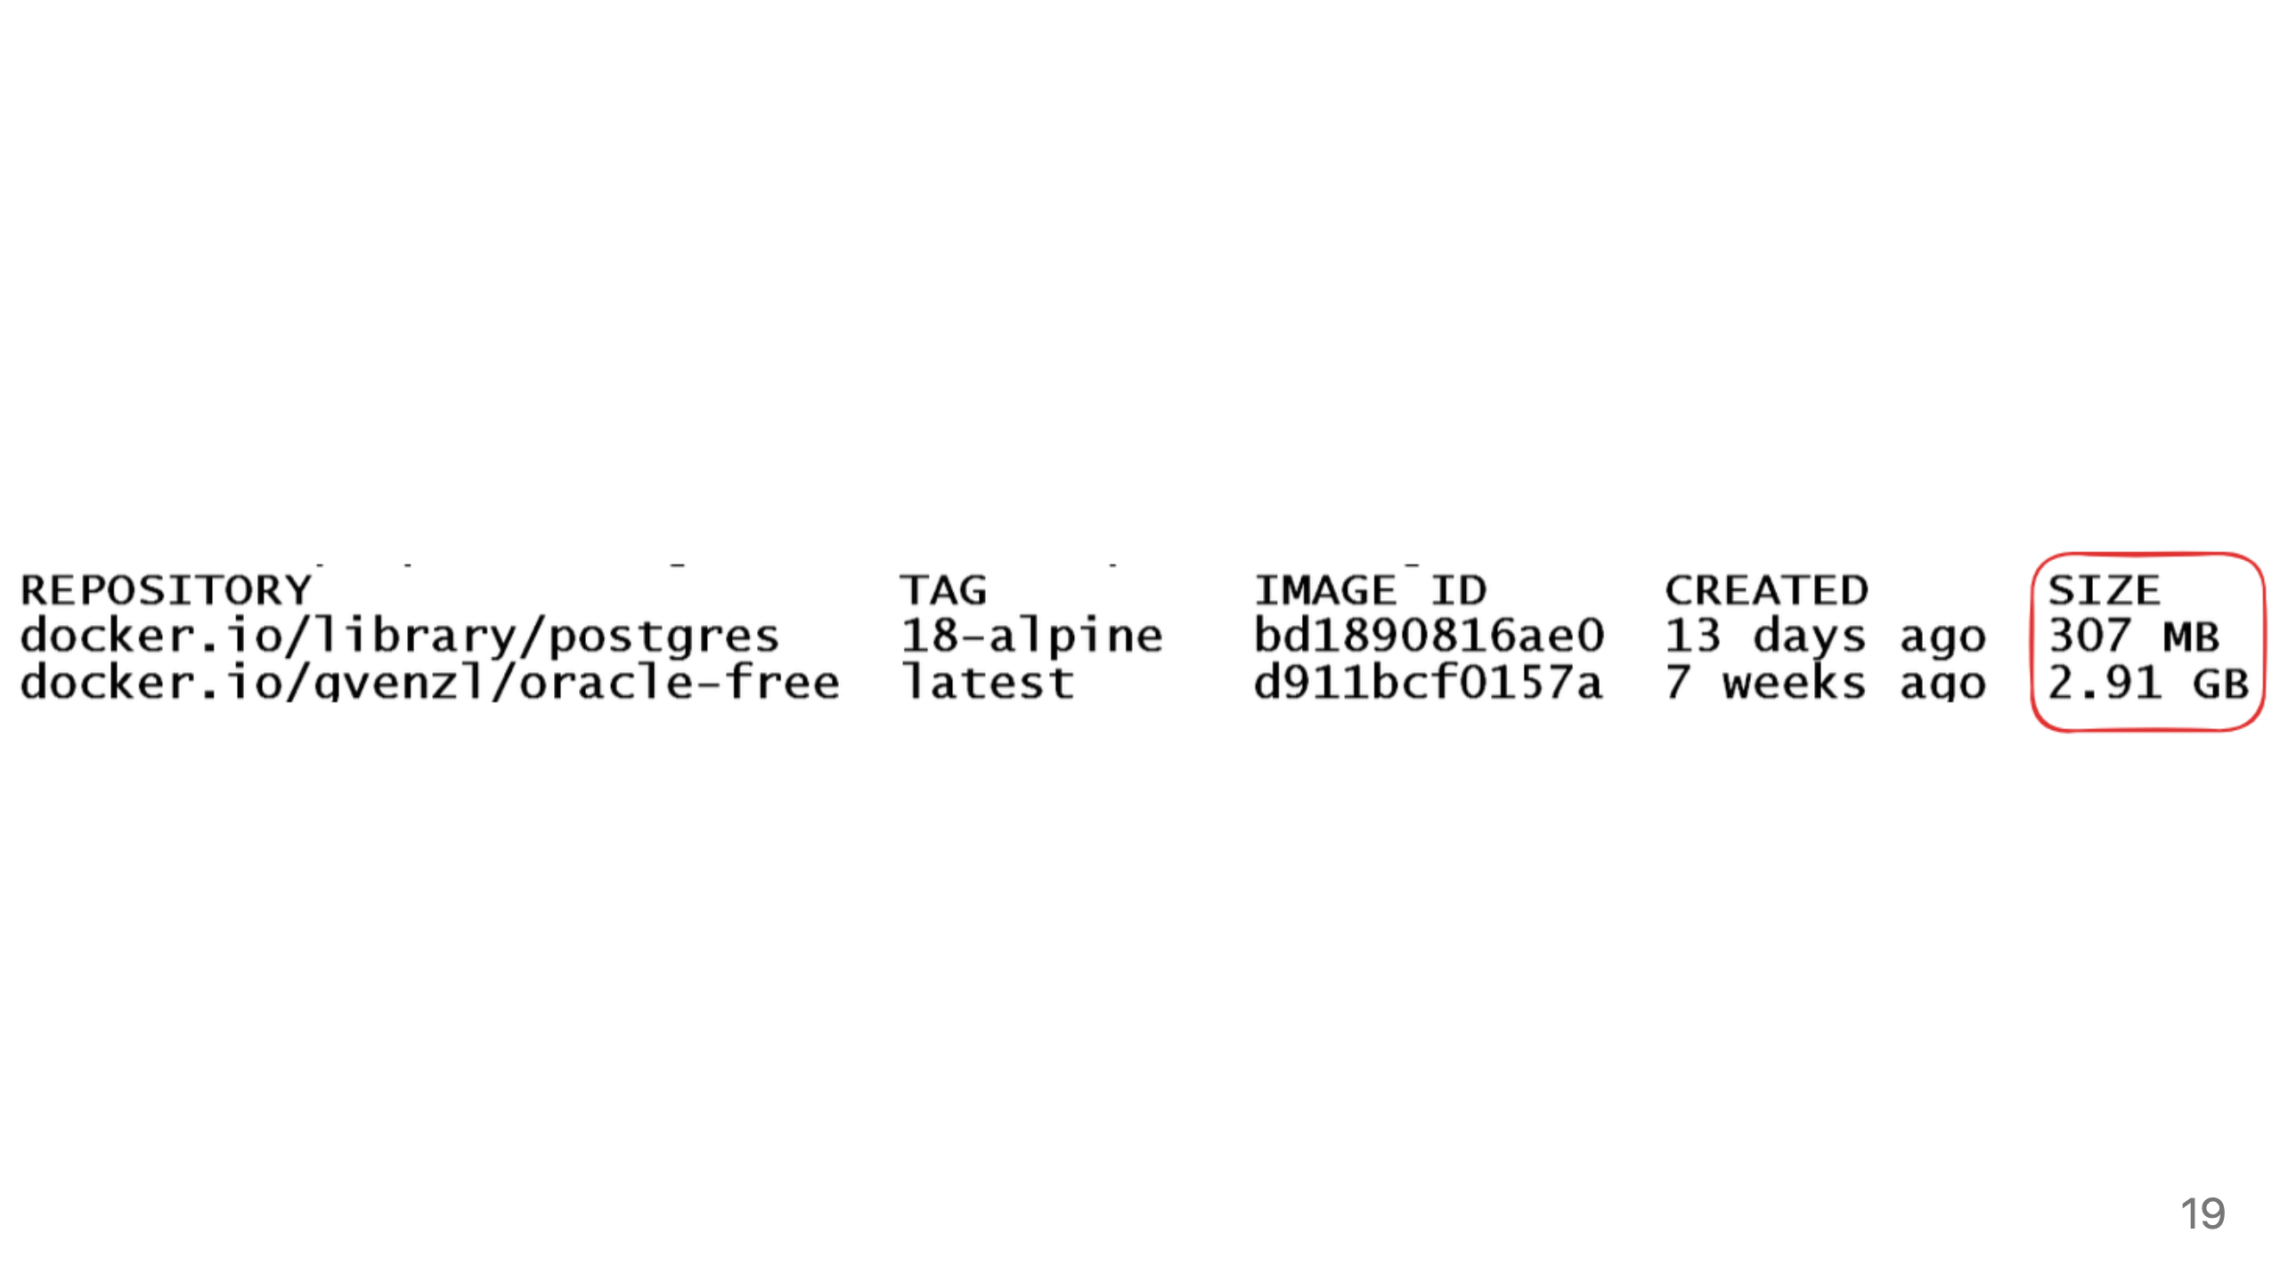
Notes:
Size matters: smaller containers are easier to user. For example, in case of testcontainers, smaller image makes
the tests run faster. But there's a catch.

Slide 20
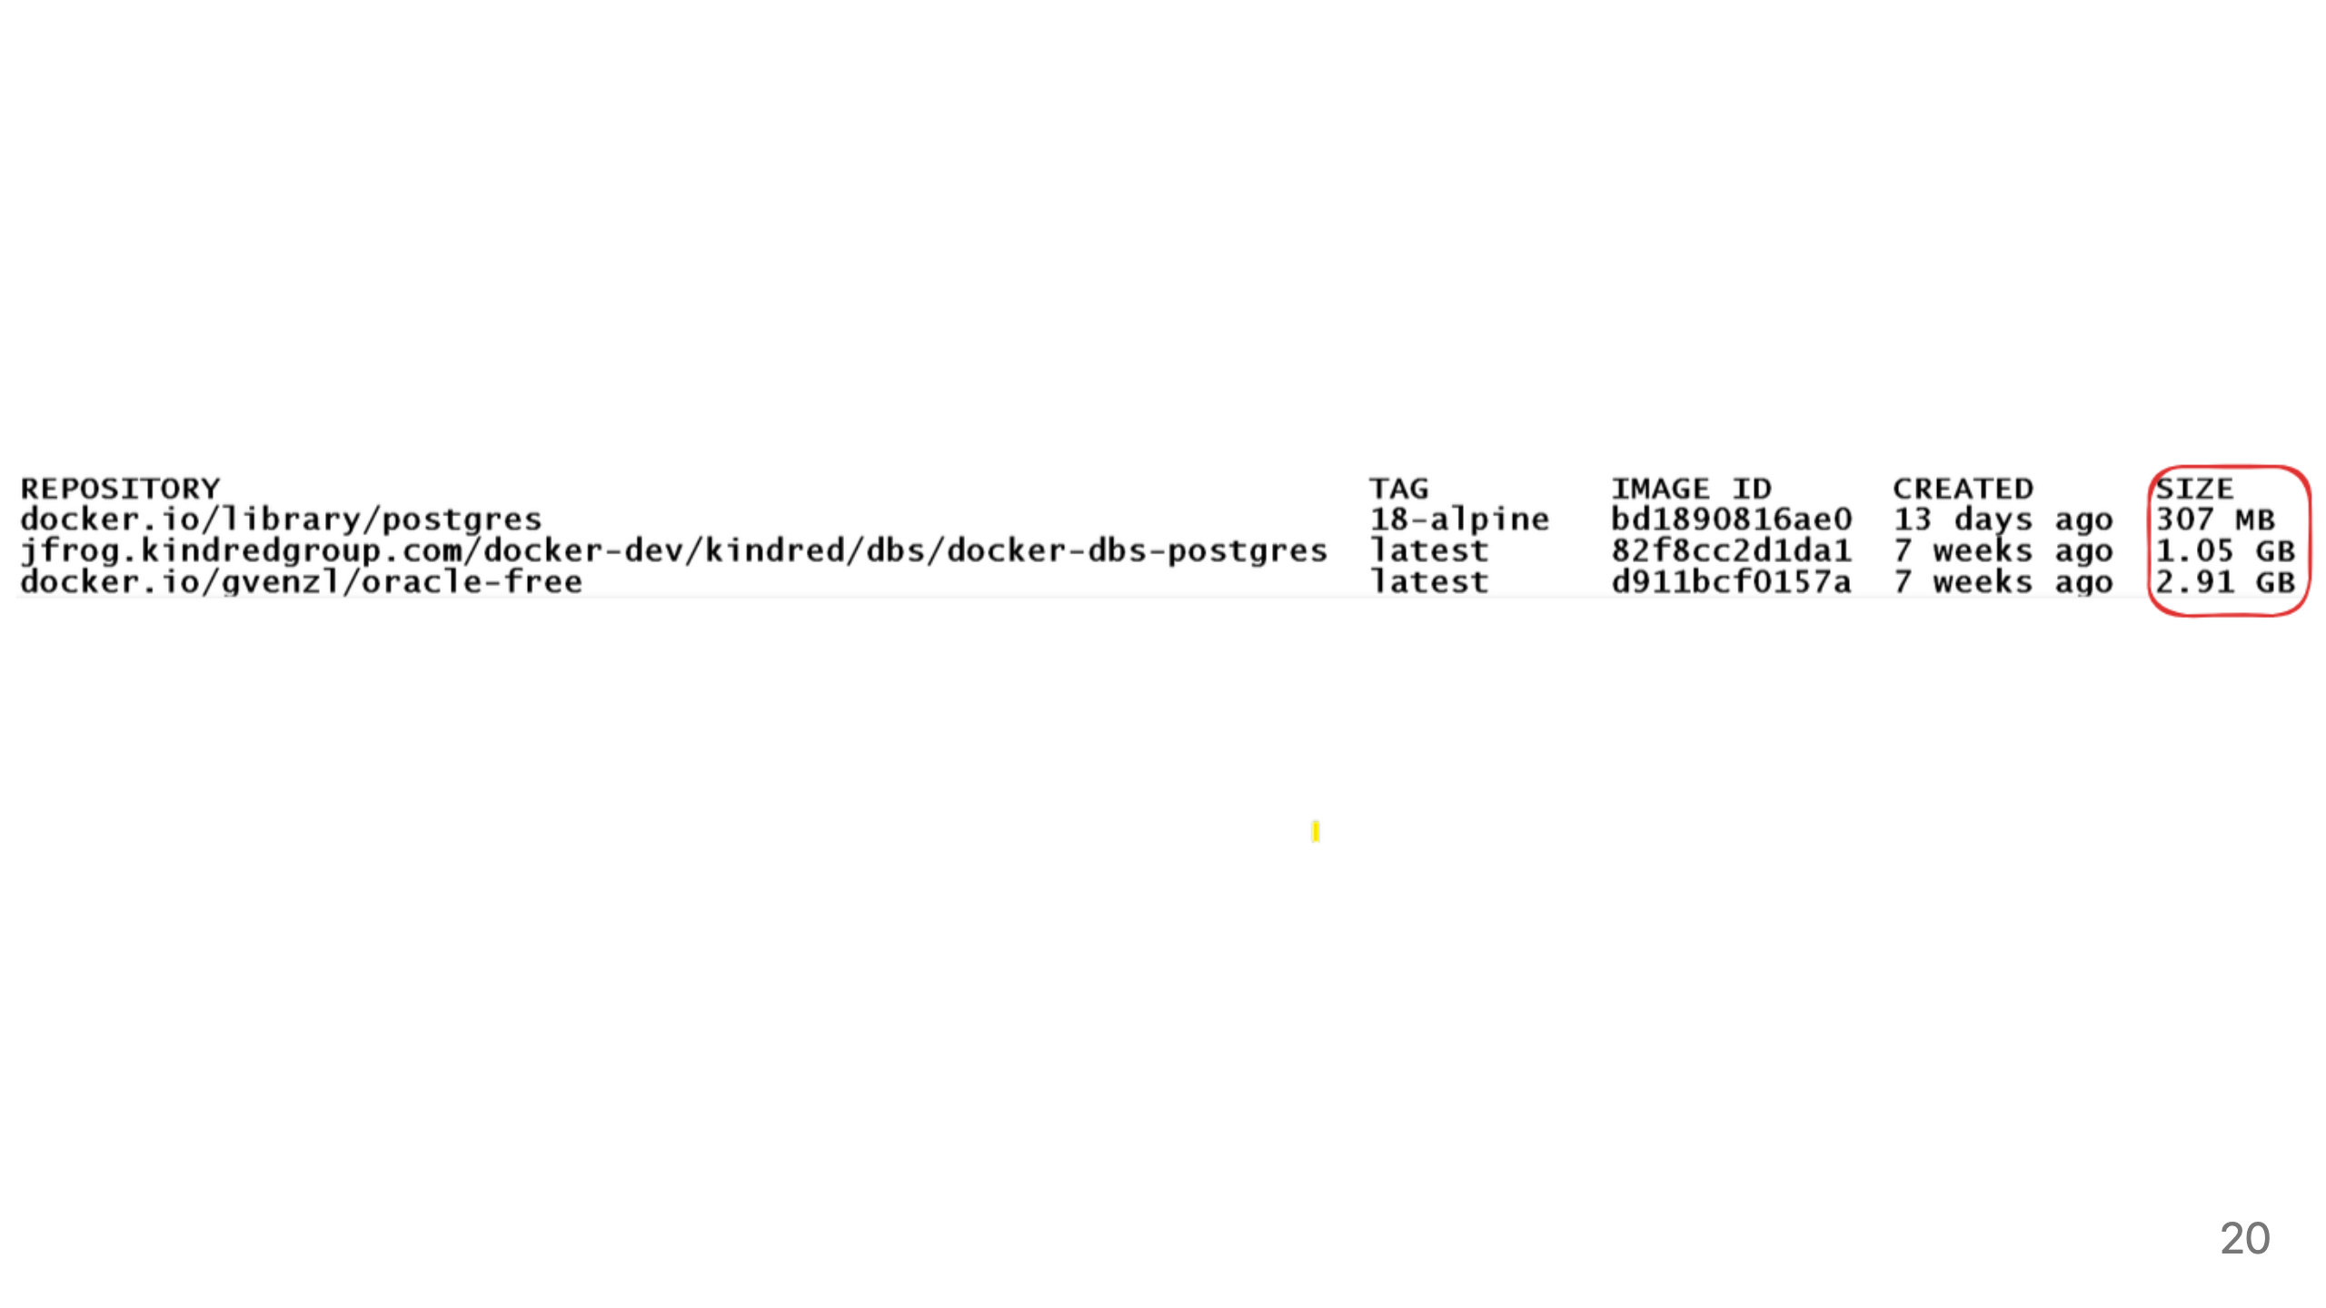
Notes:
If plugins used for daily life change database behavior in some way, then these plugins must be added to the
development containers as well. So after some pluggins and pgbouncer...

Slide 21

Notes:
In this section can go into implementing some Oracle world features in PG
From the perspective of Oracle dinosaur exploring PostgreSQL offerings

Slide 22
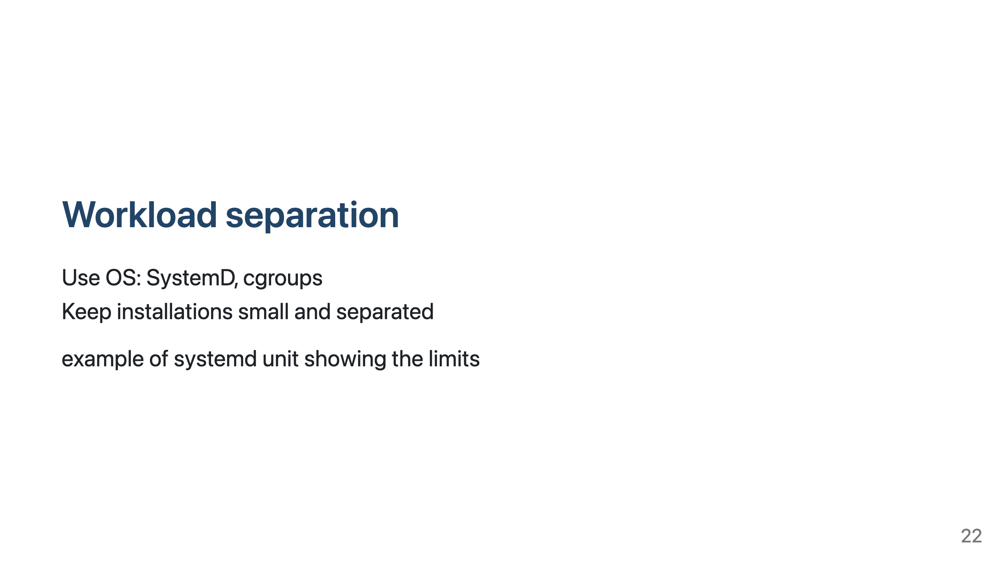
Notes:
Cloud-native deployment: one PostgreSQL server, one database, one application
Lack of workload isolation or resource manager makes it very hard to do other deployment models

Slide 23
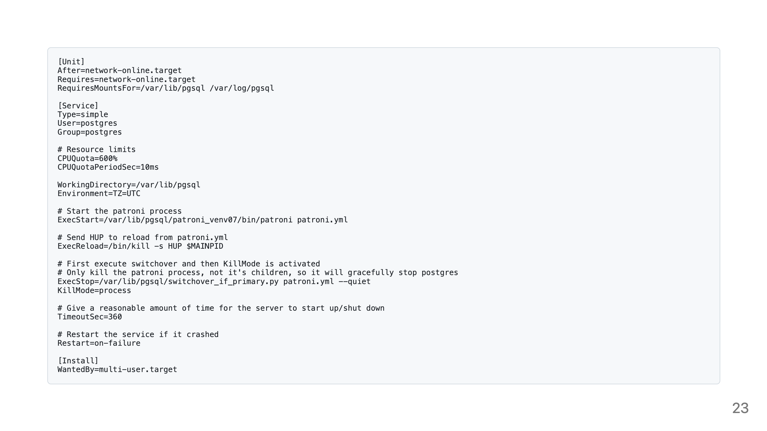

Slide 24
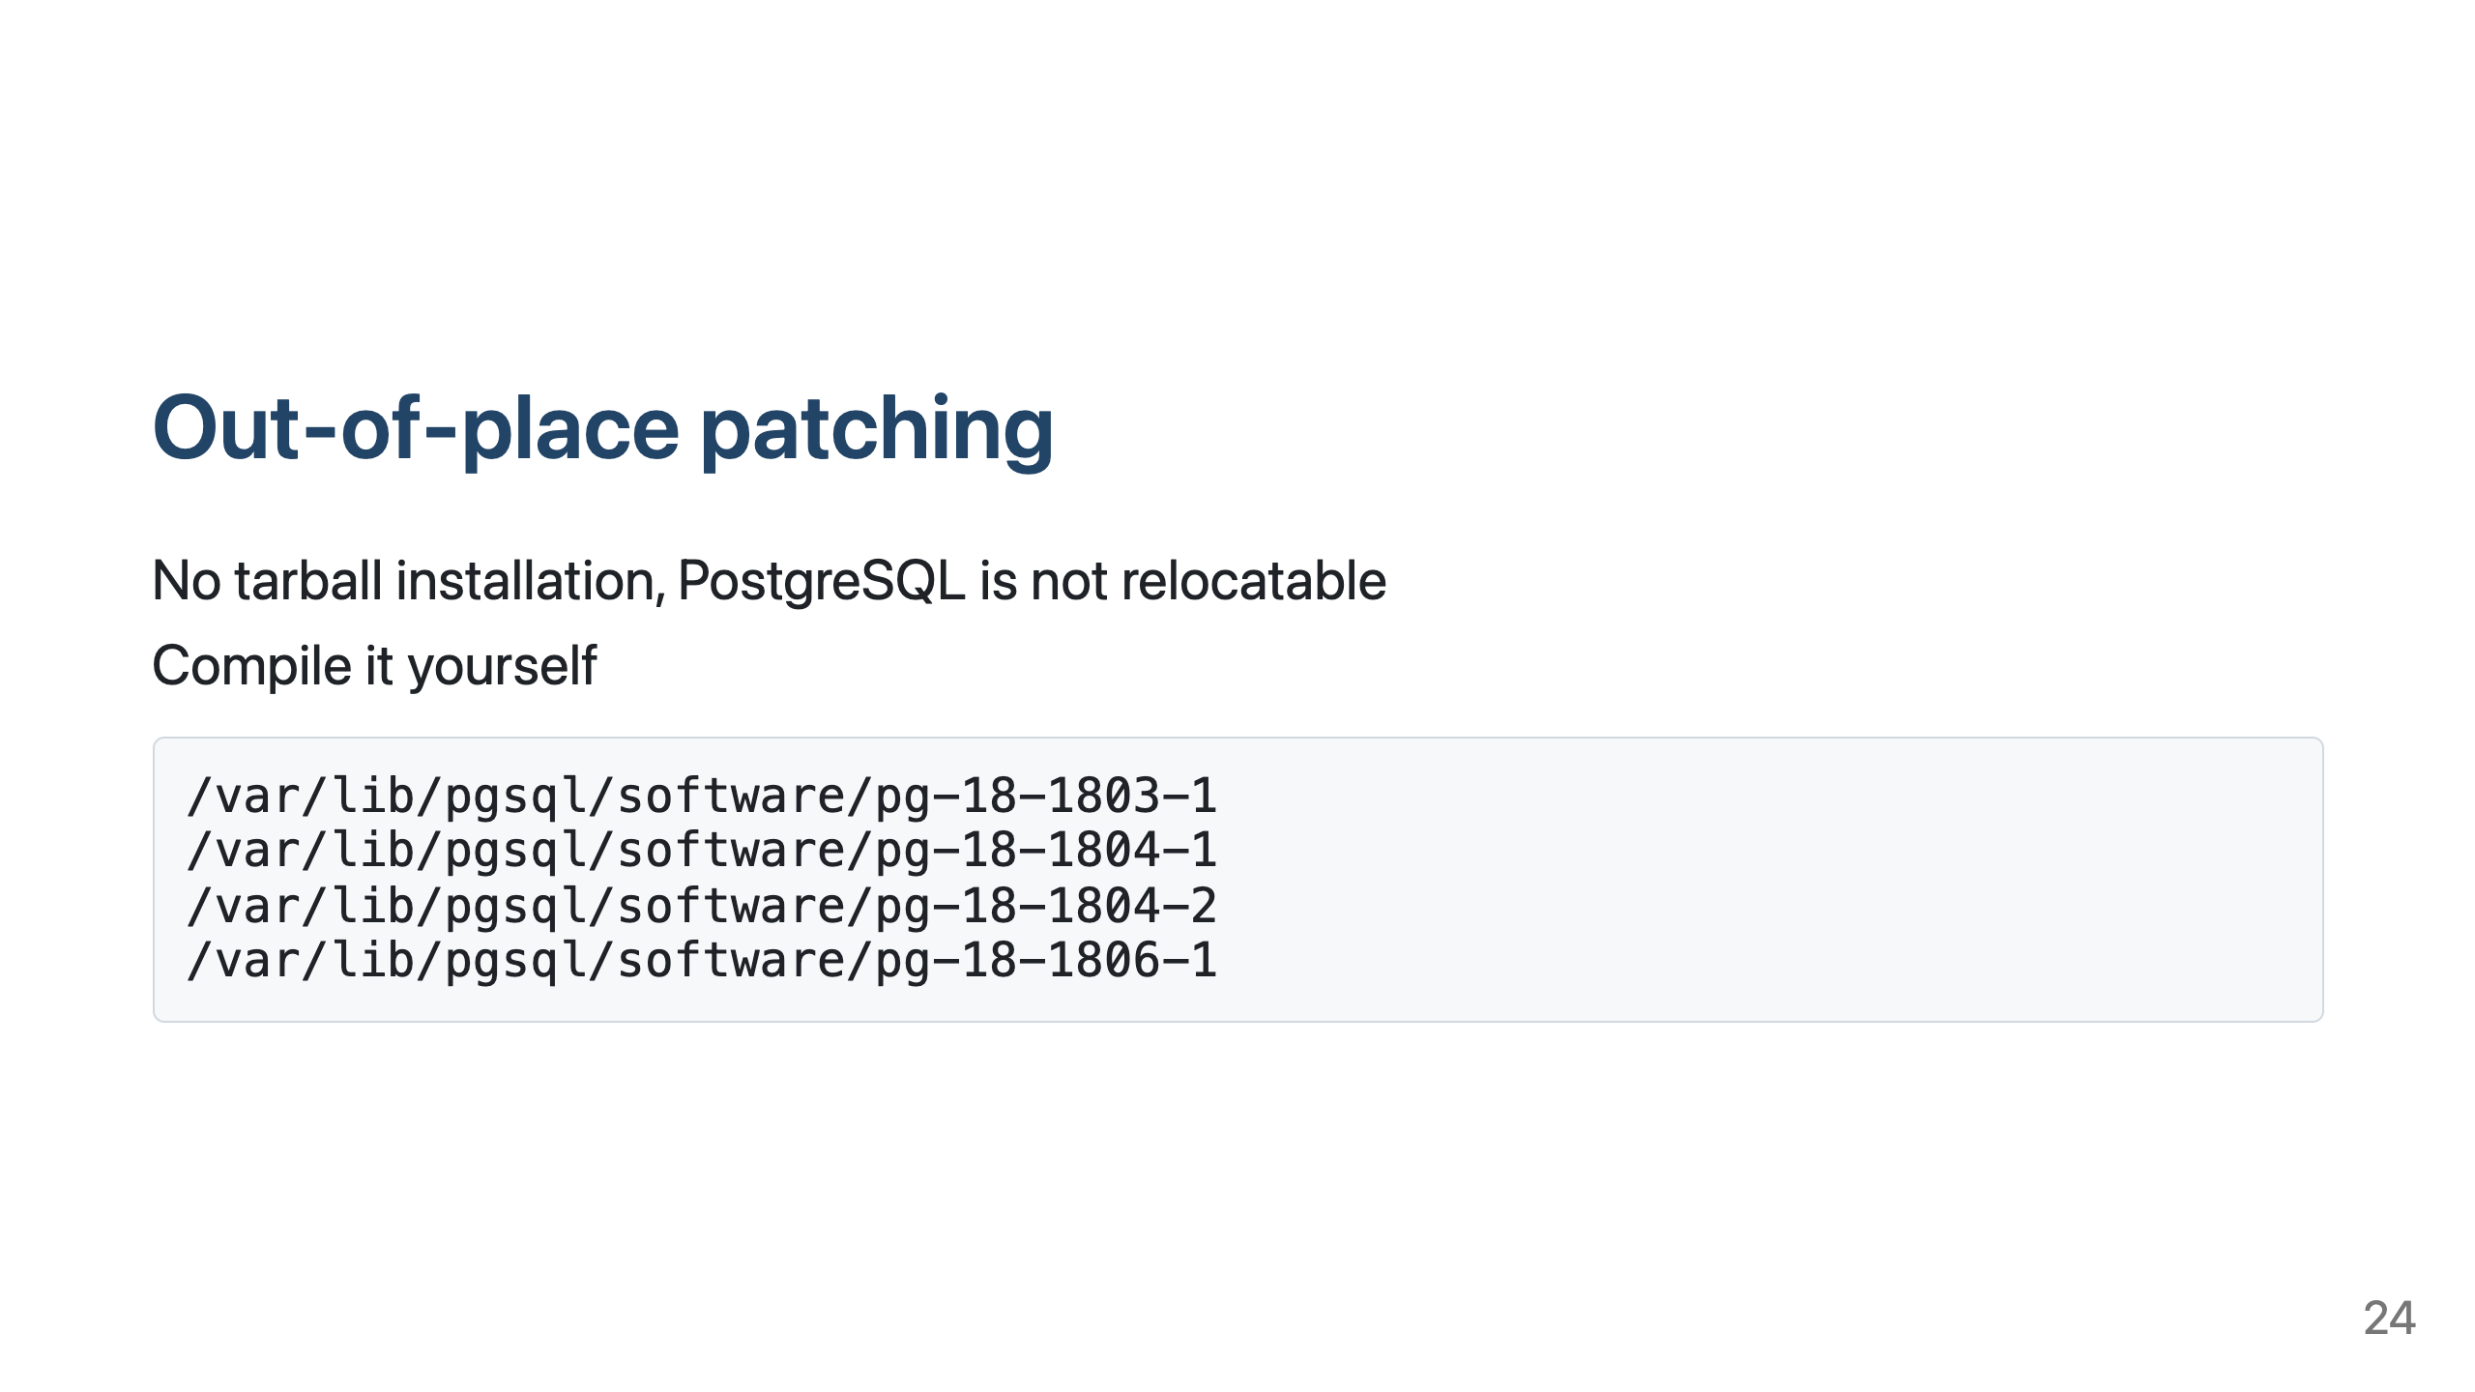
Notes:
PostgreSQL must be compiled already with the final software destination in mind

Slide 25
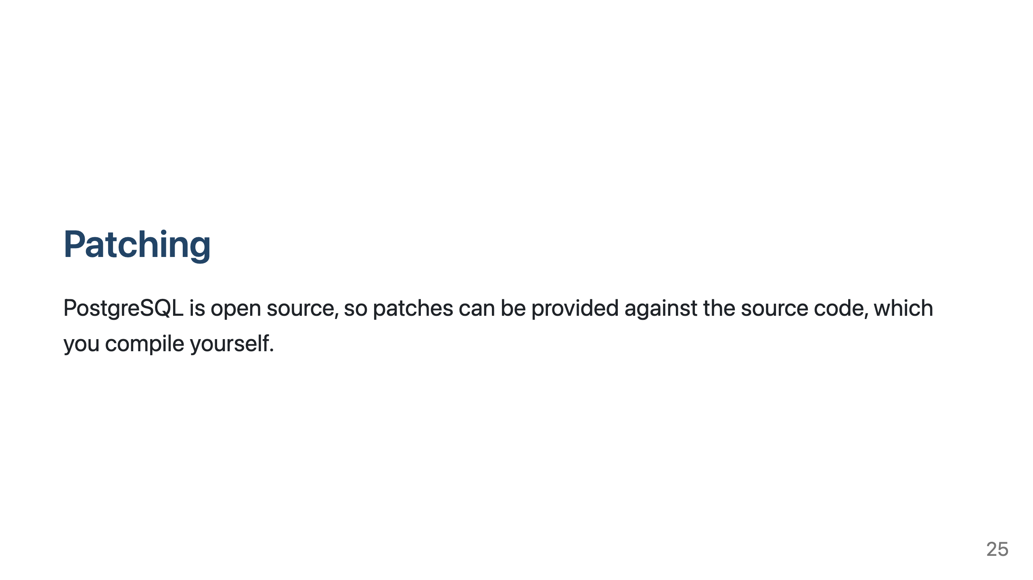
Notes:
Compiling PostgreSQL can be faster than running OPatch

Slide 26
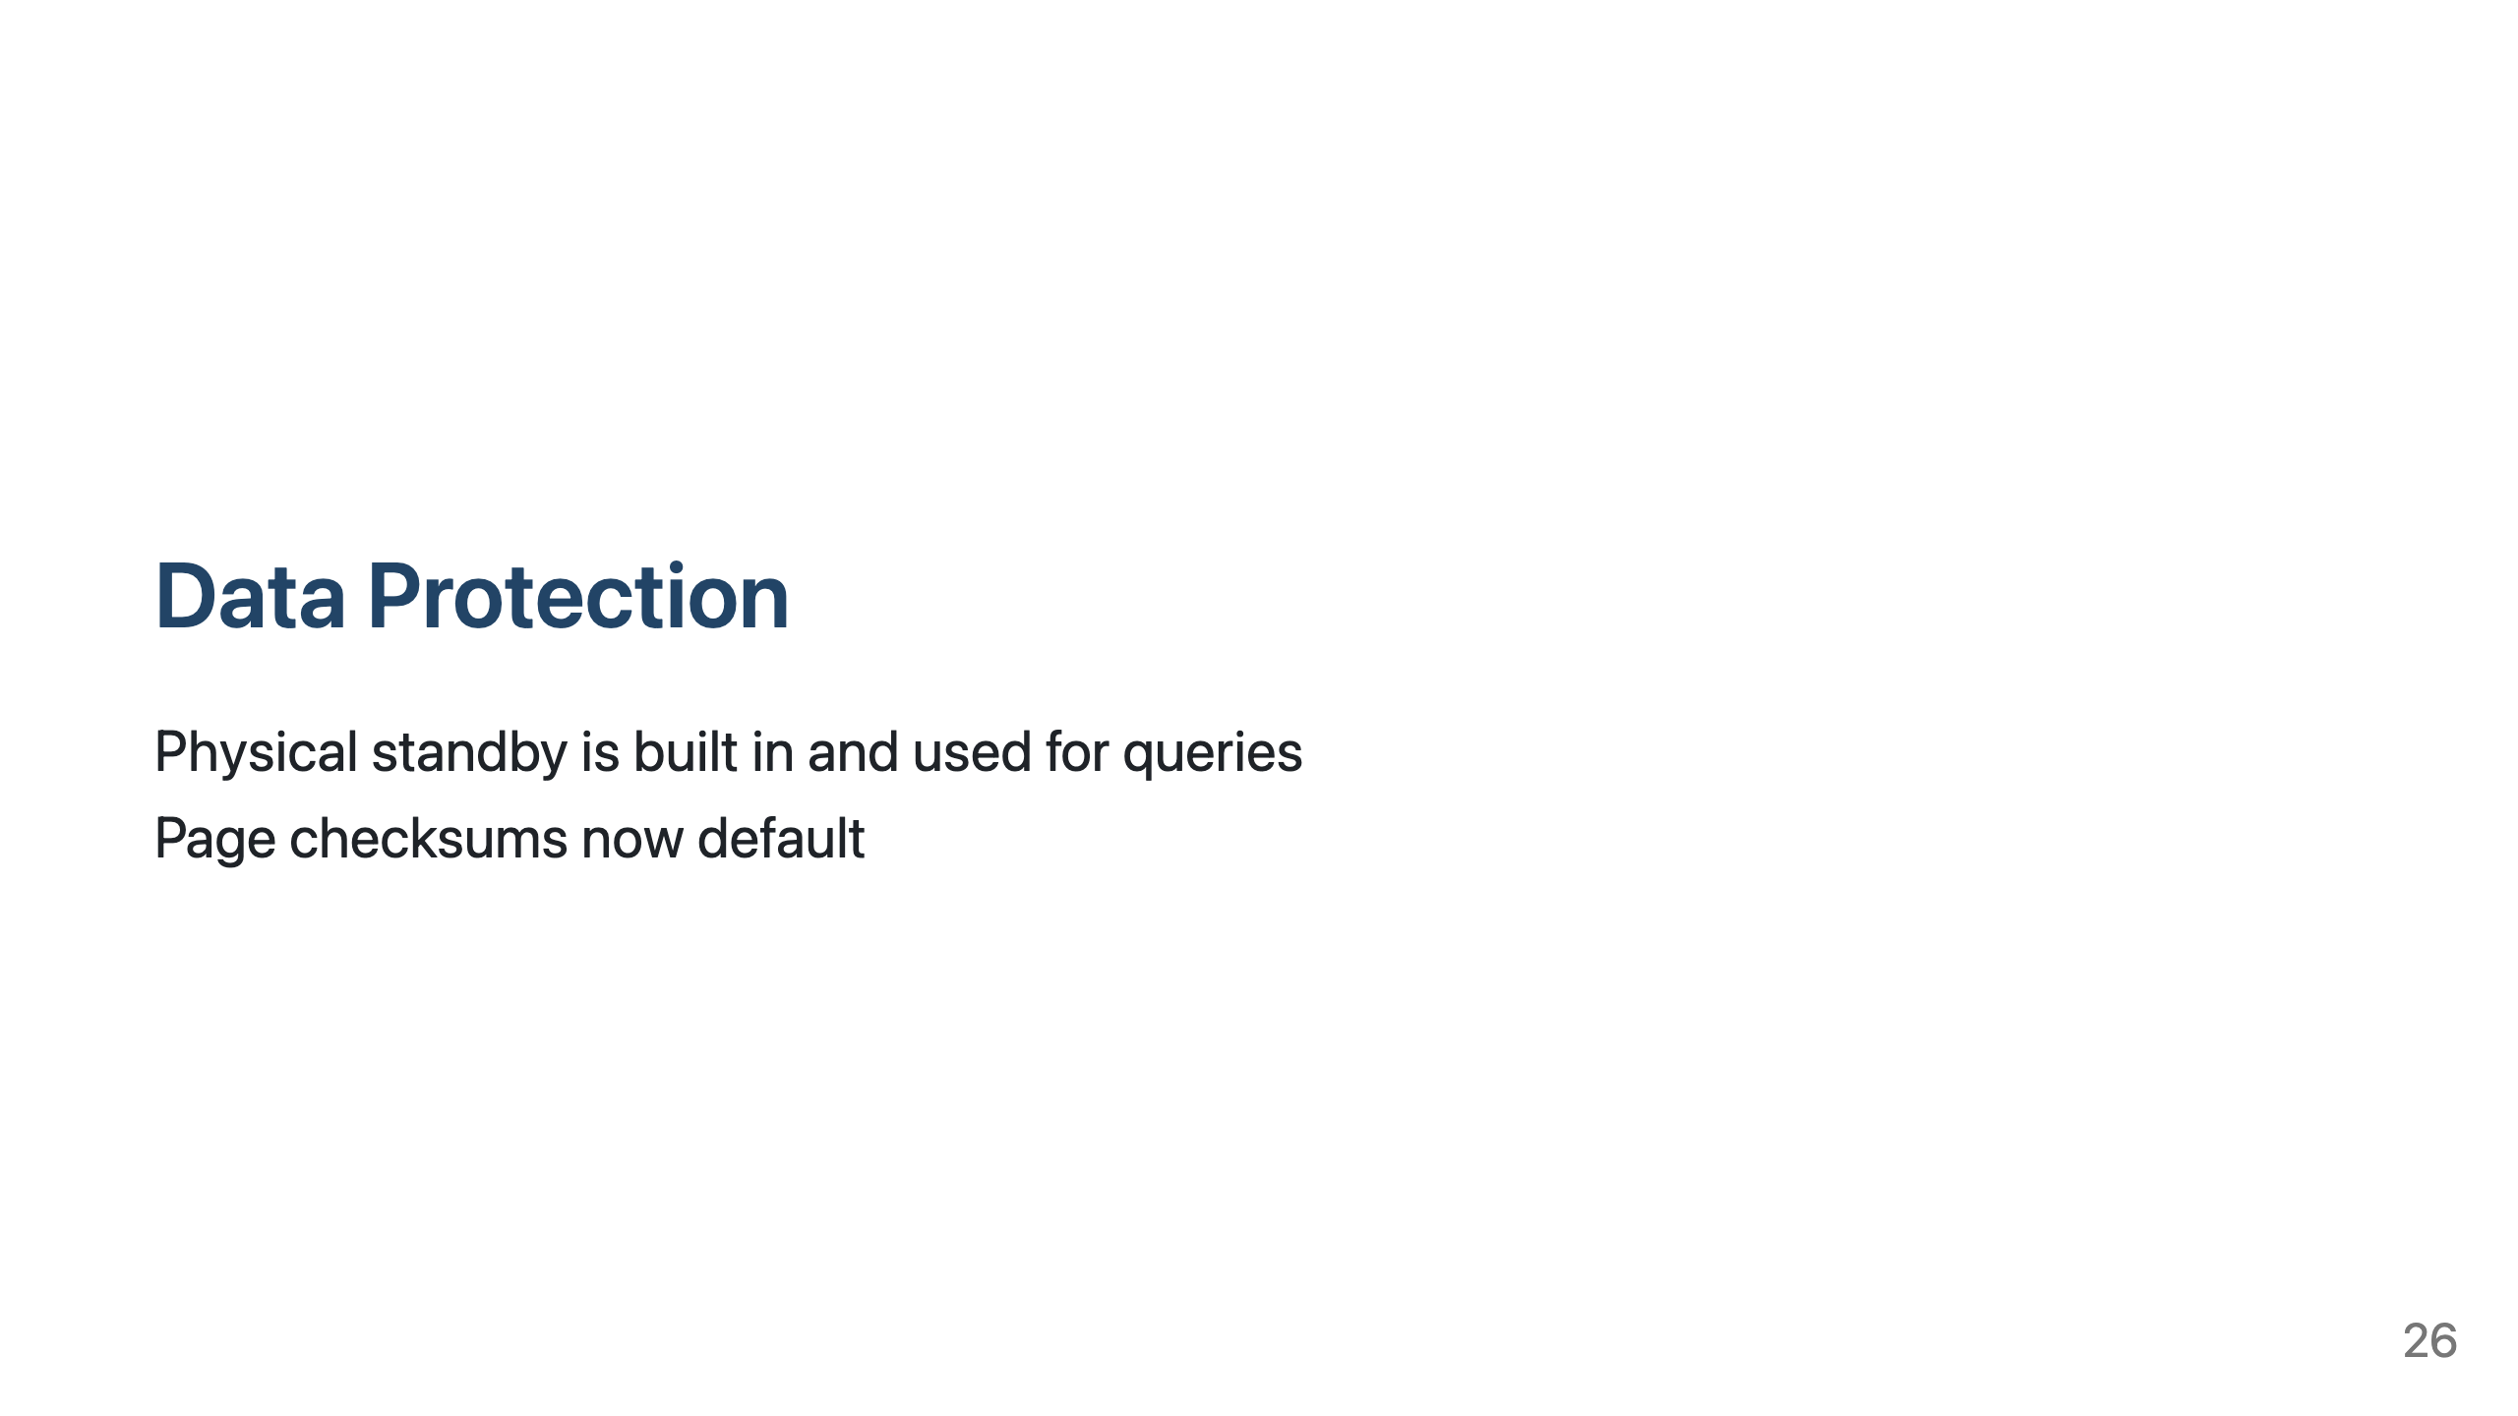
Notes:
Data Guard equivalent, for Broker functionality need Patroni in addition

Slide 27
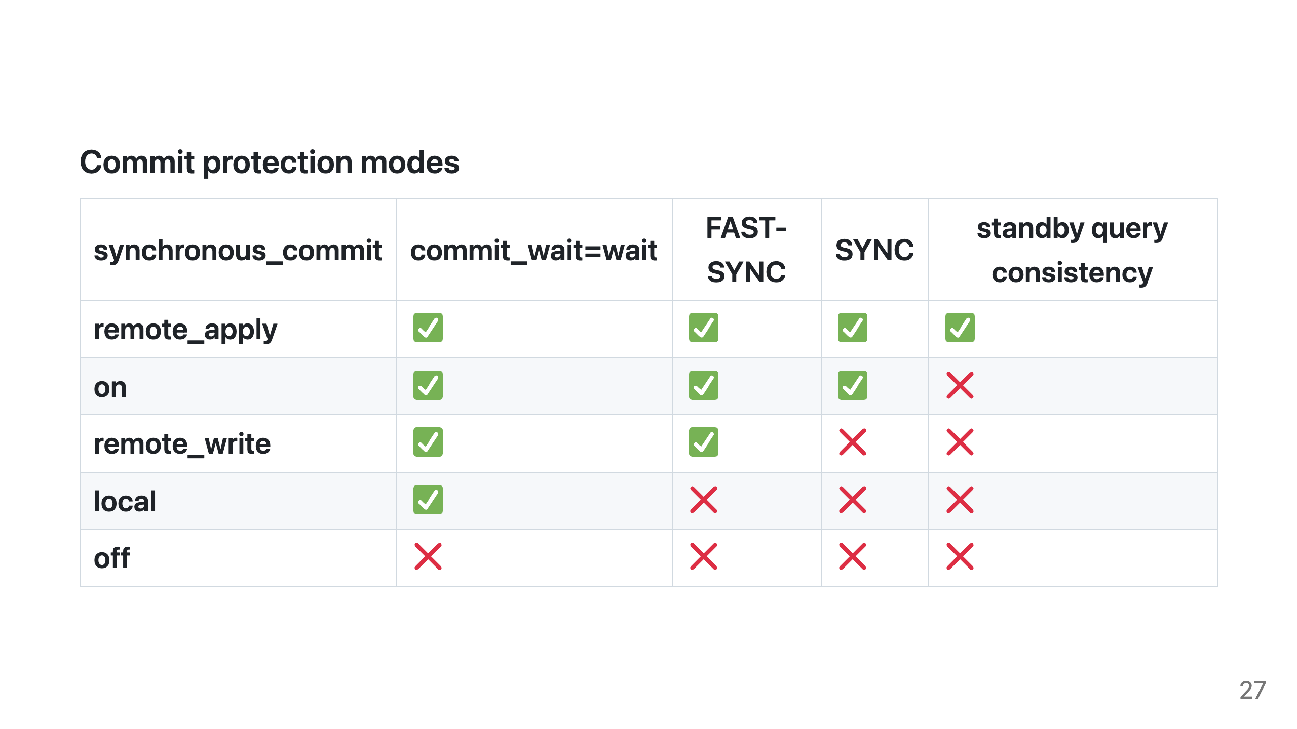
Notes:
FAST-SYNC and SYNC are Oracle Data Guard terminology
FAST-SYNC - WAL record is written to remote instance memory
SYNC - WAL record is written to remote instance memory and synced to disk

Slide 28
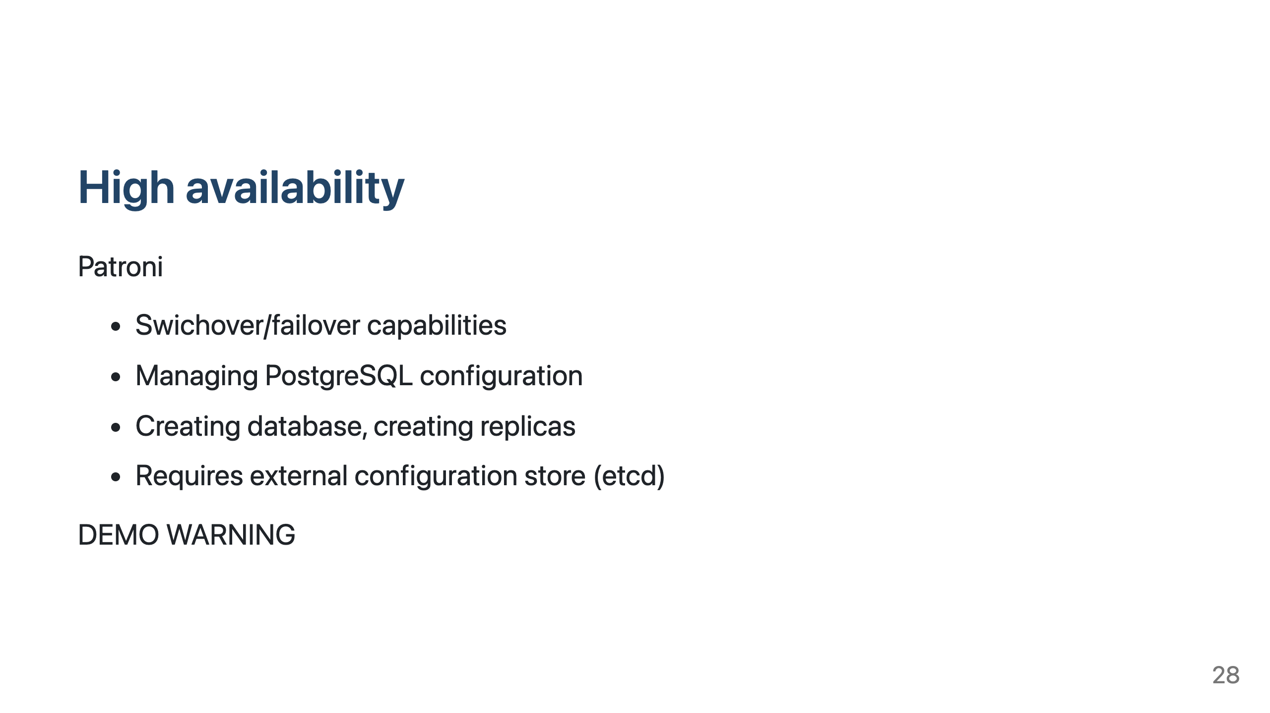
Notes:
Physical standby is built in, but you need something to manage it, automate failovers and switchovers, you need the "Data Guard Broker" functionality.
It does not get on the way for queries
So easy
REST API for all actions
etcd can be shared between multiple clusters

Slide 29
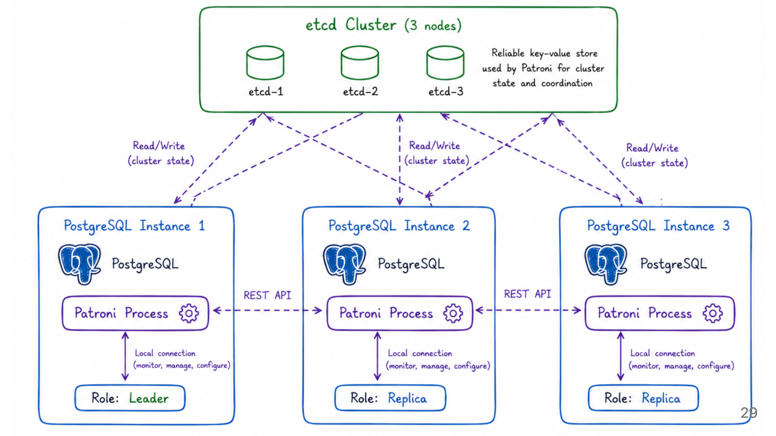

Slide 30
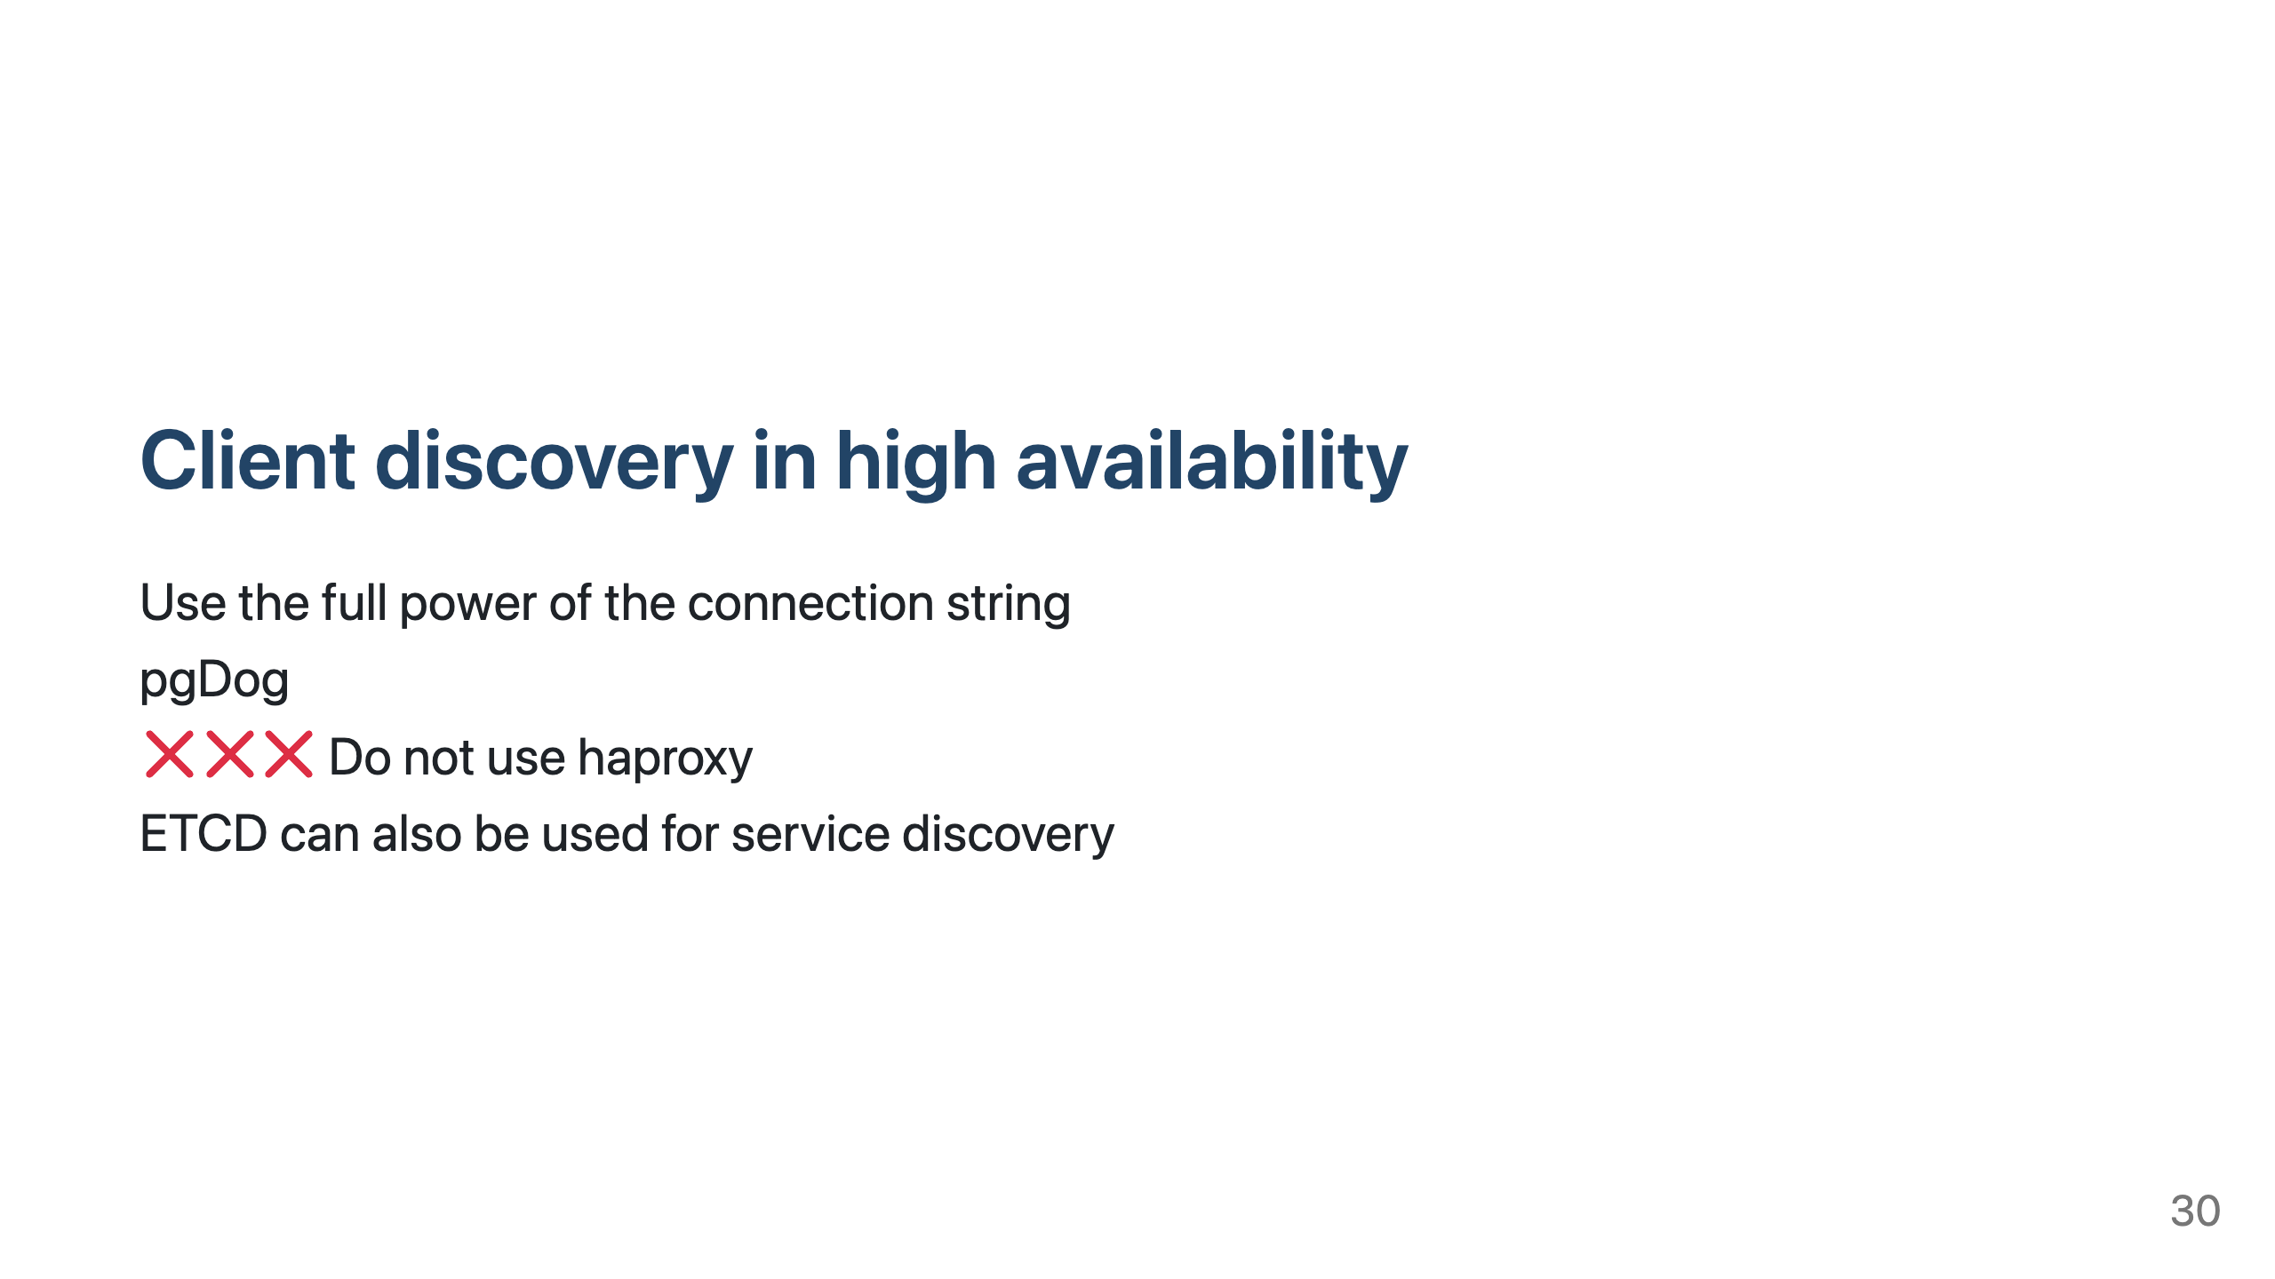
Notes:
How shall a client find, where the leader instance is currently running?

Slide 31
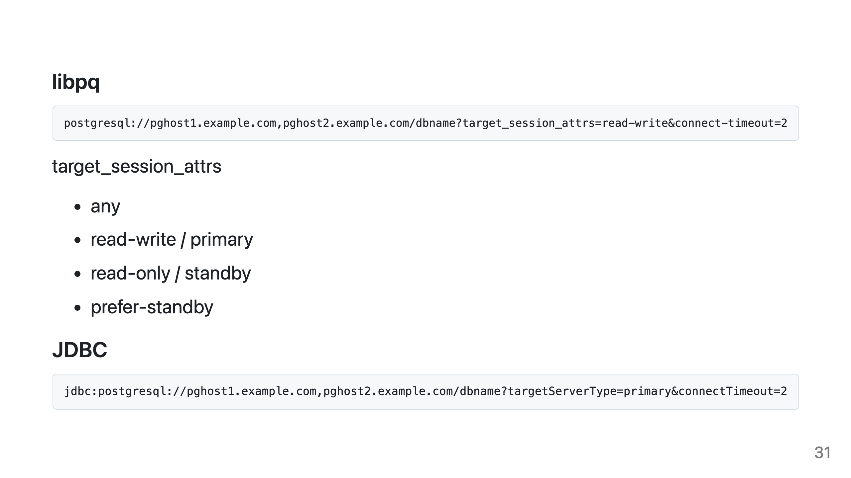
Notes:
Example connection strings
libpq syntax works also for Go driver

Slide 32
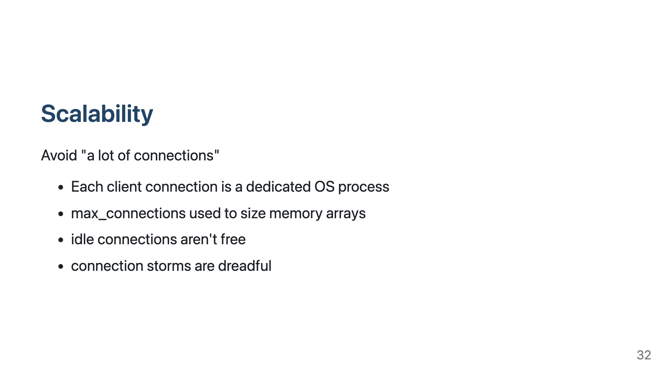
Notes:
PostgreSQL does not like "a lot of connections" - just like Oracle. Reduce heavily, or use a pooler.

Slide 33
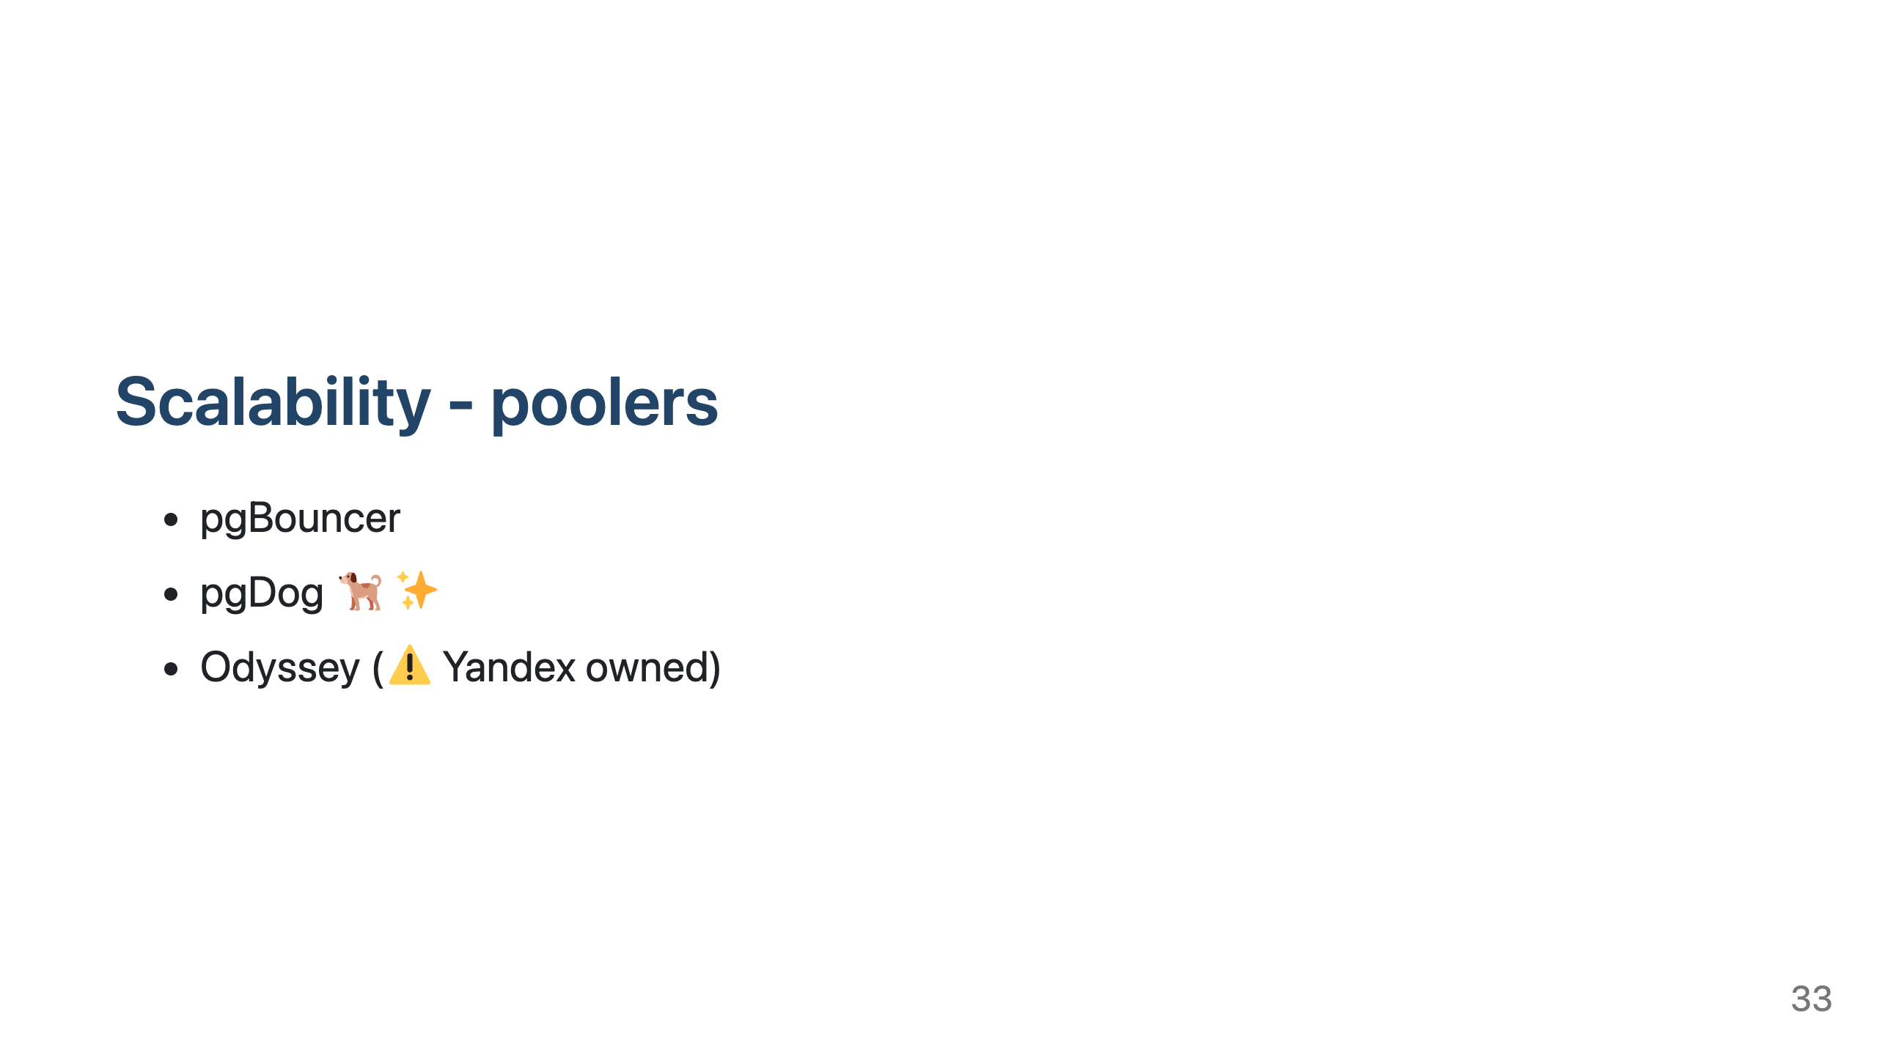
Notes:
PostgreSQL does not like "a lot of connections" - just like Oracle. Reduce heavily, or use a pooler.
pgBouncer - old and trusted workhorse
pgDog - new and shiny
Avoid pgPool-II at any cost

Slide 34
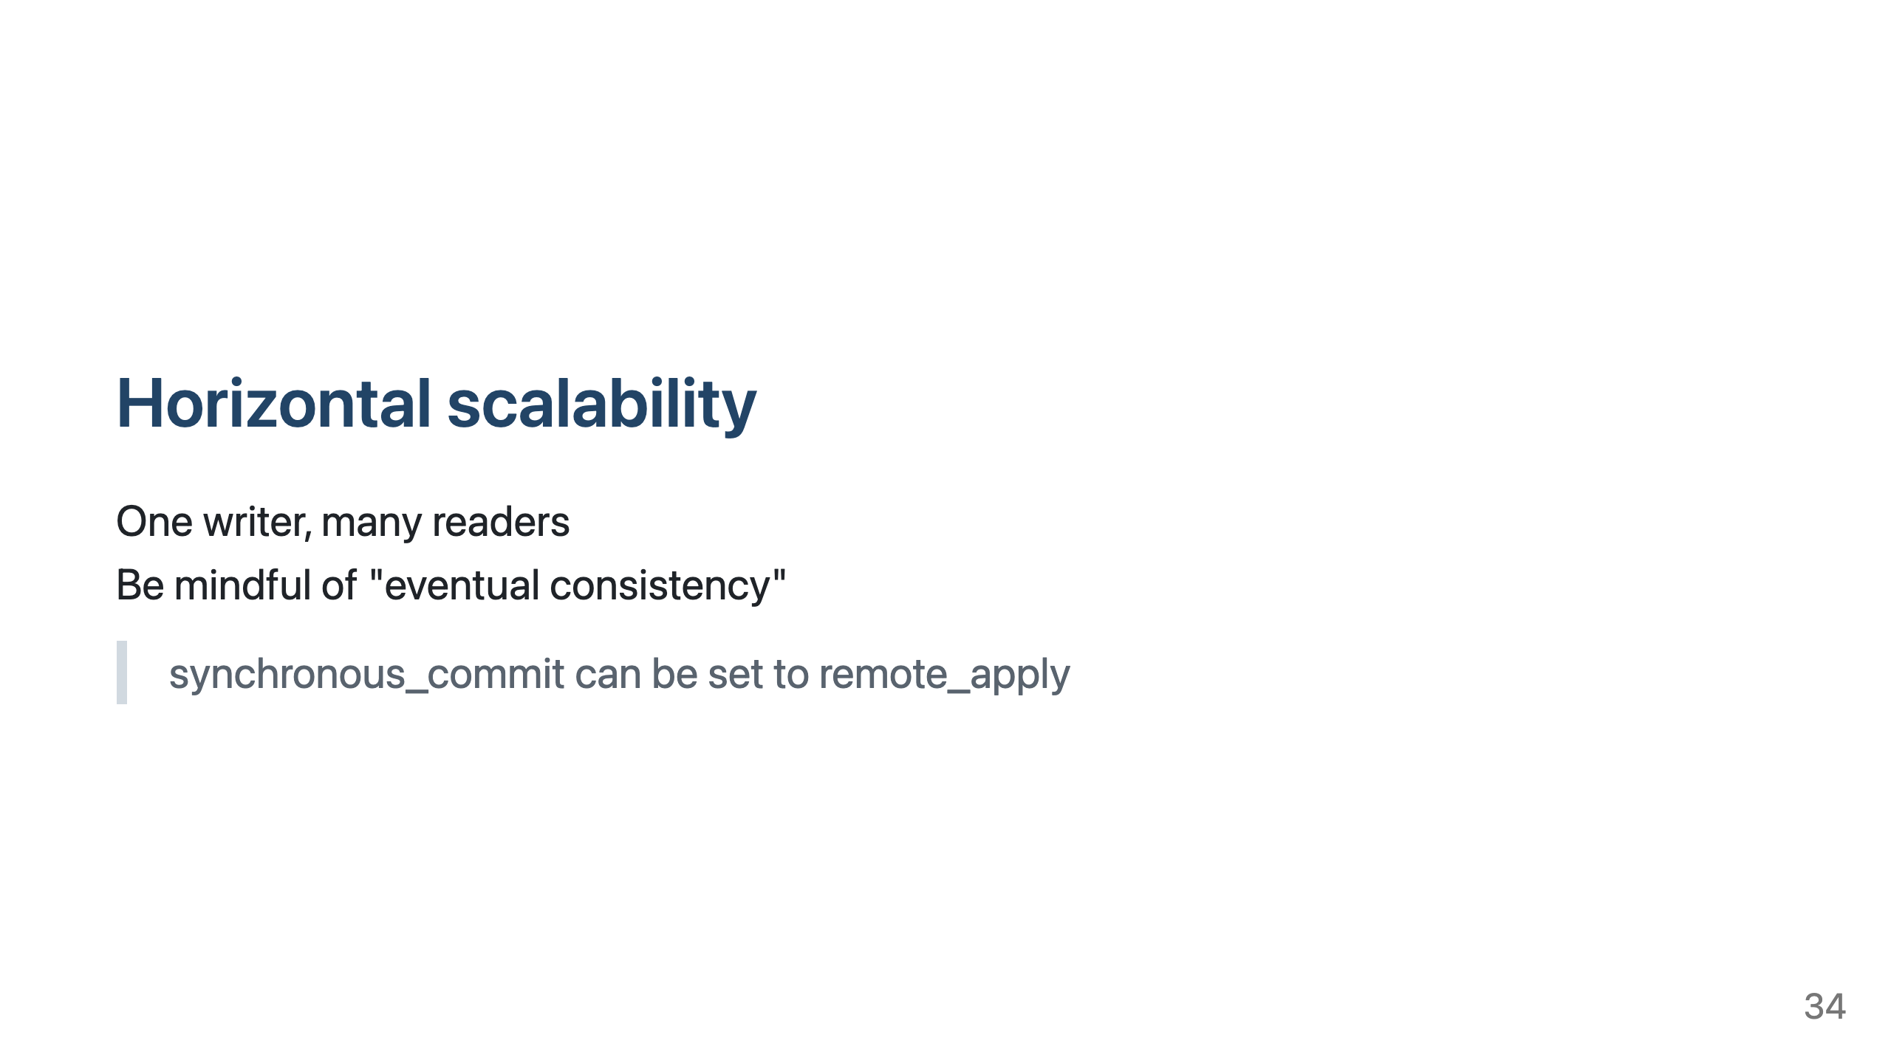
Notes:
No RAC
To achieve horizontal scalability common pattern is to have one leader-writer database and many read only replicas
Reads can be load balanced over replicas - to do it automatically you need pgDog
If more (write) scalability is needed - YugabyteDB, CockroachDB

Slide 35
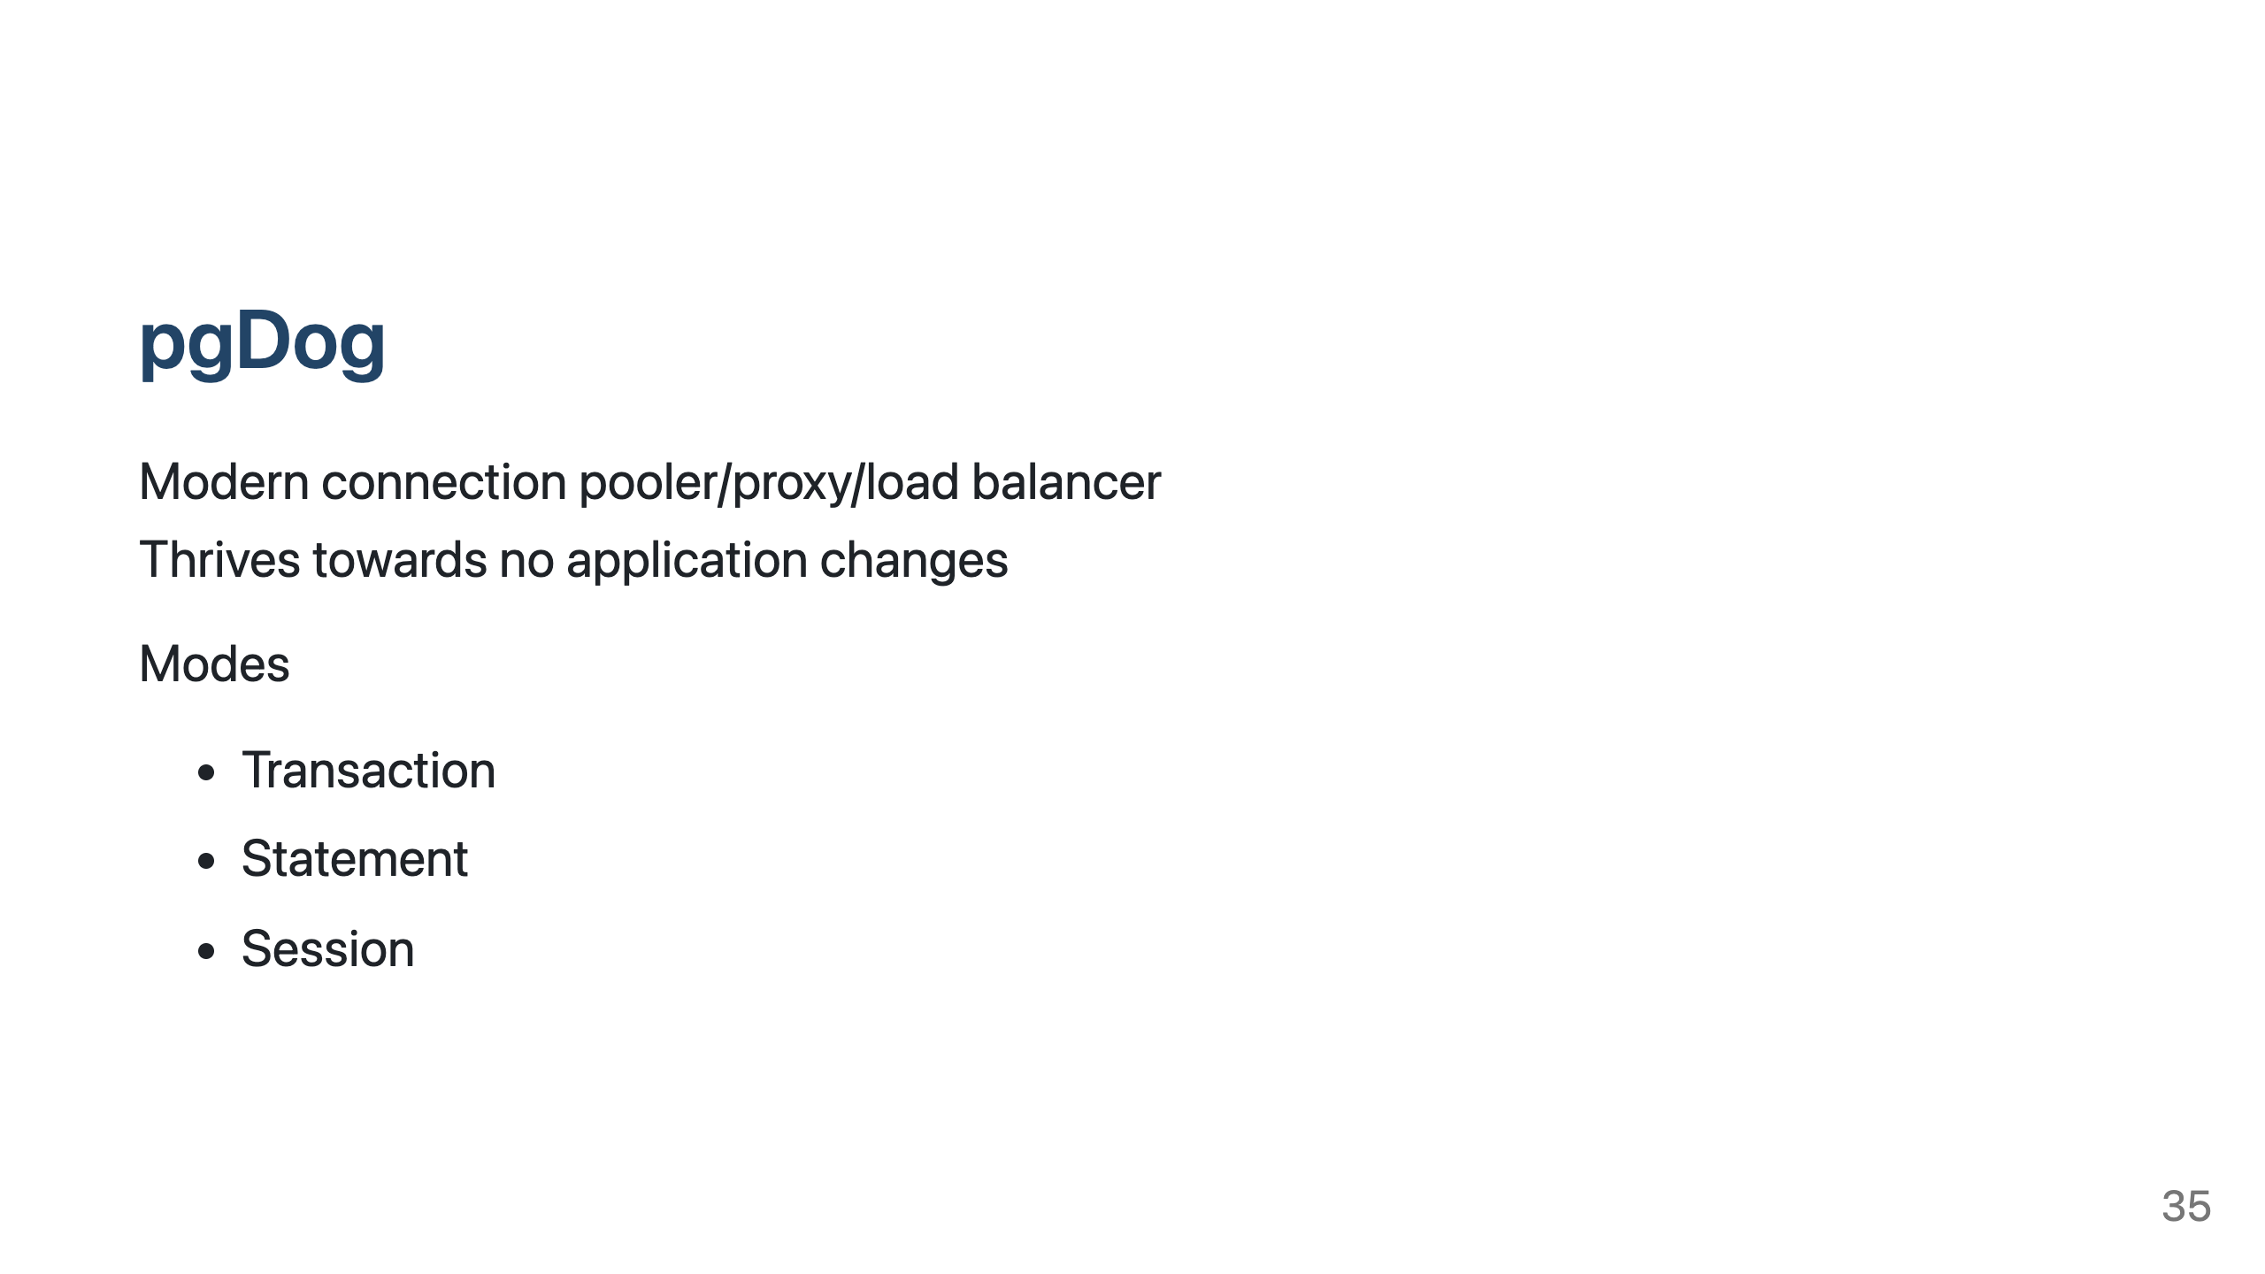
Notes:
Written in Rust, very fast
Transaction mode - few server connections can be shared between thousands? of front-end connections
Session mode - One to one mapping between client and server connection, all features supported, on client disconnect server connection remains, lazy connecting of servers (on first query)
Tries to solve PostgreSQL scalability problems - pooling, load balancing, sharding.
Very actively in development, easy to request new features.
Very fast, almost comparable to pgBouncer, but with vastly more features.
pgdog is Ilmar's personal favourite. Eventual consistency and stale reads from replicas have generated strong opipions in our team and development organization.

Slide 36
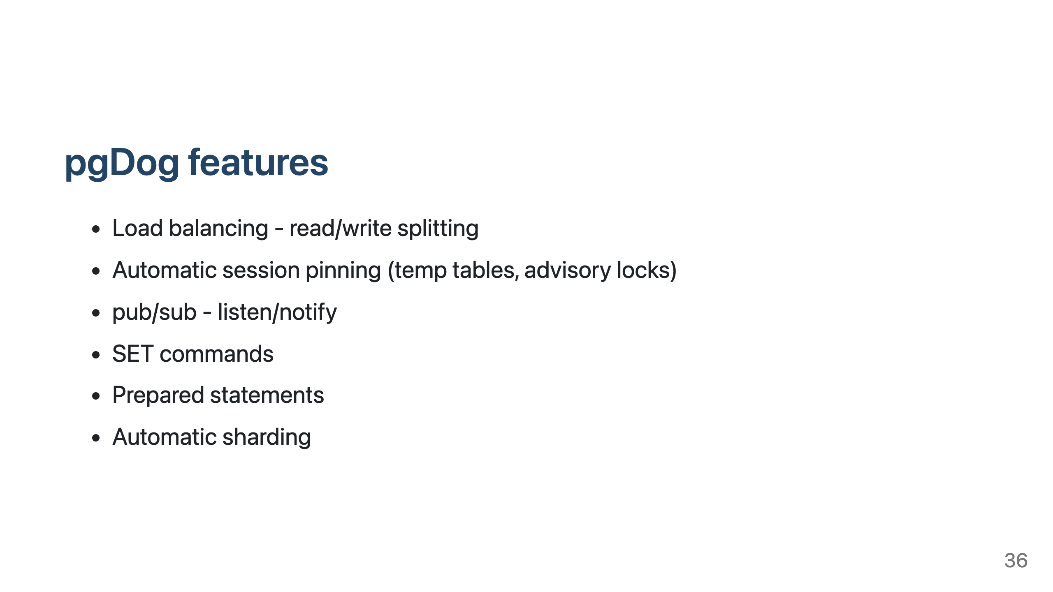
Notes:
Load balancer supports also manual routing
Not all database features - like temp tables, advisory locks, pub/sub are connection dependent, pgDog detects and automatically pins

Slide 37
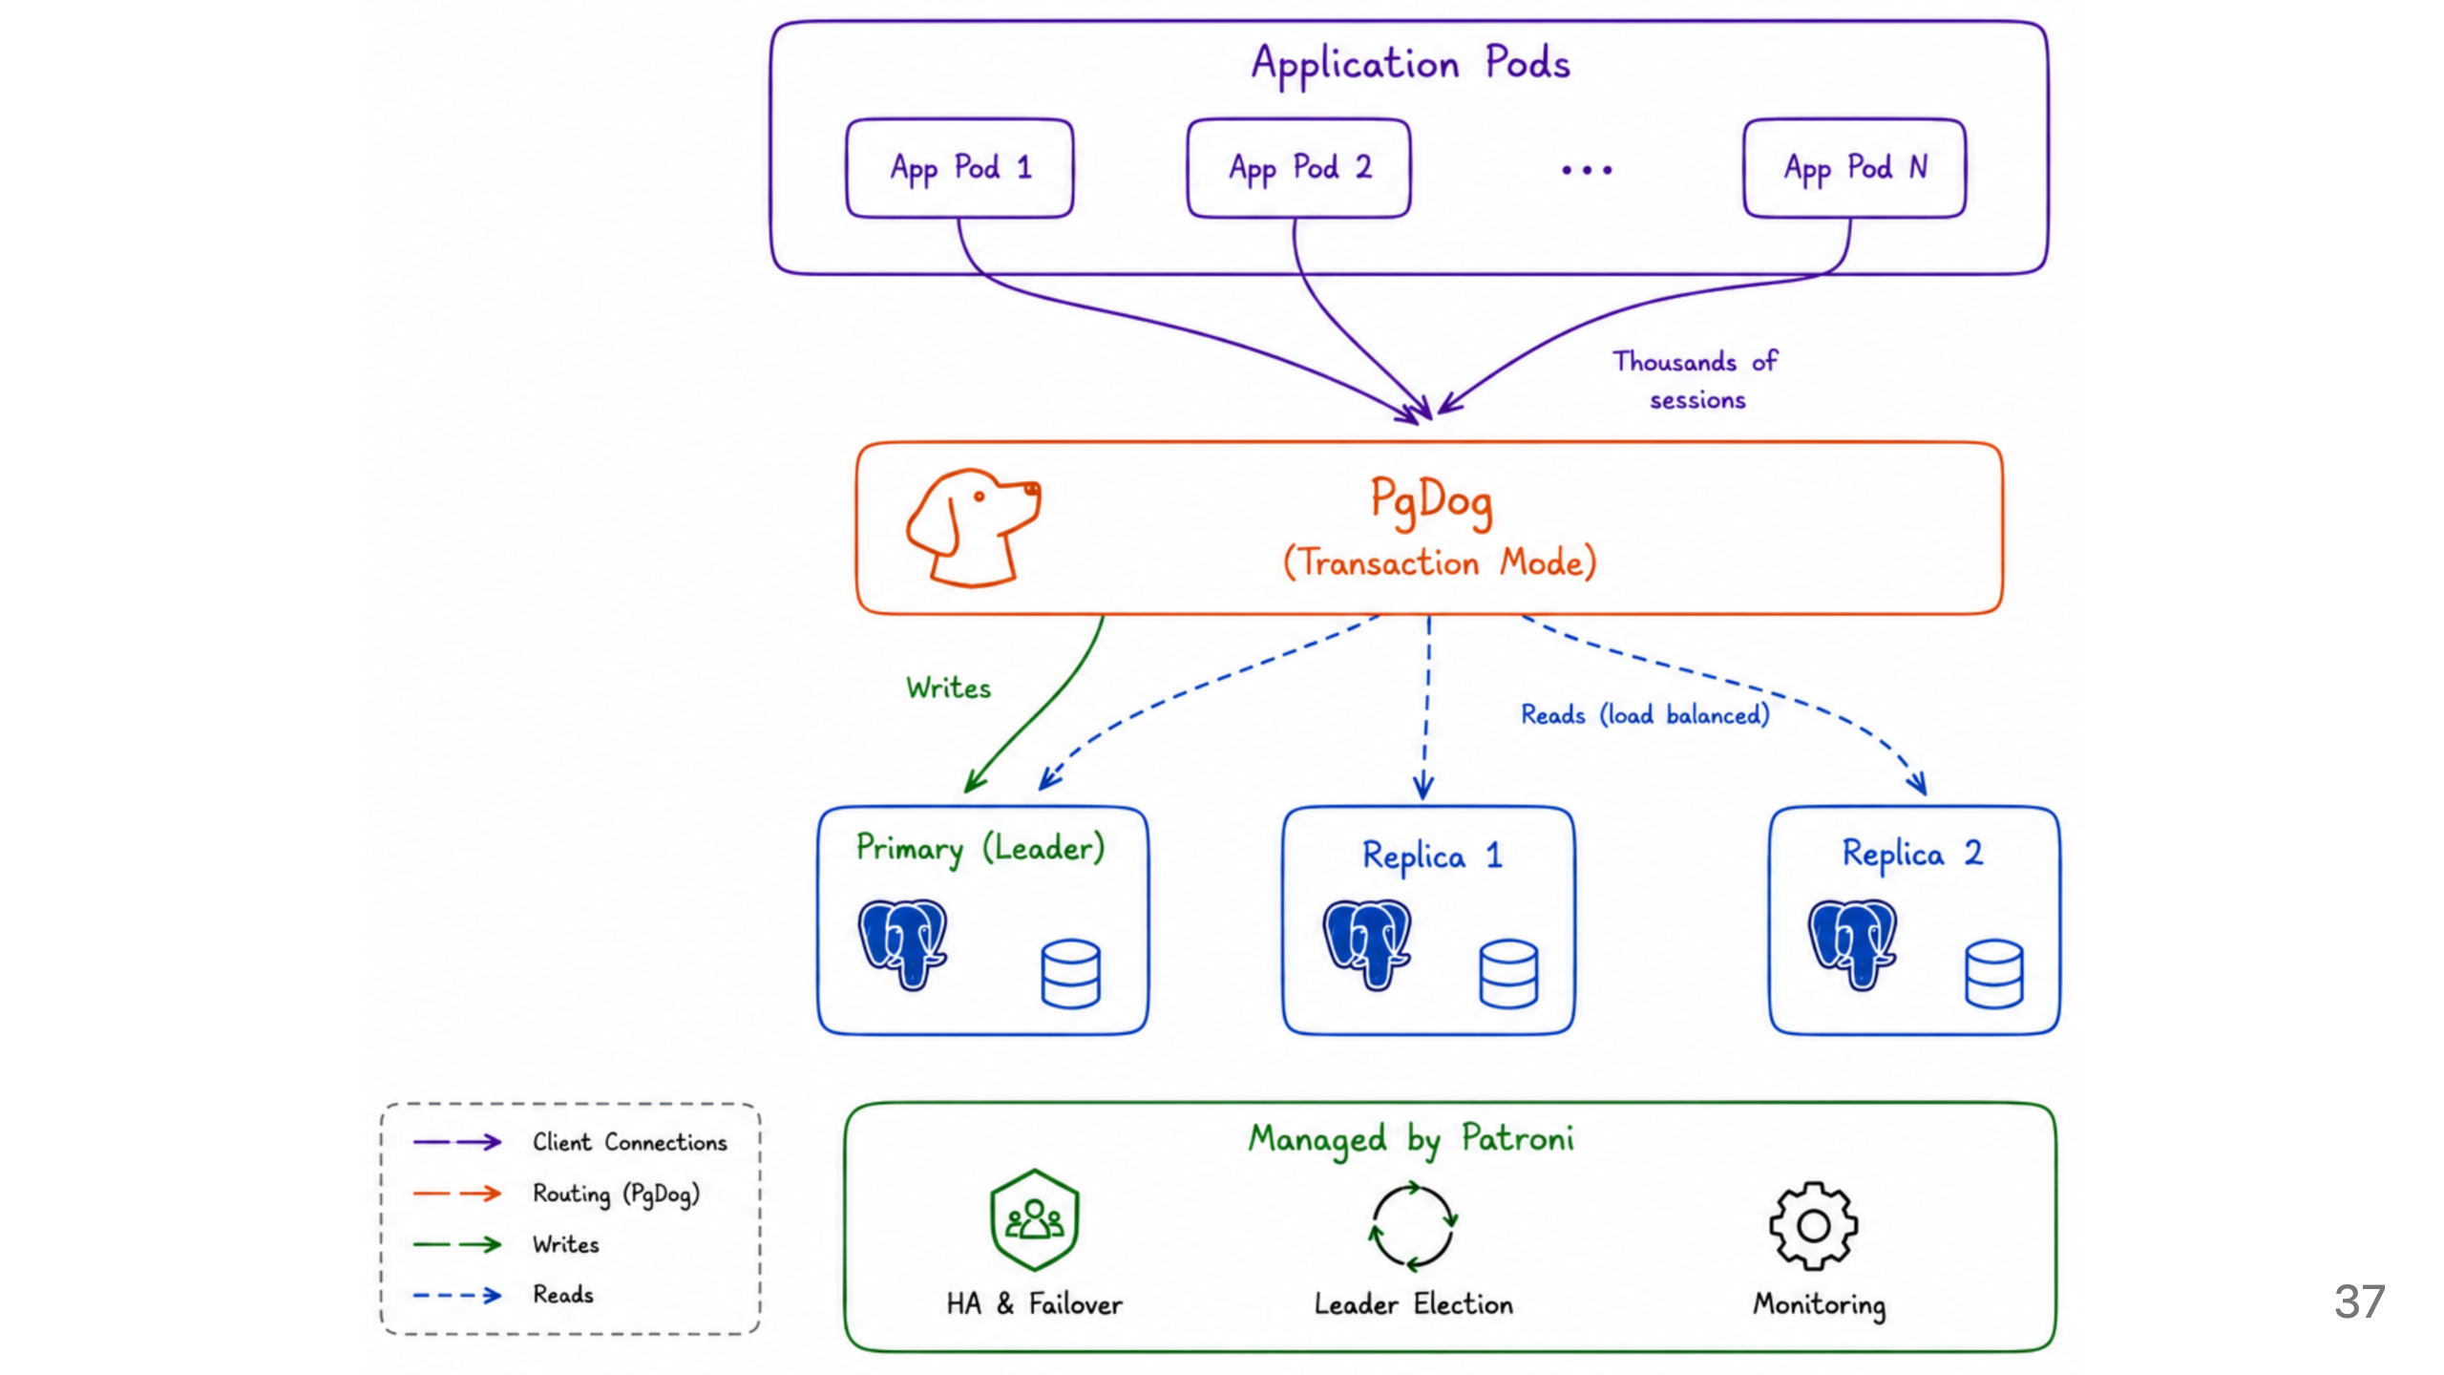

Slide 38
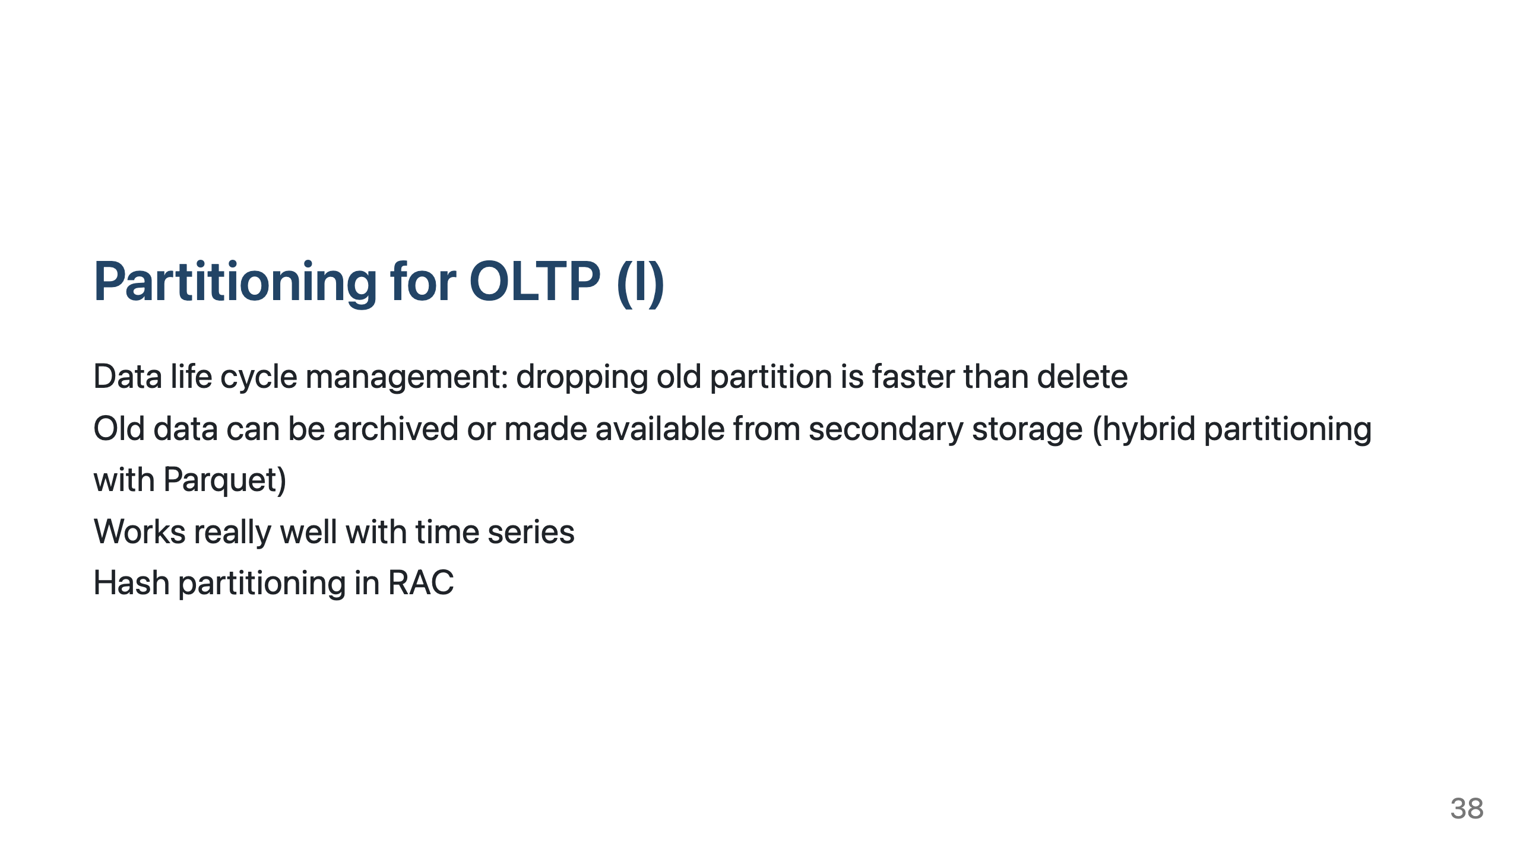
Notes:
Knee-jerk reaction is to do similar things in PostgreSQL as well.
But... ask do you actually need it. In Postgres there is less need.

Slide 39
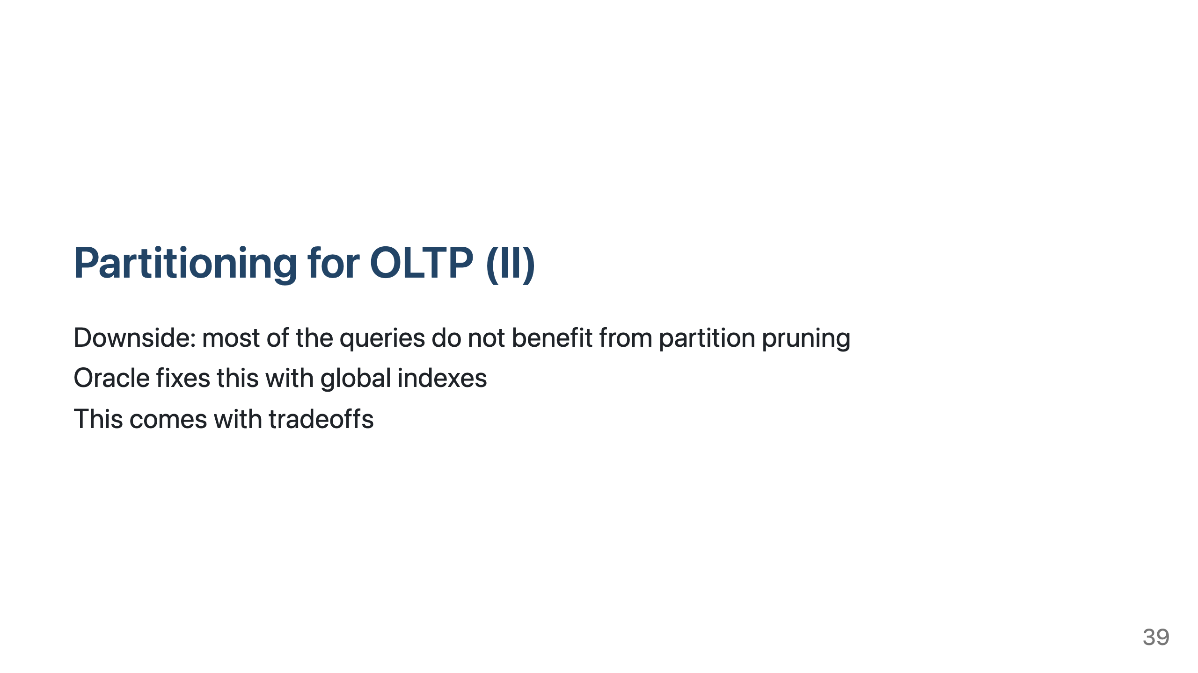
Notes:
For example: show me my last 10 transactions
---
![bg contain](img/partitioning_nopart.png)
---
![bg contain](img/partitioning_local.png)
---
![bg contain](img/partitioning_global.png)

Slide 40
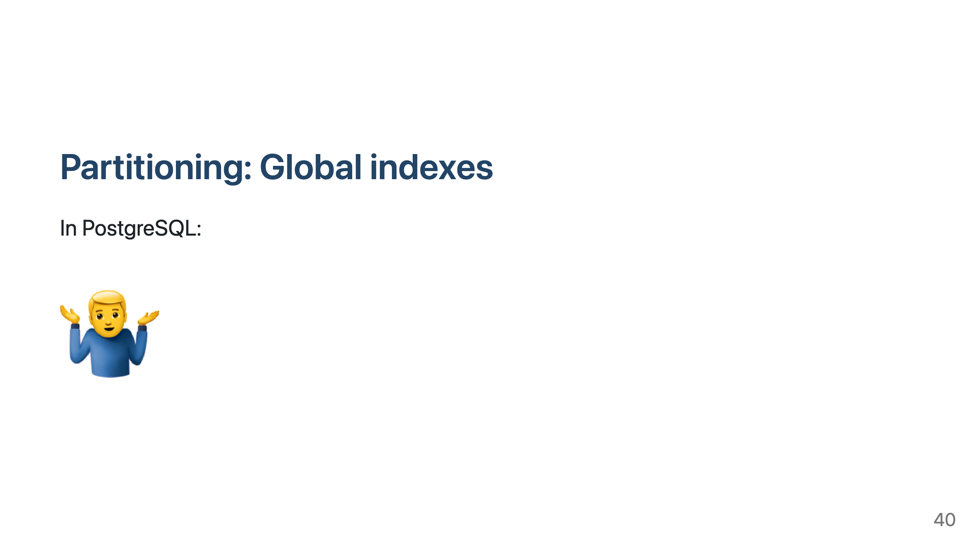

Slide 41
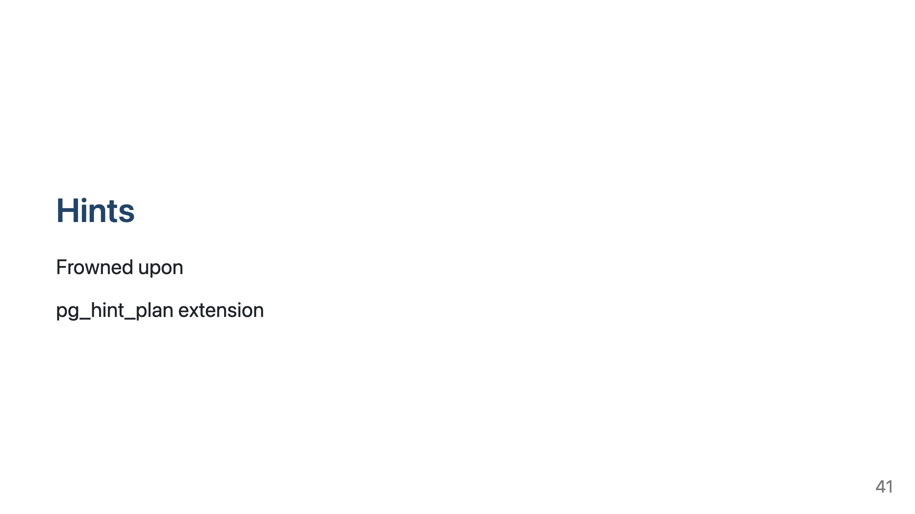
Notes:
very limited operations supported, but important ones are there
Scan method
Disable indexes
Join method
Join order
Behavioural control on join (memoize)
Cardinality correction
Parallel query
Parameter changes for planner

Slide 42
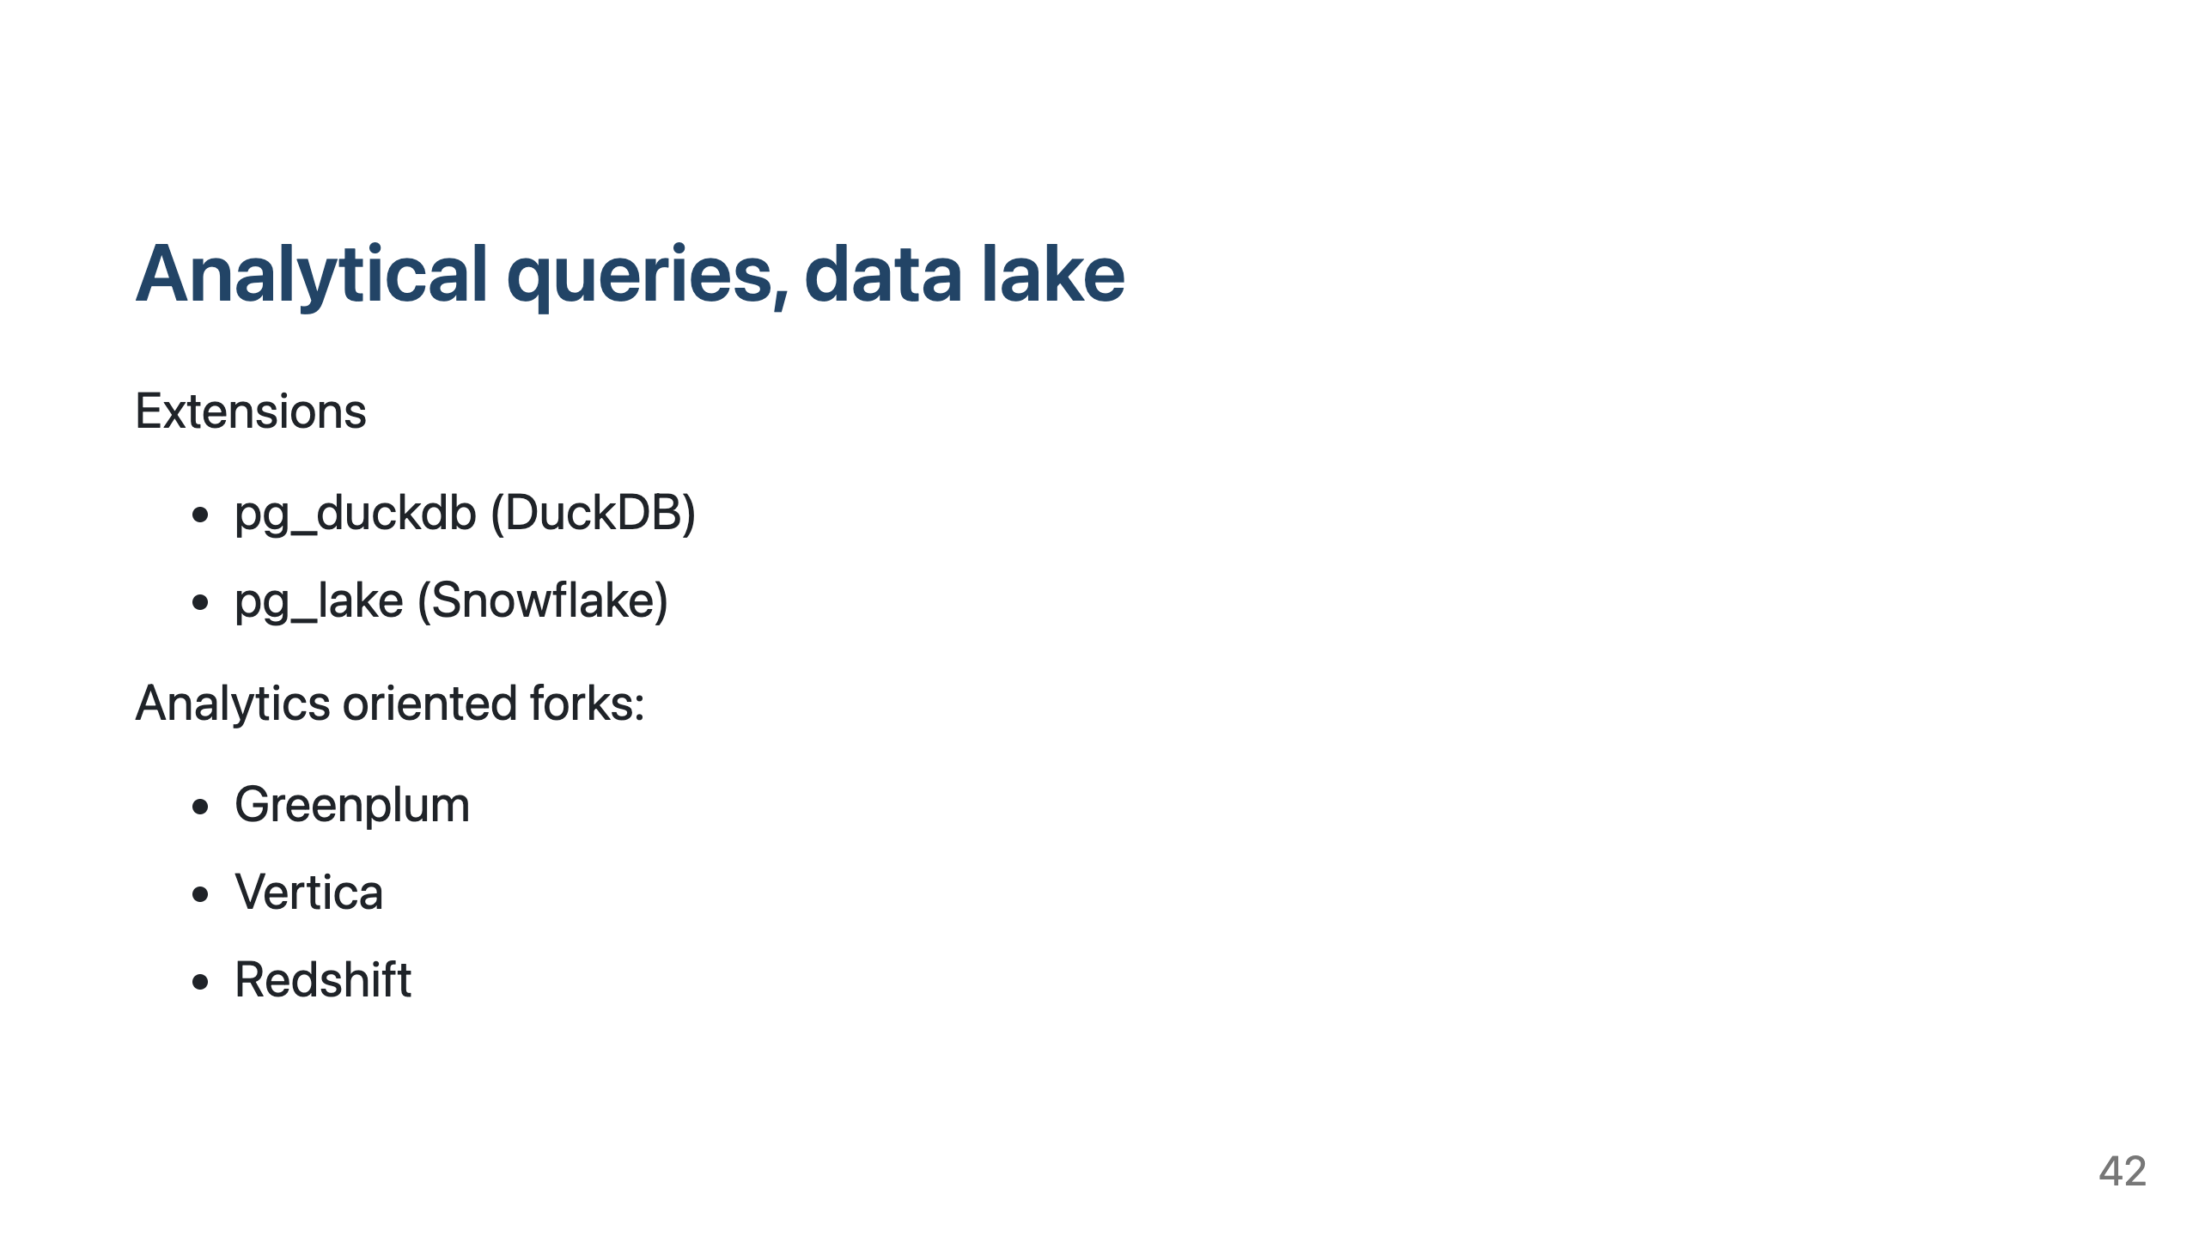
Notes:
PostgreSQL is mainly for OLTP, but analytical queries are also possible
There must be more analytics forks than mentioned
pg_dumpdb is DuckDB engine in PostgreSQL process, analytical queries can be run on DuckDB engine, accessing PostgreSQL data.
pg_duckdb is intended to be used on replica node. Can query CSV, parquet/iceberg... also
pg_lake allows querying Iceberg tables

Slide 43
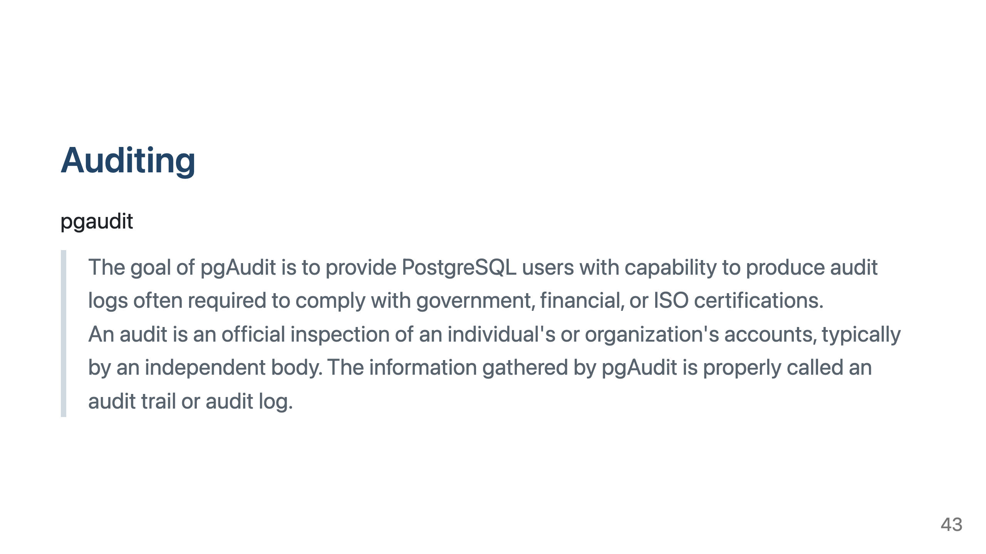
Notes:
Captures issued SQL statements and stores them in PostgreSQL log file

Slide 44
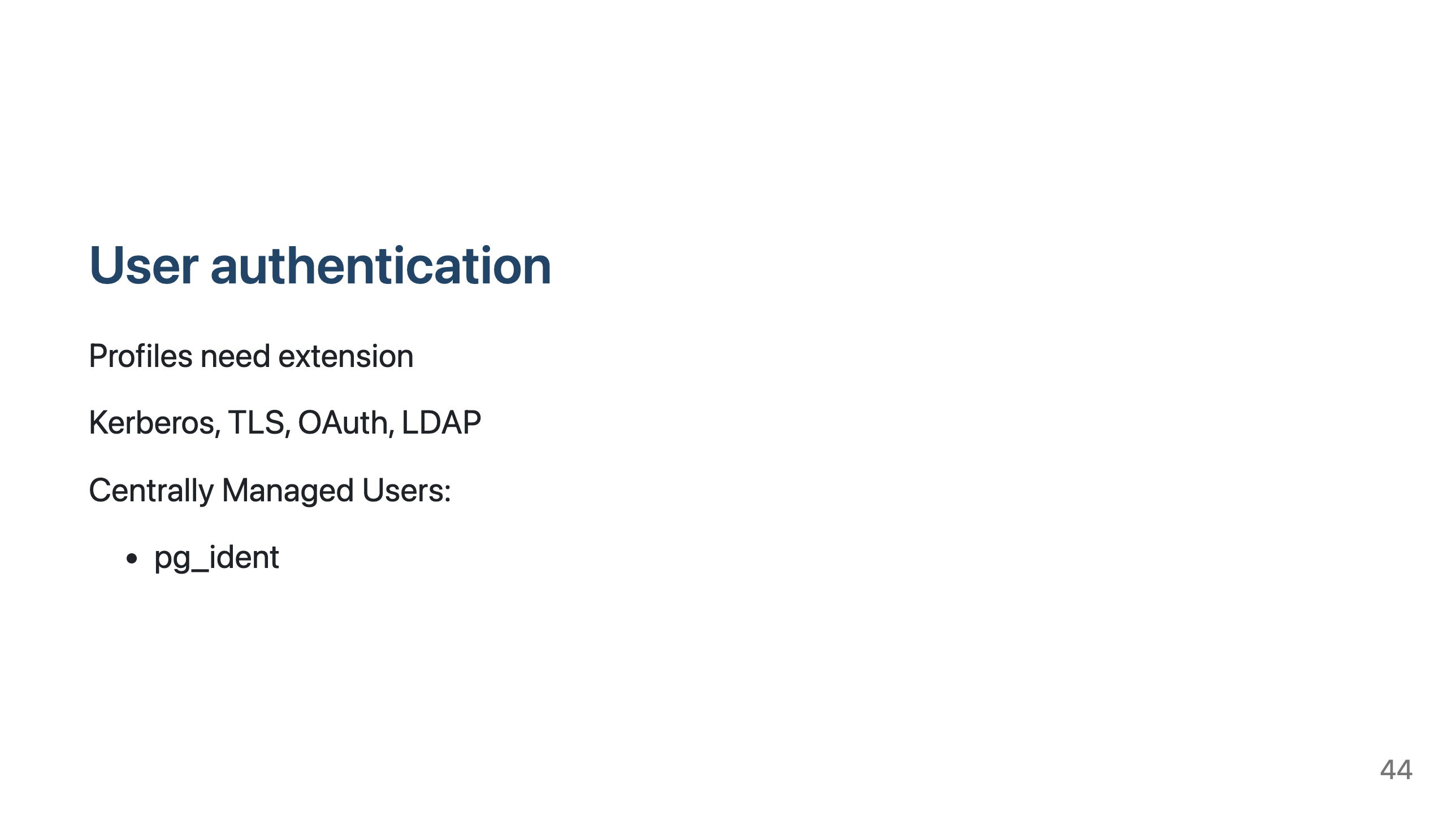
Notes:
OAuth is new and quite basic yet
For us:
mTLS and pg_ident maps user CN in certificate into shared database account

Slide 45
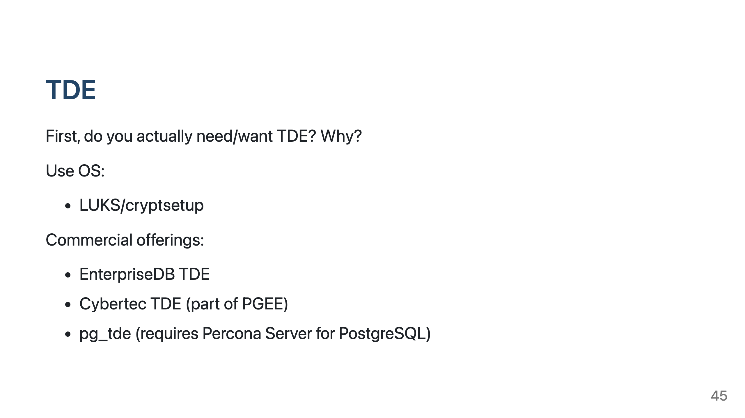
Notes:
Protection against loss of physical media (hard drives) only - nothing else!
TDE can be self-induced-ransomware if key is lost - NB! All copies of the database are encrypted with the same master key

Slide 46
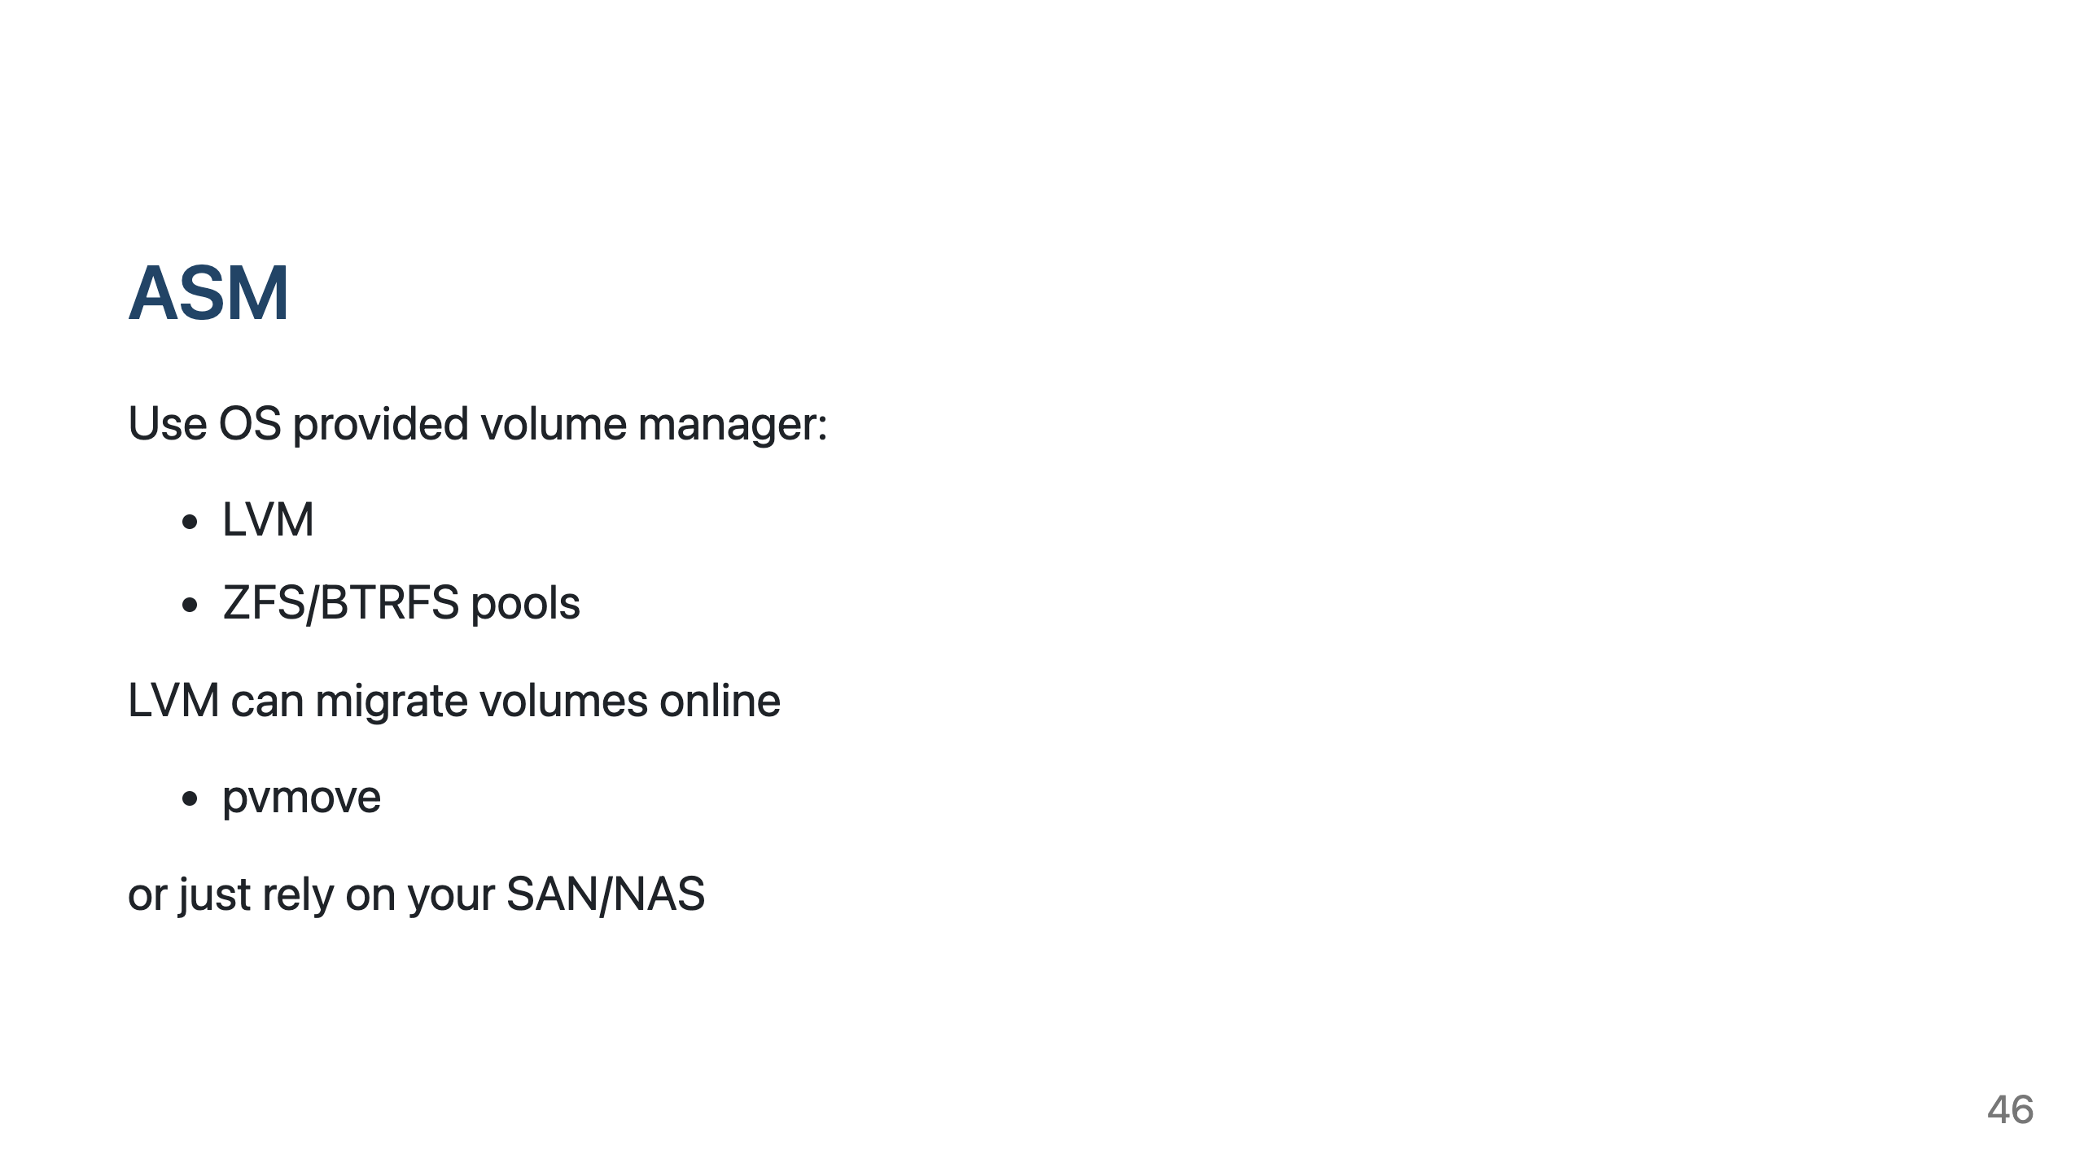
Notes:
LVM does have online storage migration with built in pvmove command

Slide 47
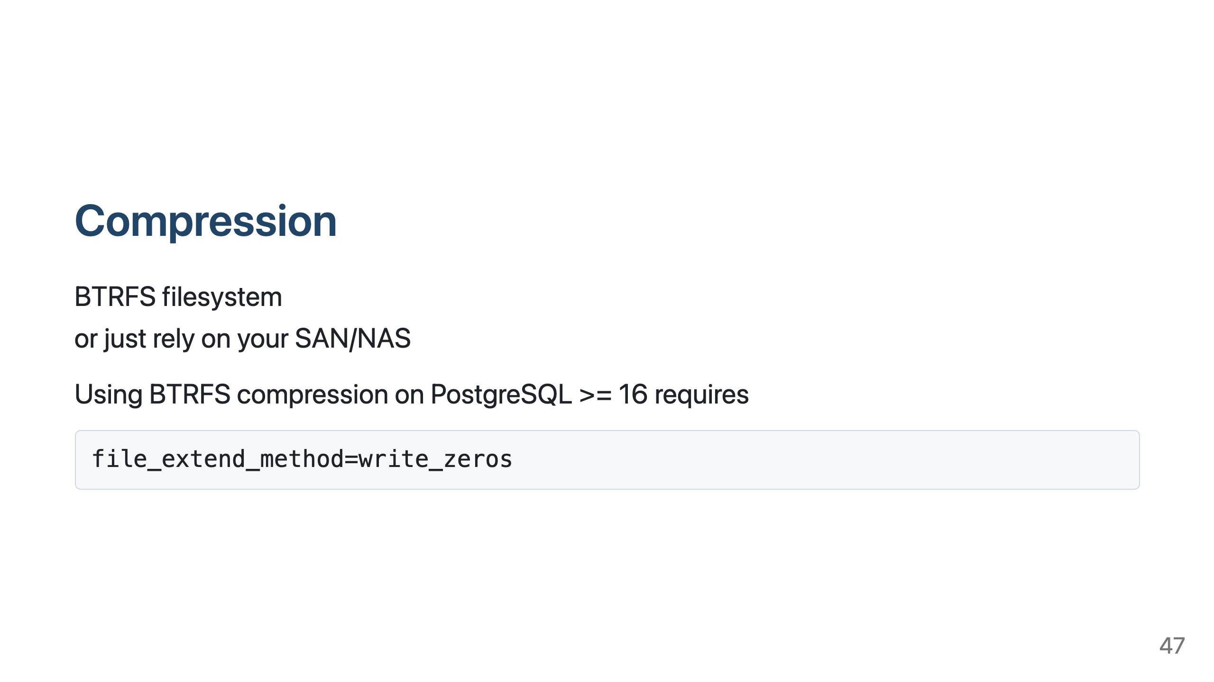
Notes:
BTRFS works well with append only/mostly data, modifications incur some write penalties
PG16 started writing relation files with posix_fallocate() that disables BTRFS compression
Keep WAL on XFS/EXT4
Our domain message (protobuf) persistence service compresses 3 times. No issues nor excessive CPU usage even at 4000+TPS

Slide 48
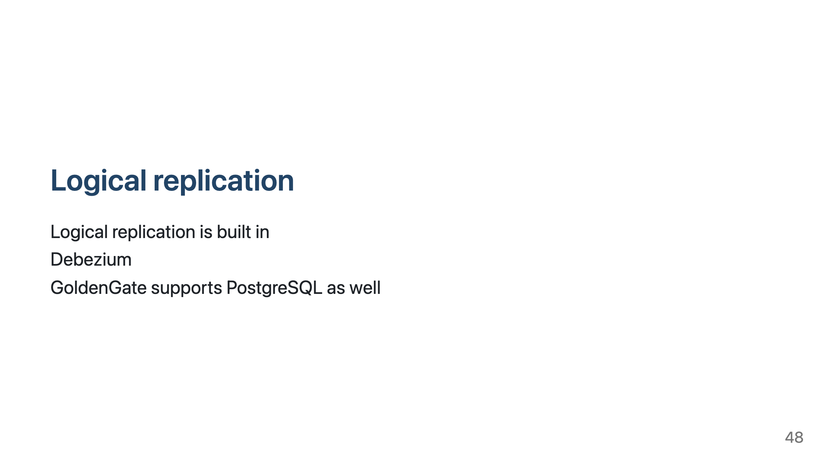
Notes:
Debezium is CDC solution built on Kafka and Kafka Connect. We will mention it later when we talk about
migration to PostgreSQL.

Slide 49
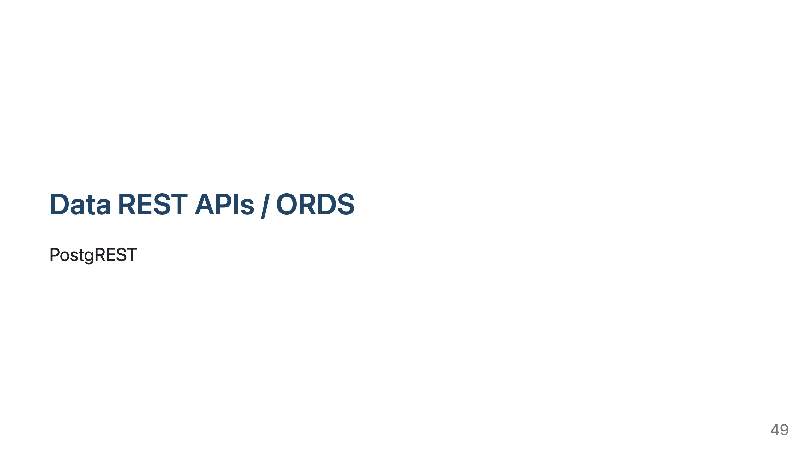

Slide 50
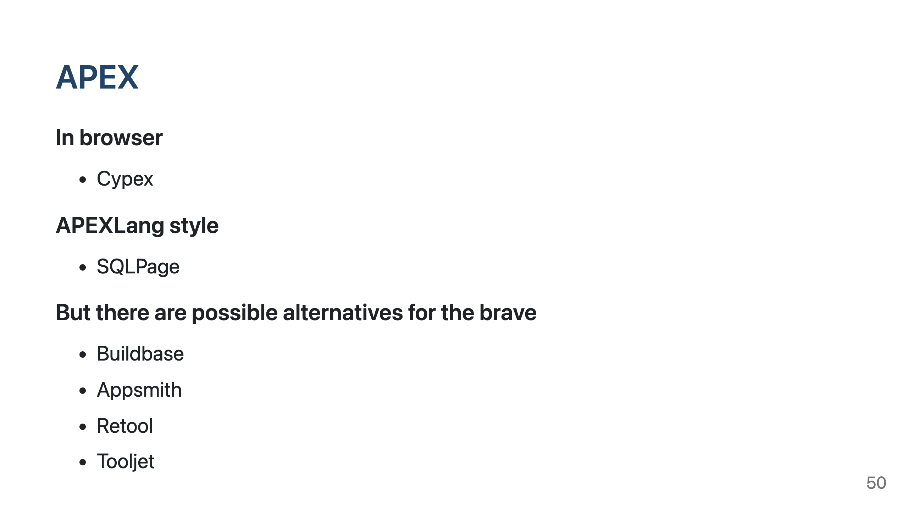
Notes:
A tough one to replace, but there are options
Source: kagi.com. Haven't tried any of this

Slide 51
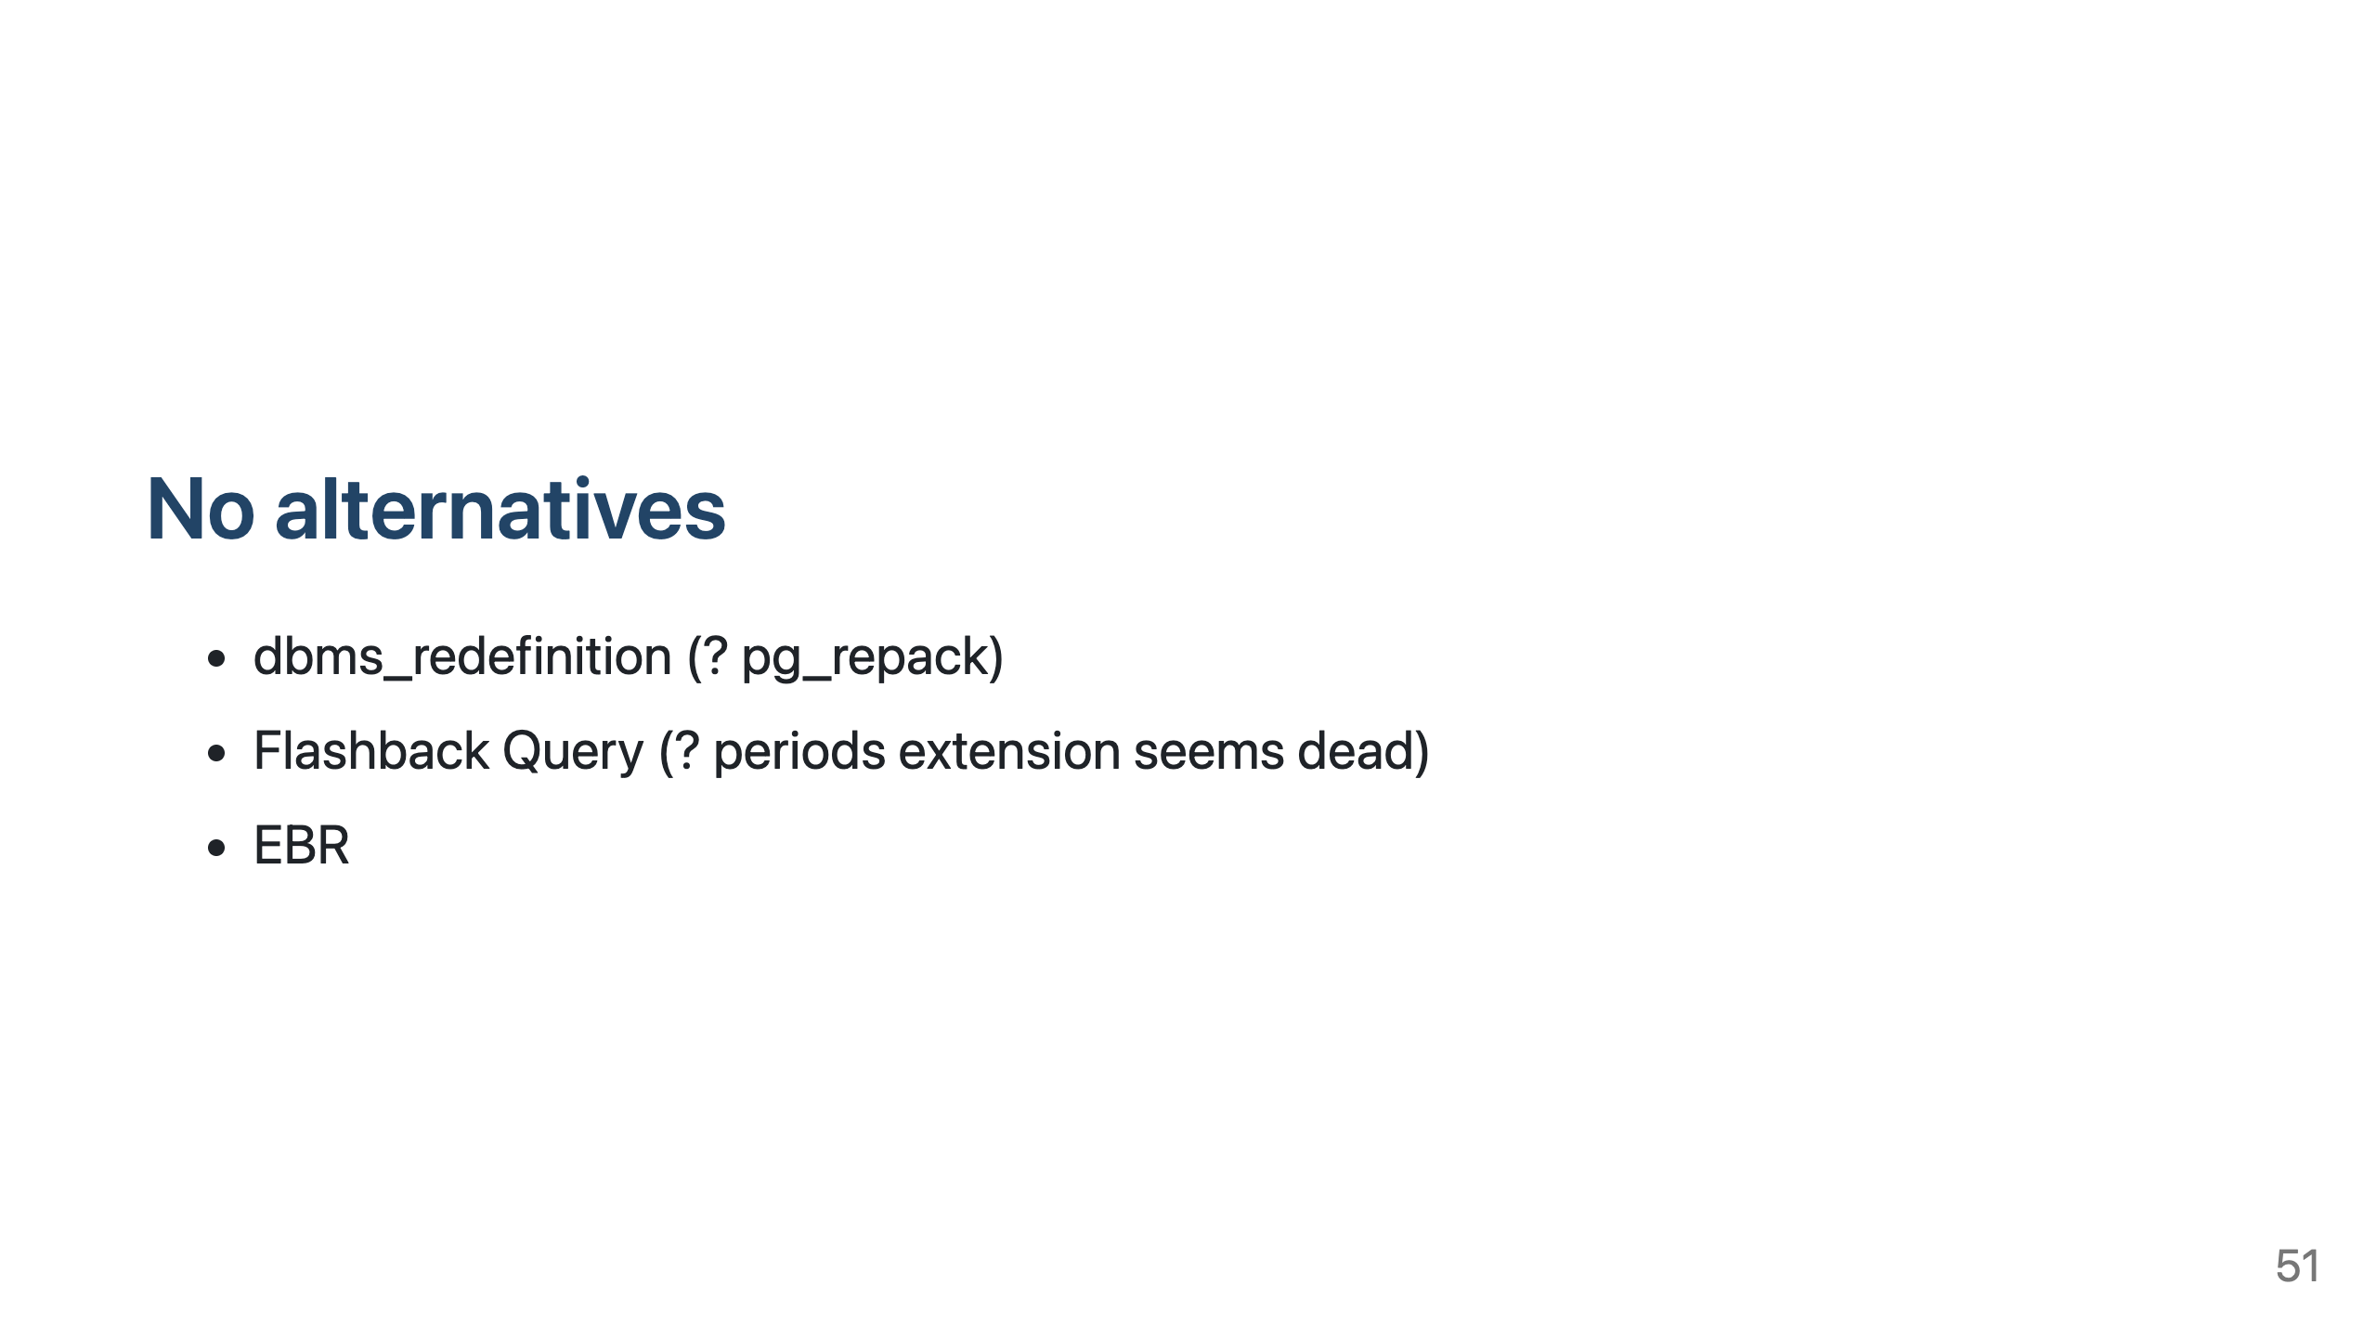
Notes:
MVCC dead tuples are not usable for flashback query
No AS OF timestamp queries. Is there a plugin for flashback data archve? "periods" extension seems dead, not built anymore and max pg15

Slide 52
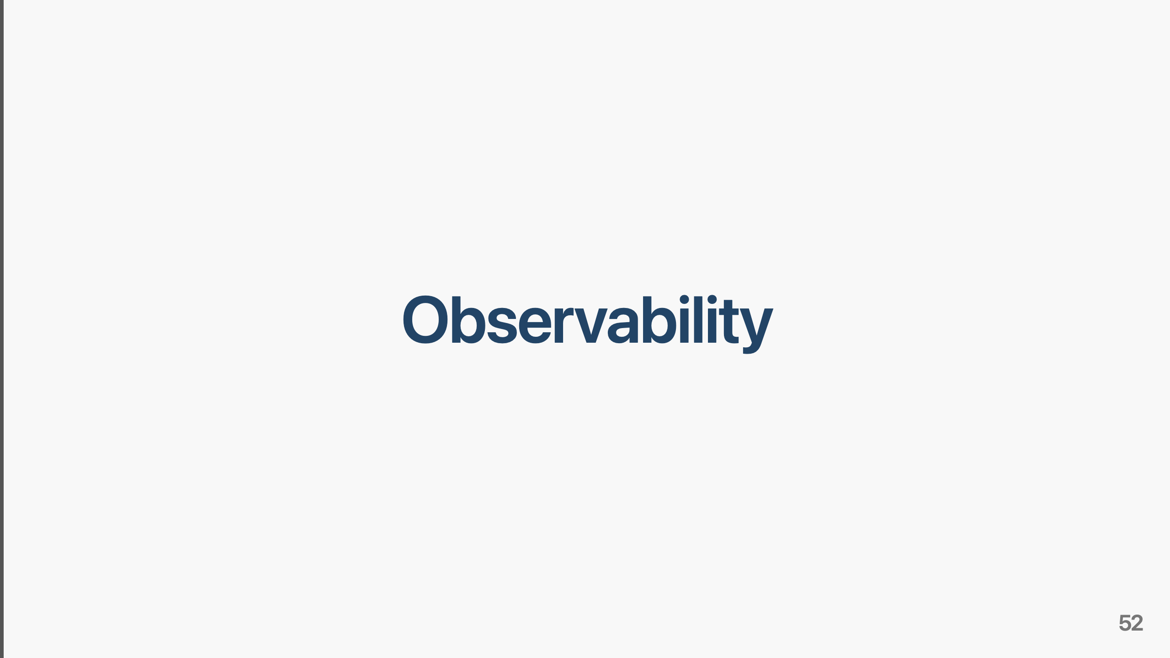

Slide 53

Notes:
Demo also part of "demo" package

Slide 54

Notes:
TODO
Being actively improved upon, PG18 especially
pg_stat_activity is v$session equivalent.
Does every plugin publish their own wait events?
Oracle 23.26.2 has 2350 wait events.

Slide 55

Notes:
`pg_active_session_history` has 29 dimensions, `pg_stat_statements_history` has 24 dimensions.
`GV_$ACTIVE_SESSION_HISTORY` has 125

Slide 56

Notes:
Quite funny: with Oracle we have to use perf or eBPF because it is a commercial product.
With PostgreSQL we have still use perf and eBPF and touch it in the low places since it is
open source

Slide 57

Notes:
FREEDOM - no be constrained to counting CPUs, what options you can or cannot use. Juse use it any way you like.
Having the source means you can ask your LLM questions about it and generate patches. (pretty much what Oracle support is nowadays anyway)
Long list of ISO/IEC 9075:2023 features that PostgreSQL does not support: https://www.postgresql.org/docs/current/unsupported-features-sql-standard.html
and some of which Oracle *does* support, like polymorphic table functions

Slide 58

Notes:
In July 2017 Oracle moved to a new release model promising "A new major database release every year"
on-prem releases only

Slide 59


Slide 60

Notes:
The following section is about strategies of migration.
Very high level and simplified, due to the time limit.

Slide 61
Notes:
Instead of a frameworks that paper over the diffrences in SQL details, you can instruct your agents to change the code.
Testcontainers make testing the code changes easy. And you can run integration tests in your laptop.

Slide 63
Notes:
As with downtime in general, adding a nine will make life exponentially more complicated, and more expensive.

Slide 64
Notes:
Streaming: Debezium works quite well
How to get the changes from Oracle? Logminer? X-Stream? OLR?
"Dual writes": streaming will help to create the second data store as well
Corner case with "dual writes" and updates: some downtime might still be needed

Slide 65
Notes:
We decided to go with XStream and Debezium: we have GG, but do not have GG hs.

Slide 66
Notes:
This listing skips a few steps, otherwise this would be way too complex to explain and display.
This simplified migration process works reasonably well, but automation is a bitch.

Slide 67
Notes:
Migrating from one database engine to another is cross-organization project (multiple platform engineering teams, dev teams, middle management and
people from the business side since the downtime.)

Slide 68
Notes:
For now, some of this presentation is pure theory, but we will try these thing in the future

Slide 69
Notes:
Demo requires docker and is in the "demo" folder. check the README.md file.

Slide 70
Notes:
Thank you for listening us!

